Slide 1
Use of Control Interventions in Ontario: Where Are We Now—Where are We Heading?
Nawaf Madi
Canadian Institute for Health Information

Slide 2
Control Interventions--Overview
Mental Health Services in General Hospitals
Where Are We Now?
Where are We Heading?

Slide 3
Mental Health Services in General Hospitals

Slide 4
Hospital Mental Health Services in Canada

Slide 5
General Hospital Separation Rates 2009-2010

Slide 6
Hospital Mental Health Services in Canada 2009-2010

Slide 7
General Hospital Length of Stay 2009-2010

Slide 8
Hospital Mental Health Services in Canada 2009-2010
 |  | General Hospitals |  | Psychiatric Hospitals
 |  | Non–Mental Illness | Mental Illness | Mental Illness
Male (%) |  | 41.5 | 49.5 | 56.8
Mean Age (Years) |  | 52.9 | 46.3 | 42.0
Age (%) | 0–14 | 7.3 | 3.1 | 2.3
 | 15–24 | 6.9 | 15.5 | 16.1
 | 25–44 | 22.9 | 31.7 | 39.0
 | 45–64 | 23.7 | 28.4 | 30.8
 | 65+ | 39.1 | 21.3 | 11.9
Income Quintile (%) | 1 (Low) | 23.0 | 28.8 | NA
 | 2 | 20.7 | 21.2 | NA
 | 3 | 19.8 | 17.5 | NA
 | 4 | 18.6 | 15.2 | NA
 | 5 (High) | 16.6 | 13.4 | NA
 | Unknown | 1.3 | 4.0 | NA
Admitted via the Emergency Department (%) |  | 51.8 | 76.9 | NA
Death in Hospital (%) |  | 4.2 | 1.1 | 0.7
Separations (%) |  | 94.1 | 5.9 | NA
Total Length of Stay (%) |  | 86.6 | 13.4 | NA
Average Length of Stay (Days) |  | 7.4 | 18.3 | 80.5
Median Length of Stay (Days) |  | 3 | 8 | 22
Distribution of Lengths of Stay (%) | 1 Day | 24.0 | 14.1 | 9.1
 | 2–7 Days | 53.7 | 34.4 | 18.6
 | 8–30 Days | 4.0 | 15.5 | 35.3
 | 31–365 Days | 18.4 | 35.8 | 33.8
 | 366+ Days | 0.0 | 0.1 | 3.2

Slide 9
Where Are We Now?
A Look at the Data

Slide 10
Control Interventions Defined
Acute Control Medication
Mechanical Restraint
Physical Restraint
Seclusion
Psychotropic (e.g. sedative) medication given as an immediate response to prevent harm to self or others
Restrained in bed and unable to ambulate
Wrists restrained but able to ambulate
Holding the person for a brief period to restore calm
A room that confines and from which the person cannot exit freely

Slide 11
Legislation, Guidelines, Policies & Practice
  Patient Restraint Minimization Act (2001) stipulates use should be limited to prevention of bodily harm
  CNO & RNAO Guidelines emphasize least restrictive approaches
    Interventions classified by level of restrictiveness
  Many institutional policies stipulate restraints as a measure of last resort
It is generally agreed that restraints are to be avoided if possible
  Although stigma and negative attitudes remain

Slide 12
Control Interventions an Issue of Importance
  Adverse outcomes
  Physical injury to patients & staff
  Negative emotional\psychological impacts
    Retraumatization
  Not conducive to therapeutic alliance
    Time spent on CI’s is time not spent on therapeutic care
  Financial costs
Ethical Issue
  Media interest drawn by question of human rights

Slide 13
What the Data Tell Us?
International Estimates Vary
  Estimates vary from 0%-35% of admissions (Steinert, 2009)
  Variation in definitions and policies
Limited Standardized & Comparable Canadian Data
  Except in Ontario
  Many gaps, much analyses focus on elderly
…but interest is growing

Slide 14
Control Intervention Use in Ontario

Slide 15
Acute Control Medication Use in Ontario

Slide 16
Physical\Mechanical Restraint Use in Ontario

Slide 17
Seclusion Room Use in Ontario

Slide 18
CI Analysis Part I:
What factors are associated with CI use?

Slide 19
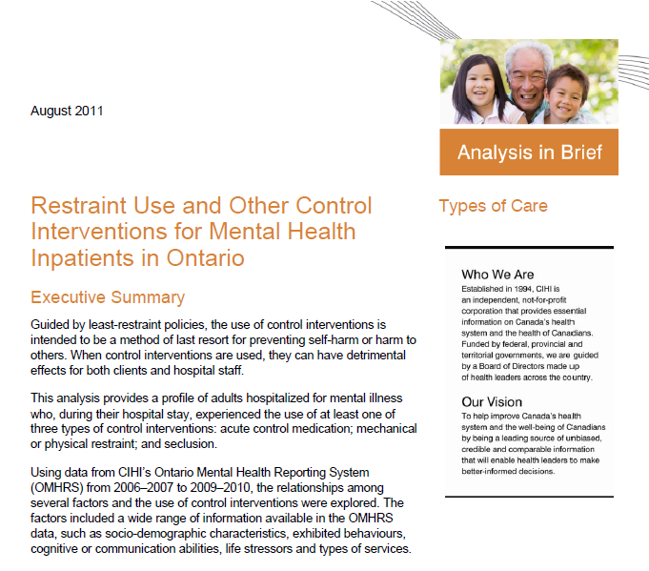

Slide 20
Purpose of Analysis in Brief
Examining rates within Ontario hospitals
Profile of individuals experiencing CIs
Identifying risks factors for CIs with adjustment for socio-demographic, clinical, & other variables
Examining differences between types of CIs interventions

Slide 21
Methods
Used OMHRS data for 2006-2007 to 2009-20010
Three mutually exclusive groups of control intervention
  Acute Control Medication
  Physical\Mechanical Restraint
  Seclusion
  Comparison: Psychiatric hospitalization with no control interventions
70 general hospital and specialty mental health facilities

Slide 22
Individuals who experienced a CI 2006-2009

Slide 23
Risk factors:
Behavioural
Danger to others
Danger to self
Inability for self-care due to MH
Police Intervention
Sociodemographic
Gender - male
Age - younger
Education
Employment
Neighbourhood
Income
Cognitive/ Communication
Cognitive impairment
Unable to consent to treatment
Difficulty making self understood
Clinical
Depression
Substance Use
Organic disorders
Bipolar disorders
Schizophrenia or Psychosis
Life Stressor
History of emotional, physical or sexual abuse or assaulte
Treatment
>6 lifetime MH admissions
Medication non adherence

Slide 24
Risk Factors for Control Interventions
 |  |  | Adjusted Odds Ratios
Domain | Potential Predictor |  | ACM | Mechanical /Physical Restraint | Seclusion | All Control Interventions
Demographic | Age (years)
 |  | 18-24 (reference) | 1 | 1 | 1 | 1
 |  | 25-34 | 0.90 | 0.68 | 0.70 | 0.81
 |  | 35-44 | 0.82 | 0.63 | 0.61 | 0.73
 |  | 45-54 | 0.75 | 0.56 | 0.53 | 0.66
 |  | 55-64 | 0.65 | 0.43 | 0.47 | 0.57
 |  | 65-74 | 0.65 | 0.45 | 0.33 | 0.53
 |  | >=75 | 0.64 | 0.59 | 0.22 | 0.54
 | Male gender (vs. female) |  |  |  | 1.18
 | More than high school education |  | 1.08 | 1.14 | 0.84
 | Not employed (vs. employed) |  | 1.22 | 1.13 | 1.28 | 1.22
 | Highest SES (vs. lowest) |  |  |  | 0.84
Behavioral | Threat/danger to self |  | 1.64 | 1.33 | 1.29 | 1.53
 | Threat/danger to others |  | 1.48 | 2.14 | 2.00 | 1.72
 | Cannot care for self due to mental illness |  | 1.65 | 1.66 | 1.37 | 1.60
 | Recent police intervention (vs. none) |  | 1.35 | 1.62 | 1.64 | 1.51
 | Recent violence to others (vs. none) |  | 1.54 | 3.11 | 1.99 | 1.98
Cognitive/ communication | Not capable of consenting |  | 1.19 | 1.90 | 1.38 | 1.39
 | Making self understood
 |  | Understood | 1 | 1 | 1 | 1
 |  | Usually/often understood | 1.71 | 1.78 | 1.41 | 1.68
 |  | Sometimes/rarely understood | 1.60 | 2.92 | 2.36 | 2.09
Life stressors | History of abuse |  |  | 0.84

Slide 25
Risk Factors for Control Interventions
 |  |  |  | Adjusted Odds Ratios
Domain | Potential Predictor |  |  | ACM | Mechanical /Physical Restraint | Seclusion | All Control Interventions
Treatment | Number of lifetime psychiatric hospitalizations
 |  | 0 (reference) |  | 1
 |  | 1 to 3 |  | 1.31 | 1.29 | 1.42 | 1.33
 |  | 4 to 5 |  | 1.69 | 1.58 | 1.86 | 1.71
 |  | 6 or more |  | 1.98 | 2.00 | 2.21 | 2.03
 | Medication adherence
 |  | Always adherent (reference) |  | 1
 |  | 80% or more |  | 1.45 | 1.65 | 1.25 | 1.43
 |  | <80% and fail to buy meds |  | 1.86 | 2.61 | 1.82 | 1.95
 |  | No meds prescribed |  | 1.28 | 1.87 | 1.40 | 1.37
 | Type of facility
 |  | Psychiatric/Specialty (reference) |  | 1
 |  | General Hospital |  | 1.68 | 2.61 | 1.45 | 1.76
Clinical | Primary mental health diagnosis
 |  | Depression/other mood disorders |  | 1 | 1 | 1 | 1
 |  | Organic disorders |  | 1.42 | 2.66 | 1.97 | 1.69
 |  | Substance related disorders |  | 0.88 | 1.37 |  | 0.91
 |  | Schizophrenic/other psychotic disorders |  | 1.28 | 1.82 | 1.51 | 1.40
 |  | Bipolar disorders |  | 1.22 | 2.27 | 2.09 | 1.50
 |  | Anxiety disorders |  |  |  | 0.43
 | Concurrent substance abuse/addiction
 |  |  | Yes | 1.07
 | Concurrent personality disorder
 |  |  | Yes | 1.13 |  |  | 1.09

Slide 26
Part I:
Summary
Patients admitted to a general hospital more likely to experience restraint use
Difficulty communicating, violent behavior greatly increase chances of patients experiencing control interventions
Highlights areas for intervention: treatment compliance, communication, training

Slide 27
CI Analysis Part II:
  What are the outcomes of control intervention use?

Slide 28
36.4%
36.0%
32.7%
22.3%
11.4%

Slide 29
*Age: Oldest quintile vs. youngest
**Highest risk vs. none (3-12 vs. 0)
†Severity of Self-Harm Scale (5-6 vs. 0)
‡Self-care Index (high risk vs. none)

Slide 30
Part II Summary
Preliminary findings--those experiencing CI’s are 60% more likely to be readmitted within 30 days even when adjusted for other factors
At 1 year, those who experienced CI’s were more likely to be readmitted
Need to understand what is it about control intervention use in previous hospitalizations that is related to readmissions

Slide 31
Where are We Heading?
The Role of Data

Slide 32
Out of the Shadows at Last
“People being locked in tiny rooms they cannot leave, tied to a bed and injected with chemicals against their will are clearly traumatic experiences that taken in any other context would be seen as devastating”
A patient’s perspective – Jennifer Chambers

Slide 33
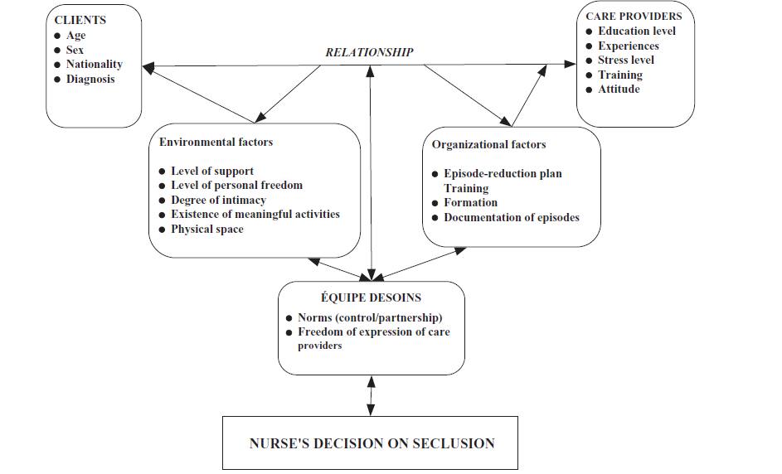
LEGIsLATION
Leadership
Restraint reduction vision
Philosophy of care
Values and Strategies
Larue et al. 2009
Data
Evidence based decisions
Est. baselines
Reduction targets
Peer comparison
Trends
Cost analysis
Resourcing
Etc.
Larue et al. 2009

Slide 34
In Ontario
Patient Restraint Minimization Act, (2001) Government of Ontario
Mental Health Act, (2001) Government of Ontario
College of Nurses of Ontario Practice Standard: Restraints, (2009)
Health Care Consent Act, 1996 (2010) Government of Ontario
Restraint use as a patient safety issue
Restraint use as a Quality of Care Indicator (HQO)

Slide 35
Comparative Reporting on CI’s

Slide 36

Informing Clinical Practice
Mental Health Clinical Assessment Protocols (CAPs)
CI CAP will trigger based on the following RAI-MH components:
  Recent self-injurious attempt
  Intent of any attempt was to kill self
  Violent behaviour/Extreme disturbance to others
  Recent command hallucinations
  ABS score of 6 or higher
  Recent ACM use

Slide 37
Clinical Assessment Protocol Reports
Informing Management Decisions

Slide 38
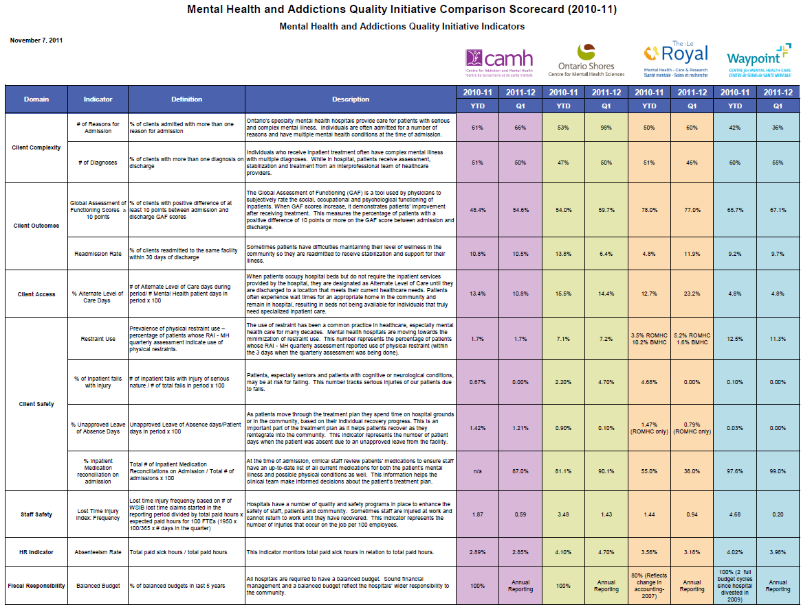
Informing Communities of Practice

Slide 39
Control Interventions Experienced 2006-2009

Slide 40
Acute Control Medications 2006-2009

Slide 41
Physical\Mechanical Restraints Experienced 2006-2009

Slide 42
Seclusions Experienced 2006-2009

Slide 43
Evidence Informed Decisions
Standardized, accurate clinical assessments provide evidence to:
Aggregate reporting of comparable clinical information provides evidence to:
Measure treatment effectiveness
Guide decision making at all levels from unit, to facility, to Ministry of Health
Evaluate quality of care
Identify risks
Guide care planning
Identify areas for improvement

Slide 44
Questions?
  nmadi@cihi.ca

