Slide 1

MAiD for Mental Disorders:
What Now?
Madeline Li MD PhD
Psychiatrist, Princess Margaret Cancer Centre
AGHPS 12th Leadership Summit
November 10, 2022
Notes:
I don’t know how many of you are GoT fans, but I was struck by it’s phase Winter is Coming as a metaphor for death – something cold, unavoidable, threatening –
dual metaphor also captures the sort of ominous feel I get in thinking about the changes coming up in March 23.

Slide 2
FINANCIAL DISCLOSURES
Expert Witness, Lamb v Attorney General litigation
Scientific Lead, Canadian MAiD Curriculum Development Project (CMCDP)
Chair, Capacity and Vulnerability Working Group CMCDP
The intent of this talk is not to advocate or oppose MAiD MD-SUMC
Notes:
I have tons of personal conflicts about MAID. I would not say I am neutral on the topic of MAiD MD-SUMC, but my intent today is….I’m not going to detail or debate the controversy…and here’s why

Slide 3

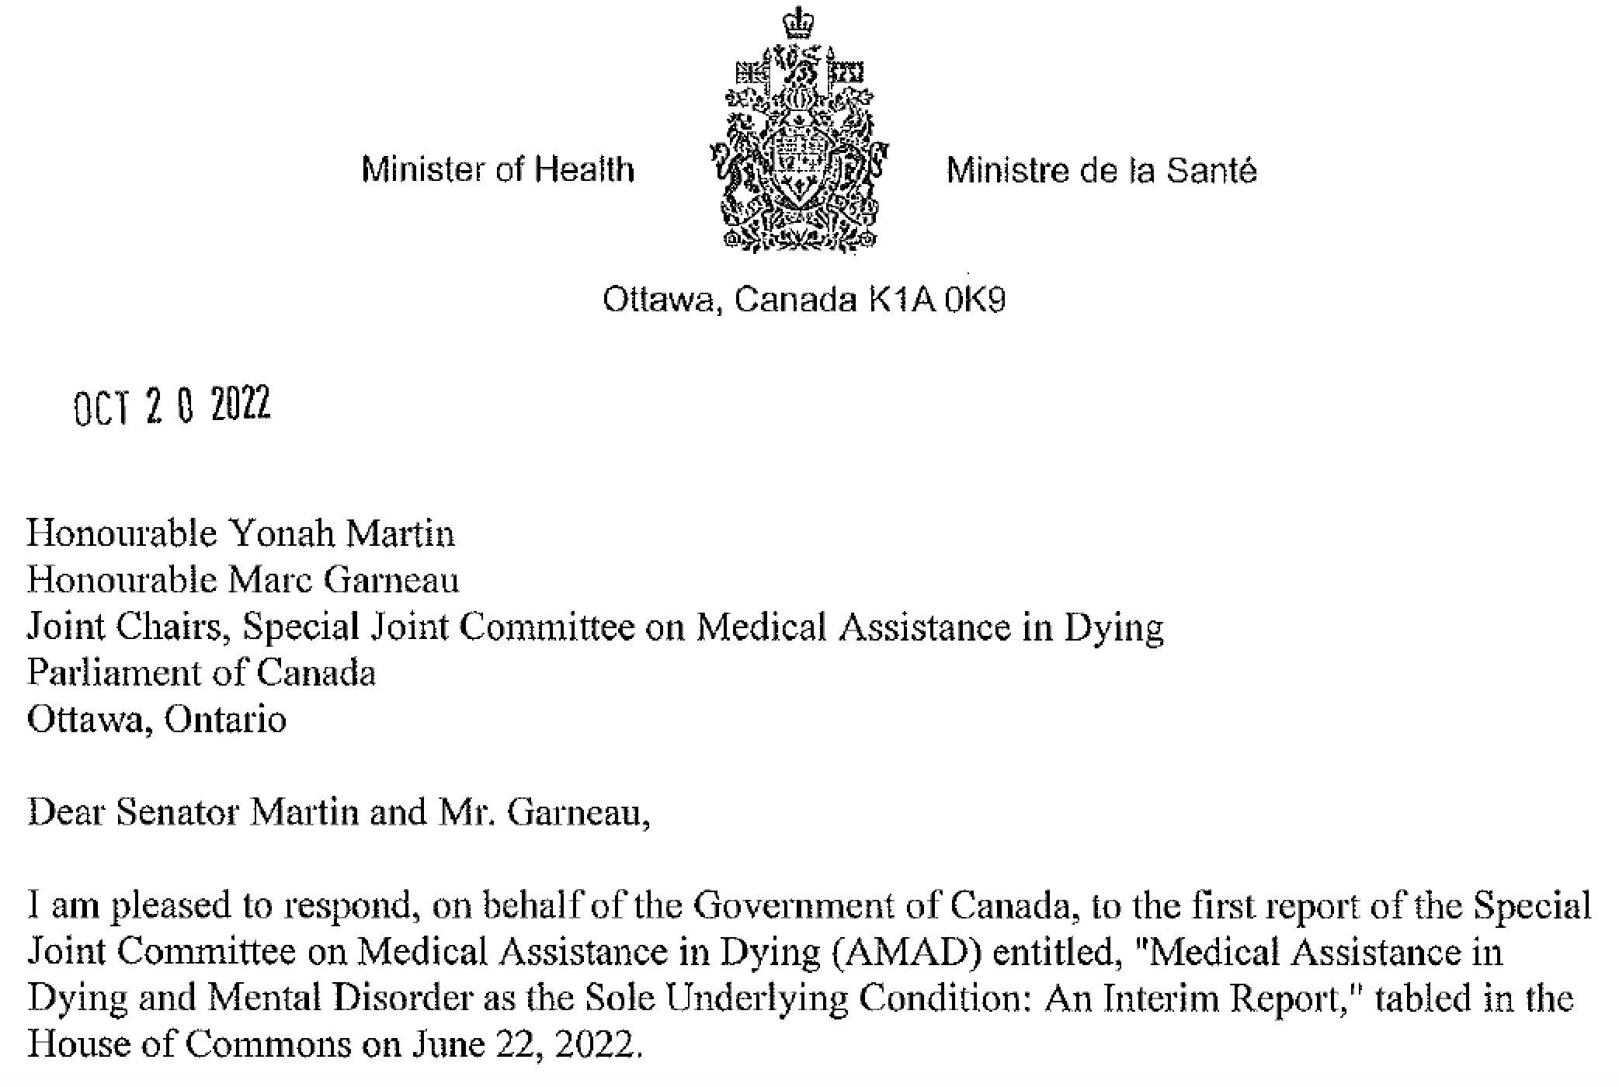

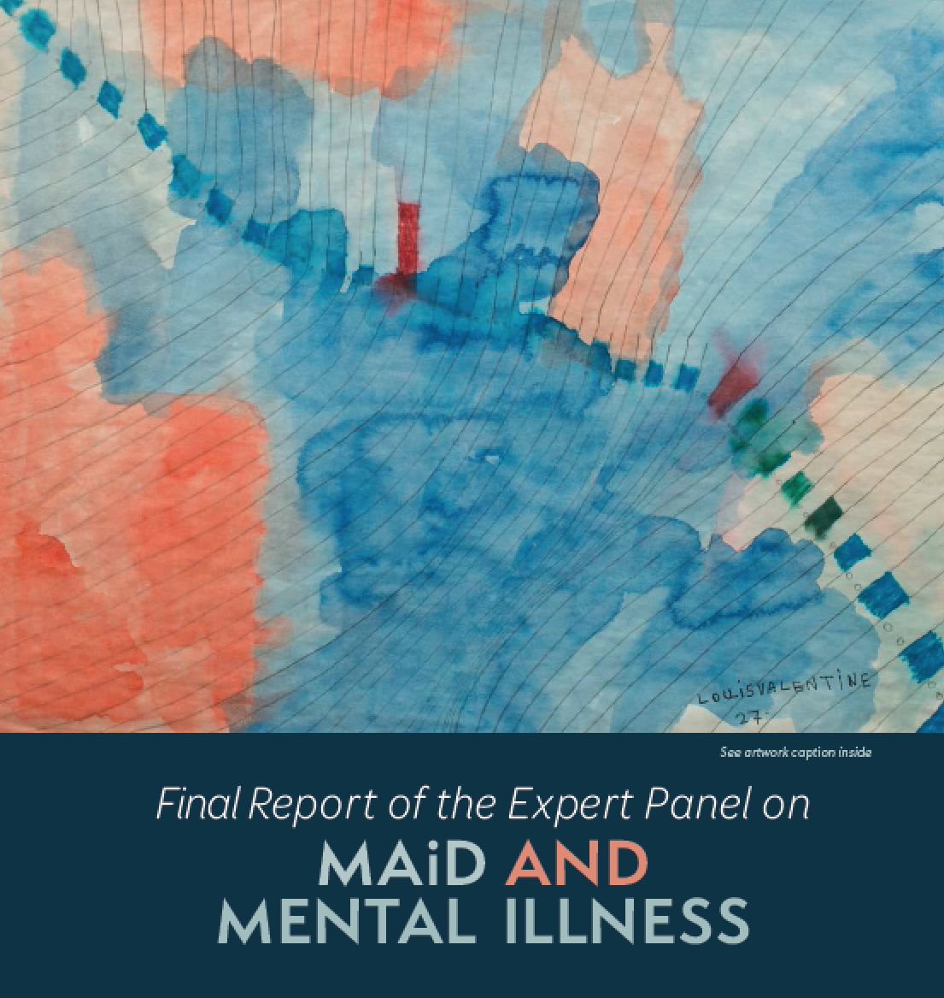

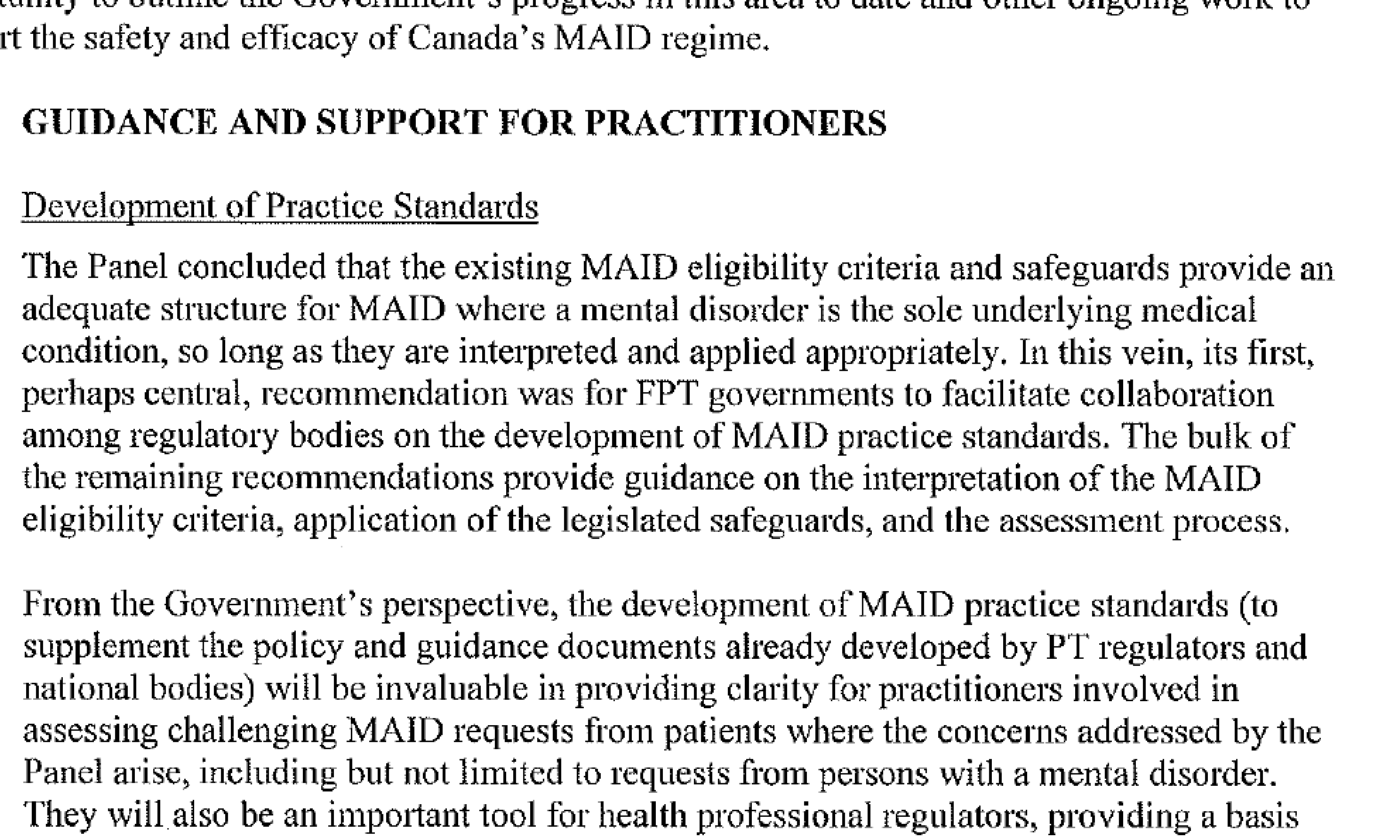
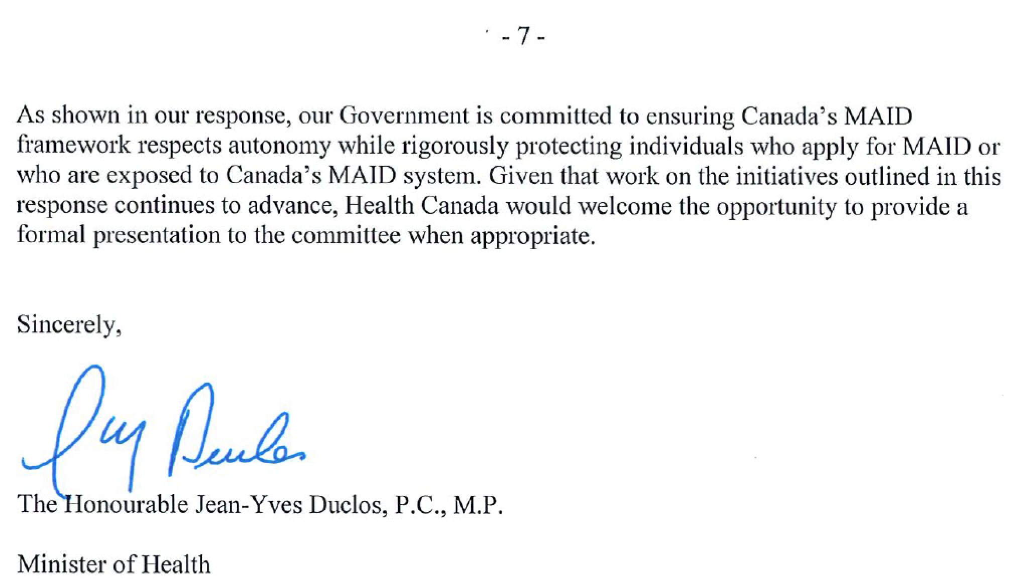
Notes:
Time for debate over the fact of MAiD MD-SUMC is over, focus on the how
Ensure access for eligible patients, protect vulnerable patients, respect clinician’s rights to conscientious objection

Slide 4

A Brief History of MAiD for Mental Disorders
MAiD for psychiatric suffering has been permitted in the Netherlands since the 1990s (van Veen, 2022) and in Belgium since 2002 (Verhofstadt, 2017), legalized concurrently with terminal conditions
Canada is unique in its stepwise legalization from Bill C-14 to Bill C-7; since eligibility clearly opened to chronic conditions causing suffering, inclusion of mental disorders is inevitable

Slide 5

Notable Differences
Lessons from Abroad
Rates of MAiD for psychiatric reasons in Belgium are relatively low (Dierickx 2017)
  0.3% of MAiD cases between 2002 to 2007
  increasing to 3% from 2008 to 2013
In 2010, the Belgian government invested in a complete service redesign of the country’s mental healthcare system (Borgermans, 2018); Netherlands has a highly innovative mental healthcare system amalgamating psychiatric care with primary care (ten Doesschate, 2007)
  57% of Belgians rate that most of their mental healthcare needs are met
  only 2.5% replied that their needs were fully unmet (Verhaeghe, 2010)
Quality and availability of mental healthcare and other social supports is significantly lower Canada
In 2018, an estimated 5.3 million Canadians reported they needed help for their mental health in the previous year (Moroz, 2020)
  22% reported that their needs were only partially met
  21% reported that their needs were fully unmet

Slide 6
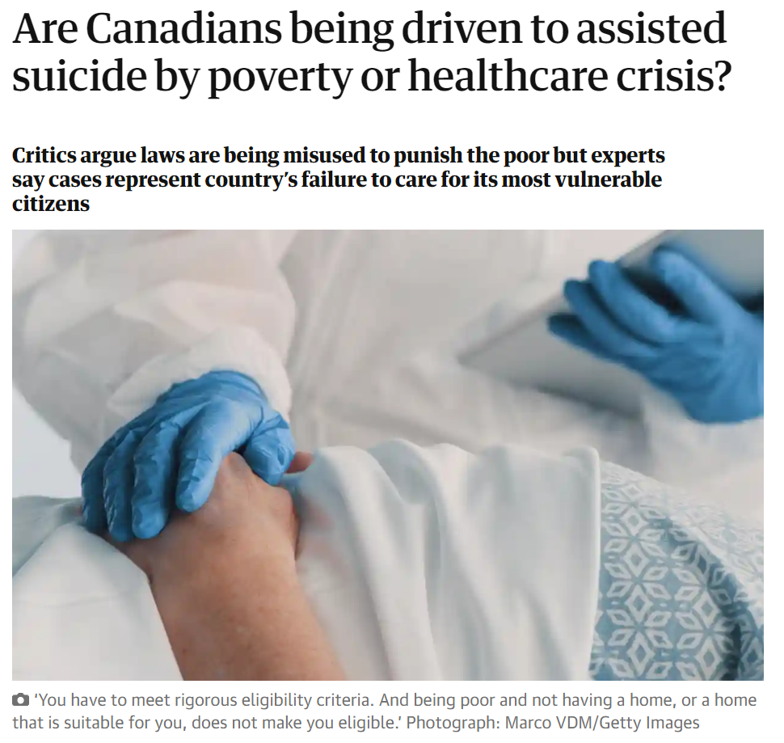
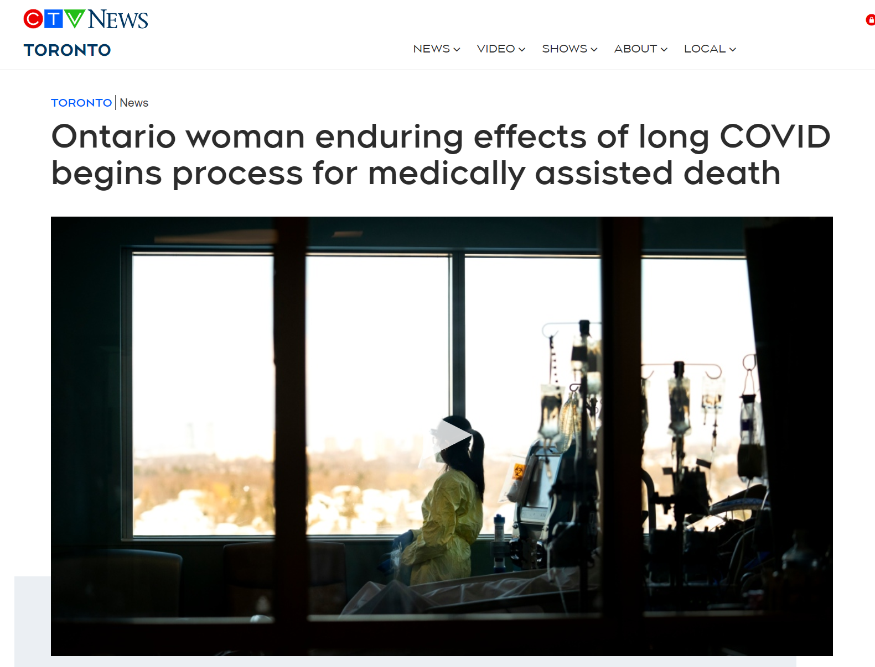
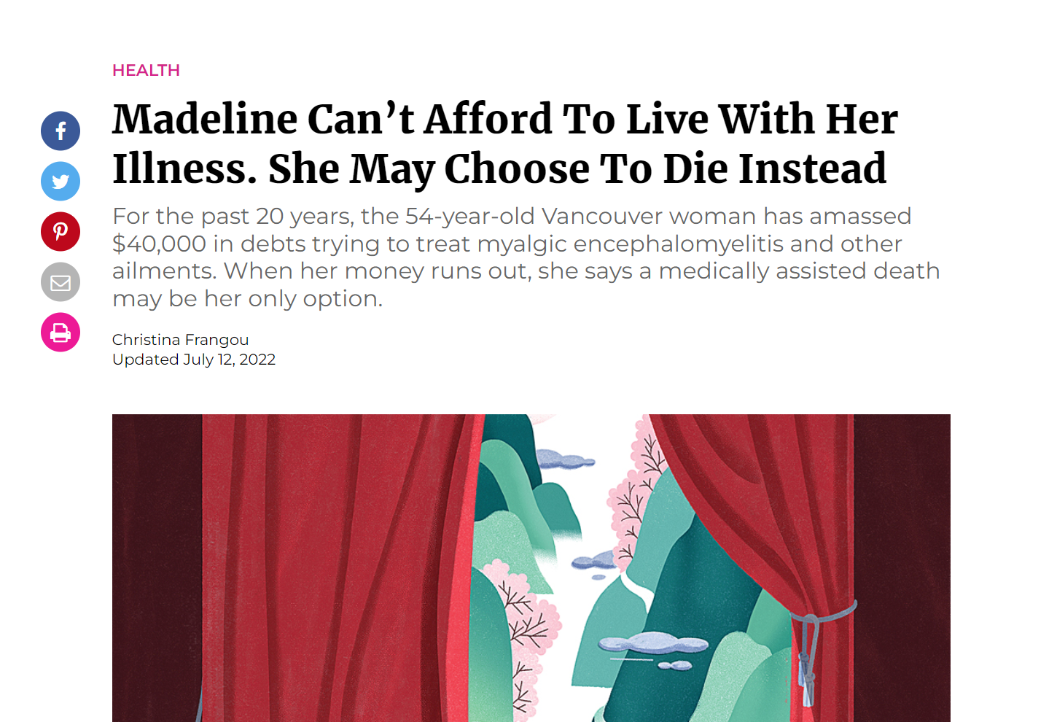
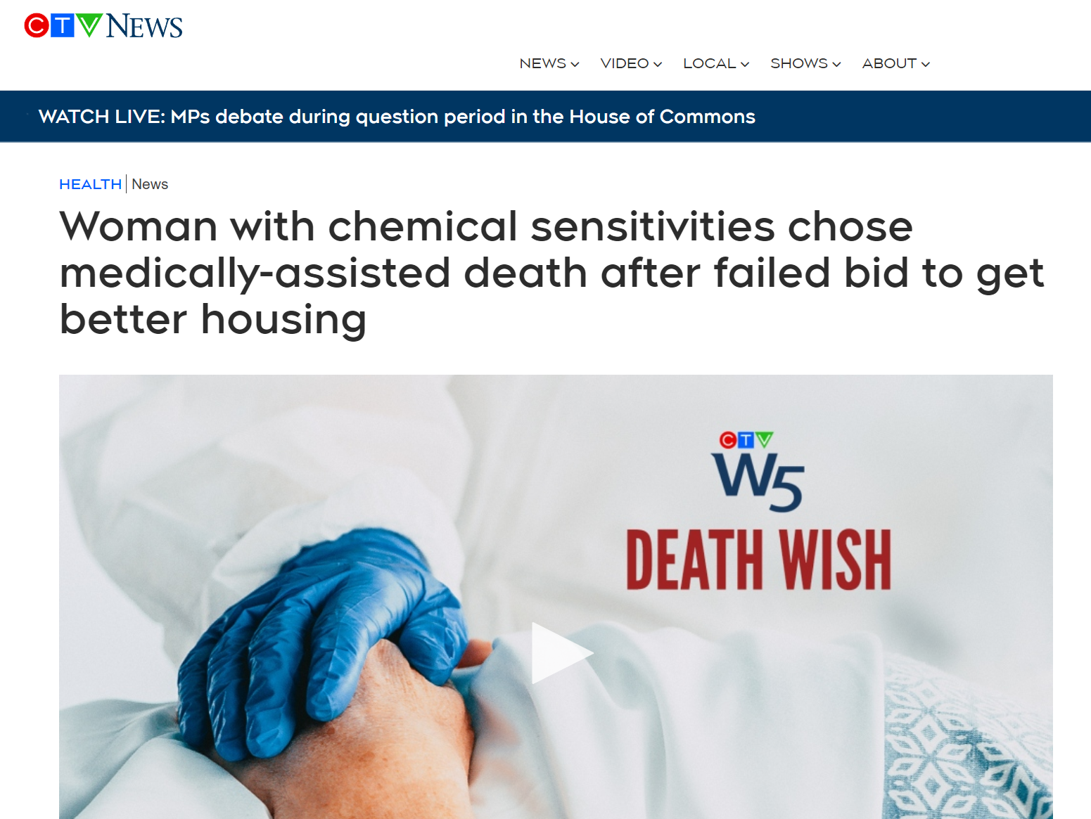
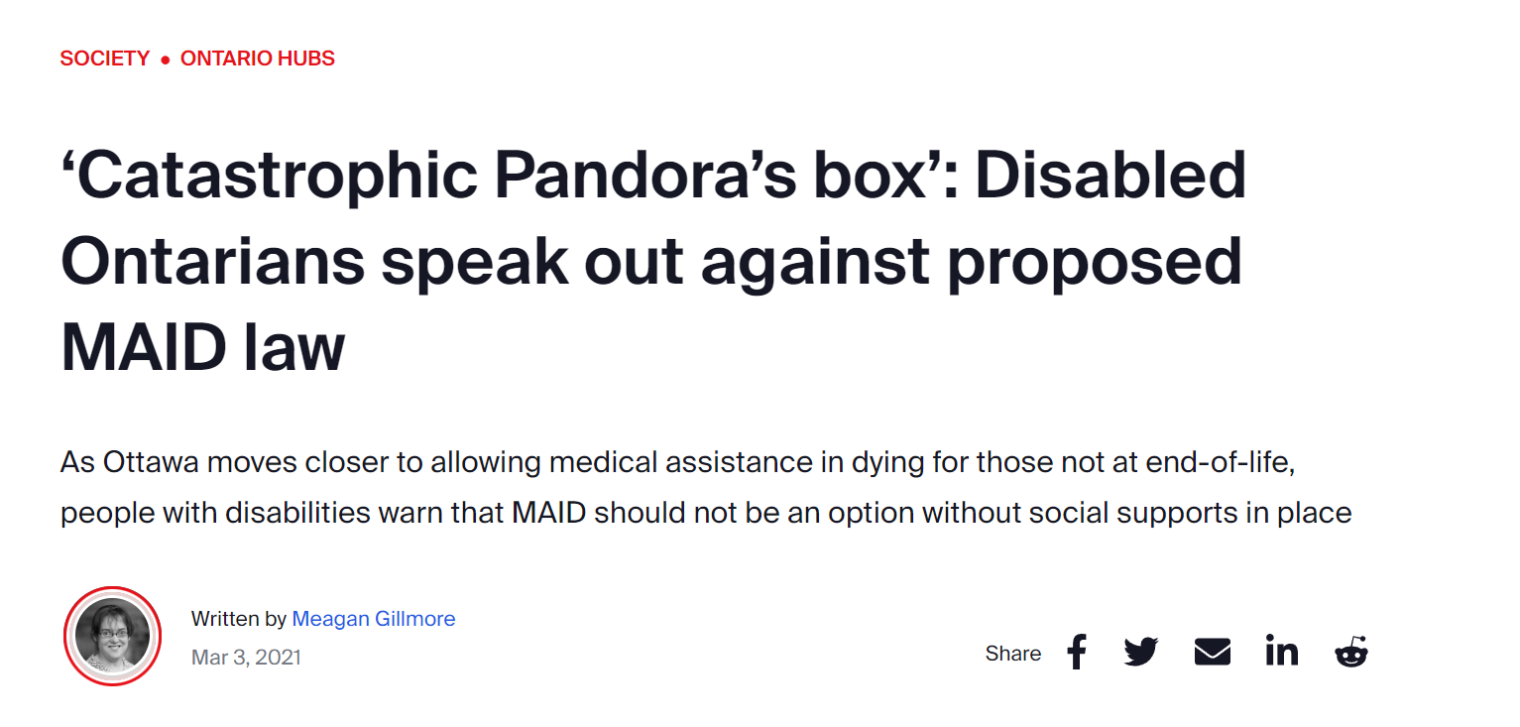
The Other Slippery Slope
Concerns about MAiD being imposed on the marginalized or vulnerable have not materialized in BeNeLux countries (Onwuteaka-Philipsen, 2016)
Concerns that suffering individuals will request MAiD for inappropriate reasons, such as poverty (Downie & Schuklenk, 2021)
Notes:
increasing

Slide 7
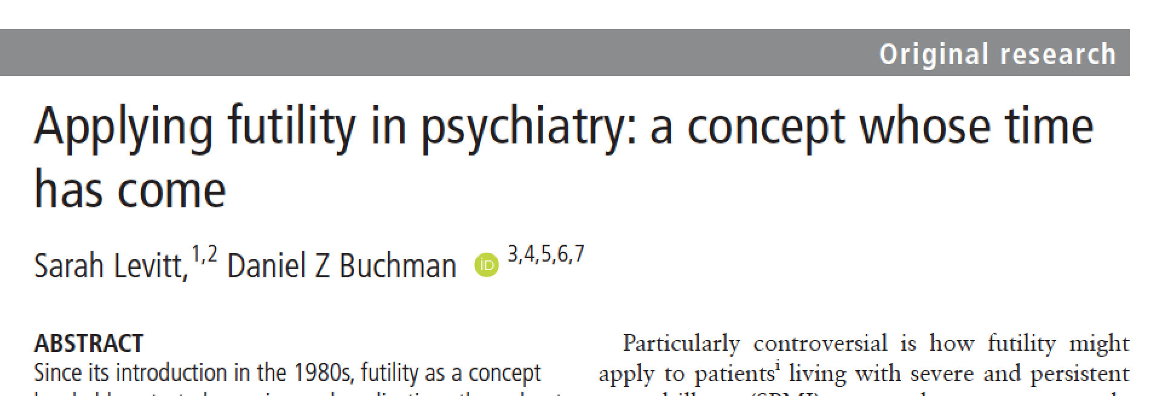
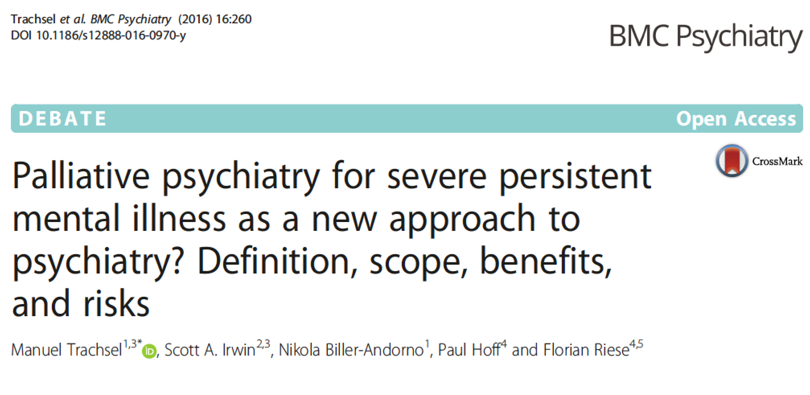
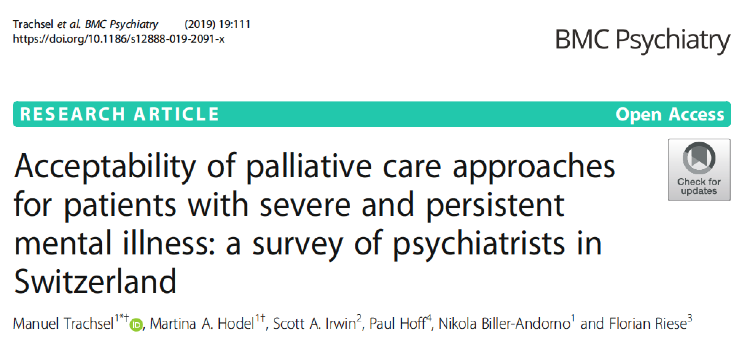
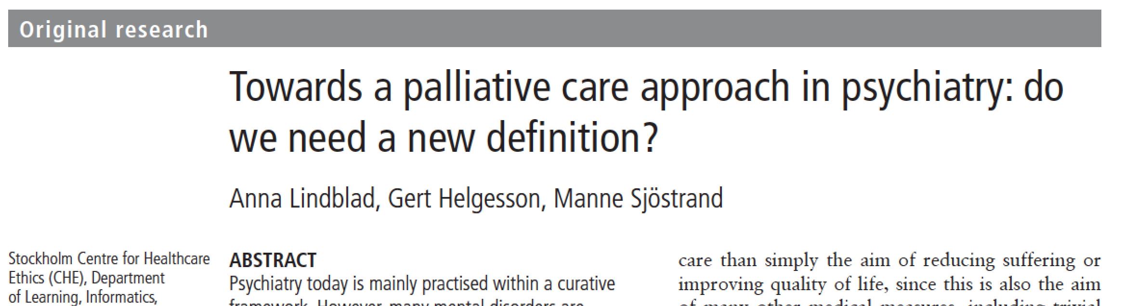
Psychiatric Futility
A palliative approach to care for severe and persistent mental illness
Cases of treatment-refractory SPMI where enforced treatment is not effective or causes iatrogenic harm and may be inconsistent with the patient’s life goals
Intent is to switch to focusing on enhancing quality of life
Notes:
Ethically, if they retain capacity, is it justifiable to exclude them from MAID?
Clinically, that’s a big if

Slide 8

Primary Concerns
Incurability and Irremediability
Capacity and Suicidality
Suffering and Structural Vulnerability
Autonomy and Paternalism
Notes:
Invalidated group, stigmatizing to exceptionalize

Slide 9
Ms X
38 y/o, single, no children, mental health care worker
Long history of treatment-resistant depression, alcohol use disorder, anorexia nervosa
On maximal doses of bupropion, fluoxetine and low dose seroquel
Multiple previous medication trials, on list for rTMS
Several previous suicide attempts by overdose
Multiple admissions to eating disorders unit, felt traumatized and stigmatized by mental health care, labeled with borderline personality traits
Waiting for March/23 to apply for MAiD – “disrespected all my life, don’t take away my control over death”
Develops stage IV melanoma with mets to lung, bone and brain
Psychiatric oncology consult within 2 weeks, trial of off-label intranasal ketamine
Feels her emotional distress is “valid” for the first time
Engages in immunotherapy to prolong life
“Why would you want to die if you weren’t suicidal from depression”?
Notes:
I don’t have a clear case of MD-SUMC because we haven’t seen any yet

Slide 10
Dr. Y (University professor, father received “orchestrated suicide”)
Father was 77 y/o, separated, 3 sons, former policeman
possible PTSD, narcissistic personality disorder, alcohol use disorder
Failed marriage – controlling and abusive to wife
Failed business – living alone on boat
Multiple previous suicide attempts, no ongoing psychiatric care
Neglecting self-care, living in squalor, “drinking himself to death”
Admitted to hospital after a fall due to sepsis, co-morbid HTN, COPD
Refusing discharge to assisted living, requested MAiD
Assessors refused to consider collateral from family, no psychiatric assessment, would not provide rationale for Track 2 eligibility
Eventual forced transfer to assisted living, stopped eating and converted to Track 1 at day 45/90, chose ex-wife’s birthday as date for MAiD as a “gift” to her, with only 2 days notice to family
Dr. Y profoundly traumatized, complicated bereavement, actively engaged in suicide survivor support groups, considering litigation/going to media

Slide 11
Is There a Muddy Middle?
Fundamental disagreements are based on values
vs non-fundamental disagreements based on facts and can be resolved
only solution to fundamental disagreements is to dispassionately present both sides
van Veen, 2020
Notes:
Scoping review of arguments – 3 recurring themes – uncertainty about irremediability, importance of hope, how to deal with treatment refusal
- Pro – autonomy Con - paternalism

Slide 12
Protection
Autonomy vs Paternalism
      False dichotomy as neither 100% autonomy nor 100% protection are safe or acceptable medical practice
        C-14: need to balance respect for autonomy with protection of the vulnerable who may be induced to commit suicide at a time of weakness
      Know where your values lie to avoid having them bias your MAiD assessments
        Unavoidable trade-off which must be recognized
some arguably eligible people will continue living lives they don’t want
some arguably ineligible people will receive MAID
Notes:
Paternalism is not a position to argue for

Slide 13
Necessary and Sufficient Conditions
Necessary condition: Must be present for an event to occur
but does not guarantee any result – e.g. having a ticket in a lottery is necessary for winning that lottery (but not sufficient)
      Sufficient condition: Alone will produce the event or result
      e.g. decapitation is sufficient for death (but not necessary)
      Causal fallacy: assuming a necessary condition is sufficient
      e.g. air is a necessary condition for life, but alone is not sufficient
  Can this apply to MAID?

Slide 14
Necessary Condition
(Legal Eligibility)
Sufficient Condition
(Consider Vulnerability)
MAiD Assessment Outcome
A. Receives MAiD
(Non-complex eligible cases, majority of Track 1)
Eligible
Clinical
Judgment
B. May or may proceed with MAiD
(Complex cases with vulnerability)
C. Cannot not receive MAiD now
(No vulnerability, advocate for legislative change)
Ineligible
Clinical
Judgment
D. Does not receive MAiD
(Non-complex ineligible cases)
Notes:
Law tells you when you can provide MAiD without going to jail, does not say that you should provide MAiD
Box C – Audrey’s amendment

Slide 15
An Approach to Box B - Considering Vulnerability in MAiD
Step 4: Determination
Step 5:
Outcome
Step 1: Recognize red flags for vulnerability
Step 3: Assess if the vulnerability
affects eligibility criteria
Step 2:
Reflect
Decline MAiD
Ineligible
Capacity
Does this case align with my values?
Can I provide an equipoised assessment?
Eligibility Unclear
Continue assessment while exploring ways to mitigate suffering
Yes
Suffering
No
Voluntariness
Engage in Shared Decision Making as part of Informed Consent
Decline the assessment
Refer to another assessor
Eligible
Notes:
“One-pager” summary fleshes out details of the components - to be included as an attachment

Slide 16
Shared Decision Making
growing standard of patient-centred health care in which clinicians collaboratively help patients to reach evidence-informed and patient value-congruent medical decisions
in cases where there is significant vulnerability, clinician discomfort can arise when patient’s request for MAiD contradicts best practice standards
  some would provide their clinical opinion recommending trial of treatment based on best practice standards (i.e. condition is not irremediable)
  this is distinct from clinician’s values/conscientious objection
  the decision regarding MAiD eligibility is the practitioner's responsibility based on clinical judgment
  if deemed eligible, the final decision to receive MAiD is for a capable patient to make

Slide 17

Bill C-14 safeguards
June 17, 2016
Substantive Safeguards | Procedural Safeguards
1. Canadian health care | 1. Written request
2. > 18 years of age | 2. Two independent witnesses
3. Capable of health care decisions | 3. Two independent MD or NP assessors
4. Grievous and irremediable condition Incurable condition Advanced state of irreversible decline in capability Enduring physical or psychological suffering Natural death has become reasonably foreseeable | 4. Right to withdraw request at any time, in any manner
5. Voluntary request | 5. 10 day reflection
6. Informed consent, including alternative of palliative care | 6. Express consent immediately before provision
Notes:
Canadian government seemingly narrowed the eligibility criteria or substantive safeguards – taken together suggests an individual on a proximal trajectory towards death
- but RFND was undefined, and in fact stipulated as not requiring a prognosis
Procedural safeguards, as a G&I condition was required, were grounded in medicine as the gatekeepers

Slide 18
Bill C-7
March 17, 2021
Substantive Safeguards | Procedural Safeguards
1. Canadian health care | 1. Written request
2. > 18 years of age | 2. Two independent witnesses
3. Capable of health care decisions | 3. Two independent MD or NP assessors
4. Grievous and irremediable condition Incurable condition Advanced state of irreversible decline in capability Enduring physical or psychological suffering | 4. Right to withdraw request at any time, in any manner
5. Voluntary request | 5. 10 day reflection
6. Informed consent, including alternative of palliative care | 6. Express consent immediately before provision
Natural death has become reasonably
foreseeable
Notes:
A number of changed safeguards, the most substantial of which was moving the requirement to have reasonably foreseeable natural death from an eligibility criterion to one of access

Slide 19
C-7 New Safeguards: 2 Parallel Streams
– Mar/23 MD-SUMC
RFND is present | No RFND
Only one witness required
Health care worker can witness
10 day reflection removed | 90 day reflection period
Waiver of final consent option | No consent waiver
 | Assessments must be informed by expertise in the medical condition causing suffering – Expertise Consult to assessors if needed Offered consultation for counselling, disability supports, palliative care, etc. Agree that the person has given serious consideration to reasonable and available alternatives
– Shared Decision Making
Notes:
Other substantive safeguards and the procedural requirement for 2 assessors and for the person to be informed of the right to withdraw their request didn’t change, listed here are just the changes introduced in Bill C-7, which creates two separate streams
Easing access for those with RFND and providing more stringent requirements for those without RFND
Significantly, RFND remains undefined, leaving it to the variable determination of clinicians to decide which patients should undergo more stringent requirements

Slide 20
AGHPS MAiD MD-SUMC Protocol Consensus Guidelines
Consider:
Feasibility (balancing ensuring accessibility, wait times, patient safety)
Acceptability (to MAiD practitioners/general psychiatrists/advocates and patients/families/public)
Unintended consequences (detrimental outcomes of doing/not doing any of these, ie. shifting requests from hospitals to the community to circumvent such “oversight”)

Slide 21
Policy Statements (Best Practices)
Respect rights and limitations of conscientious objection
Clinical equipoise – do not “try” to find patients eligible or ineligible
Clinical judgment - legal eligibility ≠ receives MAiD if it is contrary to best practice standards
Recommend informing family and consider their perspectives – consider declining consult if refused
Restrict MAiD MD-SUMC cases to Track 2 –suicidal intent, refusal of preventive care or VSED will not convert to Track 1
Psychiatrists should undertake MAiD education and training (CMCDP)

Slide 22
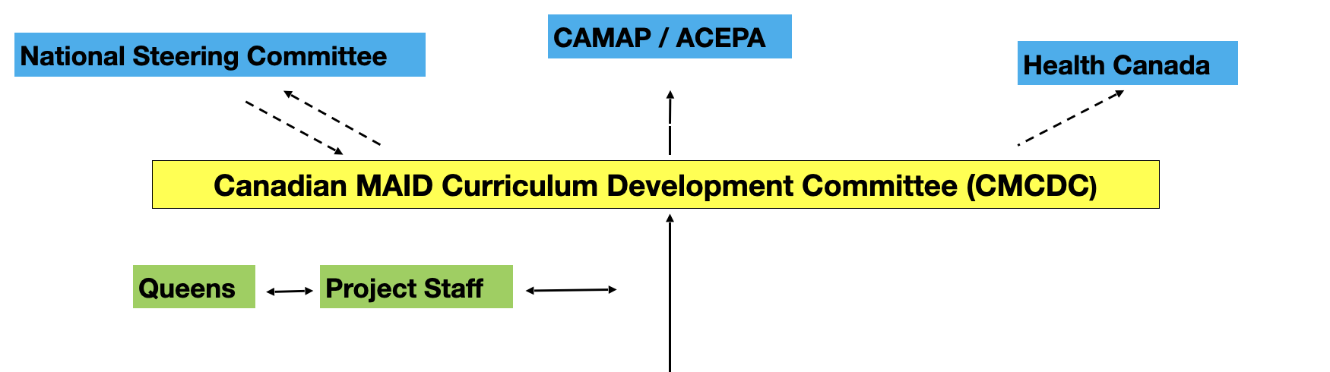

CMCDP Organizational Chart
Foundations
Clinical Conversations
MAiD Assessment
Assessing Vulnerability and Capacity
Providing MAiD
Navigating Complex Cases
Mental Health and MAiD
Resilience and Reflection

Slide 23
Domain
Pre-launch = 6 month before CMC hard launch. Post-launch = 1 year after CMC hard launch.
Data Elements
CMC Evaluation Framework
Formative and Process Evaluation
Outcome and Impact Evaluation
Needs assessment surveys
Key stakeholder qualitative needs assessments
End-user course satisfaction surveys
Participant and course leader focus groups
Reach and coverage
Participant numbers
Participant disciplines
Participant geography
Clinician outcomes
Assessment and delivery confidence
Numbers of MAID practitioners
Quality outcomes
Consistency in application of legislation
Attention to psychosocial vulnerability
Health system impacts
Attitudes in goals of care conversation
Frequency of use of final consent waiver
Analyzed to inform course content development
Stakeholders will target Indigenous, rural and remote communities
Pilot group analytics and ongoing course evaluations for course content refinement
For qualitative feedback to enhance train the trainer approaches
Descriptive metrics to be reported every 3 months after launch to inform knowledge translation and determine access to MAID training
Pre-/post-CMC completion evaluation of clinician confidence
Pre-/post-launch MAID clinician #s from federal reporting data
Pre-/post-launch analysis of federal reporting data by province
Case questionnaire via CAMAP/CMA/OCFP/CNA
Pre-/post- launch survey via CMA/OCFP/CNA
Data from federal reporting data and survey of CAMAP members
Analytic Plan
Notes:
A research framework will be used to evaluate this project, including formative and process evaluations, as well as outcome and impact evaluations. Formative and process evaluations will inform development of the educational content and uptake of the course, including evaluation of increased access to MAiD training in rural and remote and Indigenous communities listed as an expected result in the Request for Proposal. Outcome evaluations will address the three other expected results, including the outcomes of increased confidence of MAiD assessment and delivery by health care professionals, greater consistency in application of the MAiD legislative framework, and increased numbers of MAiD practitioners.

Slide 24
Process Recommendations
Two psychiatrists determine irreversibility
  Expertise Consult on Ψ management/opinion on psychiatric futility only
Psychiatrist independent of treatment team should be one of the MAiD Assessors
  Full MAiD eligibility plus Ψ assessments including formulation of the desire for death
Hospital psychiatrist panel provides Expertise Consult & 2nd MAiD Assessor
  Case review by panel or individual consult with patient
Establish provincial group of psychiatrists for Expertise Consult & MAiD assessments
Expertise Consult
(may be the Treating Ψ)
MD/NP
1st Assessor
Independent Ψ
2nd Assessor
MAiD
MD-SUMC Request
Hospital or Provincial
Panel
Treating Ψ
1st Assessor
Independent Ψ
2nd Assessor

Slide 25
Provincial Psychiatric MAiD Group
Pros - centralizes expertise, facilitates community access, robust provincial data collection on cases
Cons – volume overload risk, explicit/implicit bias risk
Alternate process if such a group can be implemented
MD/NP
1st Assessor
Hospital Ψ
Expertise Consult Panel
MAiD
MD-SUMC Request
Provincial
Ψ Group
Independent Ψ
2nd Assessor
Treating Ψ
1st Assessor

Slide 26
Process Recommendations
MAiD eligibility determinations should be based on at least 2 longitudinal assessments to ensure stability/non-ambivalence
  Particularly important for chronically or recurrently admitted in-patients
  For in-patients < 6 months, assessments should occur only after discharge
Final eligibility will be determined by no more than 3 assessors
  best 2 out of 3
  re-assessment of eligibility should not occur more frequently than once/year
Other thoughts/suggestions?

