Slide 1
AGHPS Leadership Summit
Toronto, Ontario
Panel Presentation
November 15th, 2013
Birth and Development of a Model for Access to Acute Care Child and Adolescent Services
Notes:
*

Slide 2
Birth and Development of a Model for Access to Acute Care Child and Adolescent Service
Objectives
Affirmation of the importance of collaboration and cooperation in the development of access models for children and adolescents.
Demonstration of a working model of access to acute care for children and adolescents.
Discuss the importance of community service access from hospital to maintain an accessible pathway into acute care.
Notes:
*

Slide 3
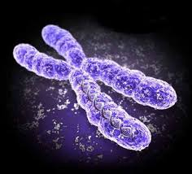
Birth and Development of a Model for Access to Acute Care Child and Adolescent Service
The “Genetic” Material
Capacity for Collaborative Partnerships: STAR Model
Aim to maintain care closest to
home
Urban and rural population mix
Willingness to integrate
component services
Goodwill “genes”
Inter-ministry cooperation
Notes:
*

Slide 4
Birth and Development of a Model for Access to Acute Care Child and Adolescent Service
“Conception”
1997 formal contractual agreement between DCAP-LHSC and MCYS
Access for SW REGION MCYS AGENCIES to C&A Psychiatrist on ER call 24/7
Spectrum of phone consultation
with agency Case Manager/
Therapist...face-to-face direct to
CAP-ER assessment…potential
for urgent acute care admission to
CAMHCP-LHSC
Notes:
*

Slide 5
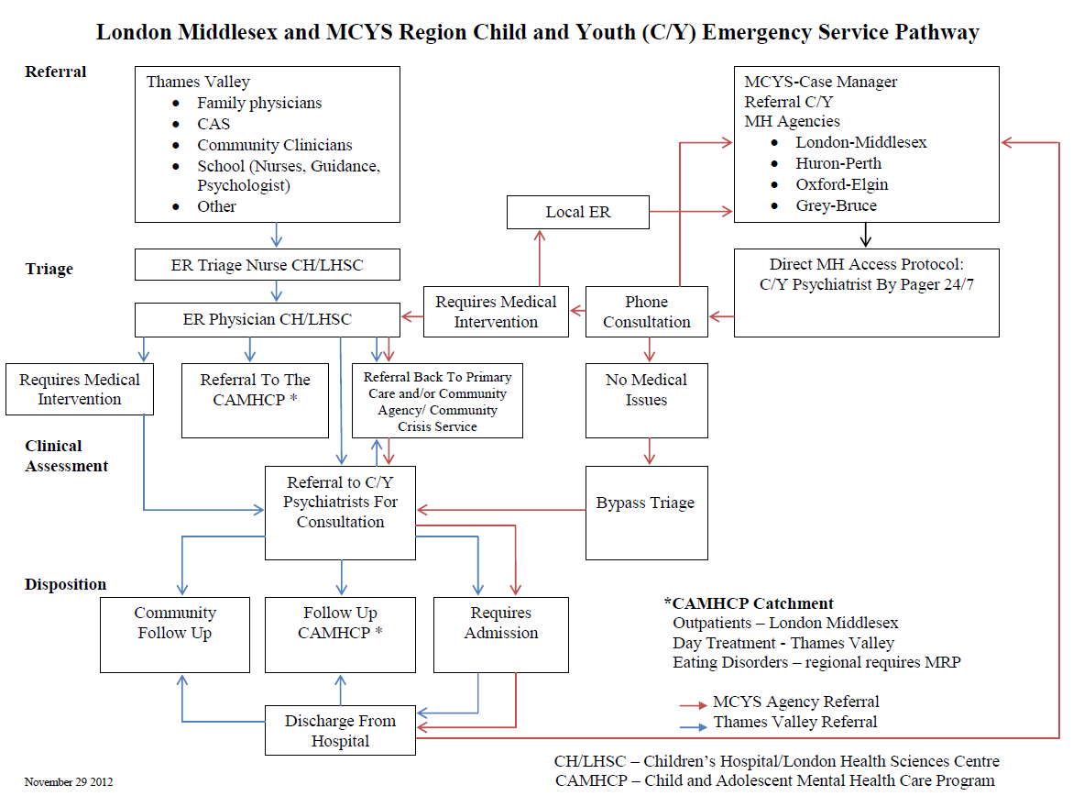
Birth and Development of a Model for Access to Acute Care Child and Adolescent Service
Notes:
*

Slide 6
Birth and Development of a Model for Access to Acute Care Child and Adolescent Service
“Delivery”
MCYS provided a session for 24 hour on call psychiatrist to be directly available by pager
Evaluation and feedback mechanism established
“Implementation Science”
Notes:
*

Slide 7
Birth and Development of a Model for Access to Acute Care Child and Adolescent Service
“Development”
Establishment of alternatives to the ER, e.g. C-IT (Middlesex), OECCY (Oxford and Elgin)
Expansion of access through formal partnerships between schedule 1s without child and adolescent beds and MCYS agencies, e.g. SGH and HPCCY and GBHS and Keystone
Integration with RMHC-AU when required/appropriate, e.g. tertiary
care for youth > 13 years or
acute care capacity
ity
Notes:
*

Slide 8
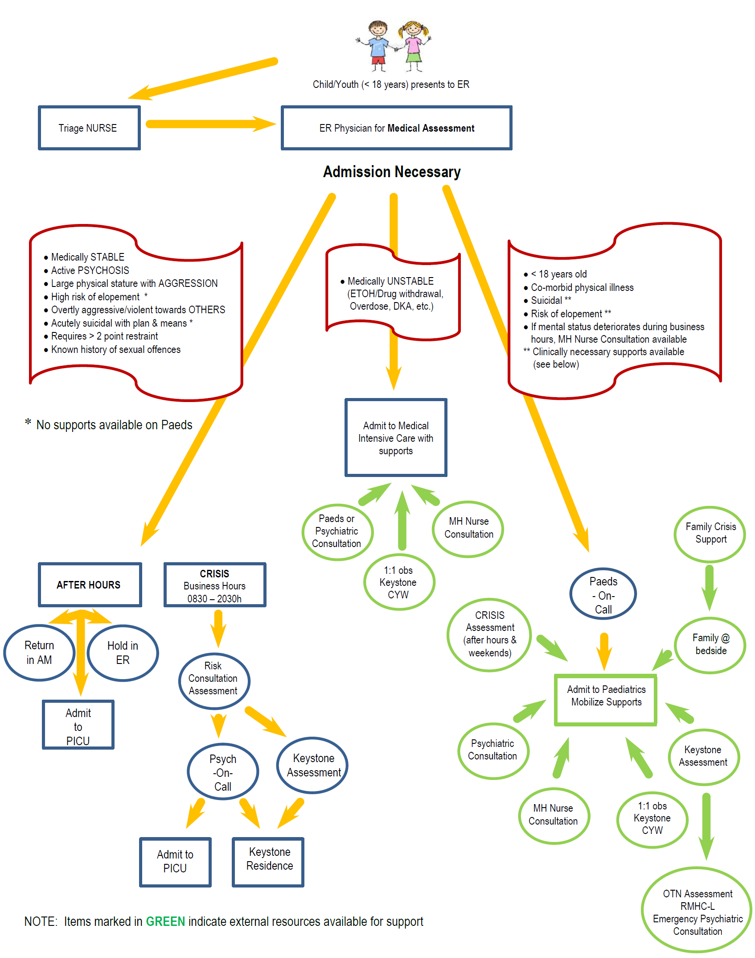
Birth and Development of a Model for Access to Acute Care Child and Adolescent Service
Notes:
*

Slide 9
Birth and Development of a Model for Access to Acute Care Child and Adolescent Service
Developmental Challenges
Importance of access from acute care to community services and ability to repatriate to local services
Triage to tertiary services for children < 13 years
Notes:
*

Slide 10
Birth and Development of a Model for Access to Acute Care Child and Adolescent Service
Maturity
Paediatric Maternal Child Health Advisory Provincial(PMCHP) Committee: ED clinical pathway for C and Y with MH Conditions/Addictions
CAMH Southwest Provincial Collaborative: modification of PMCH ED clinical pathway
Notes:
*

Slide 11
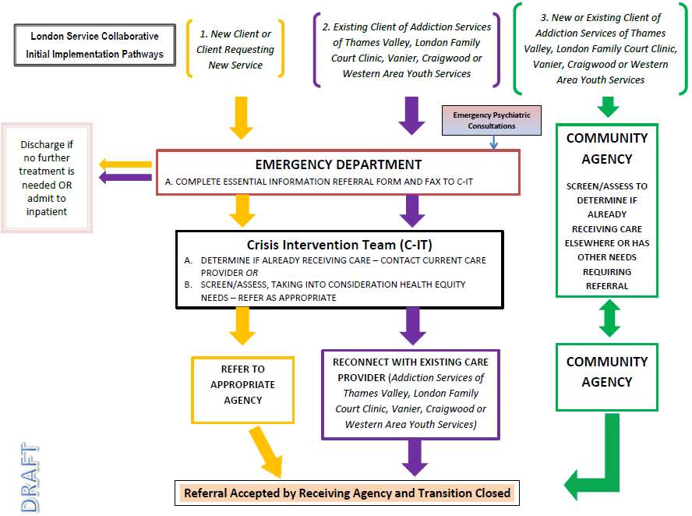
Birth and Development of a Model for Access to Acute Care Child and Adolescent Service
Notes:
*

Slide 12
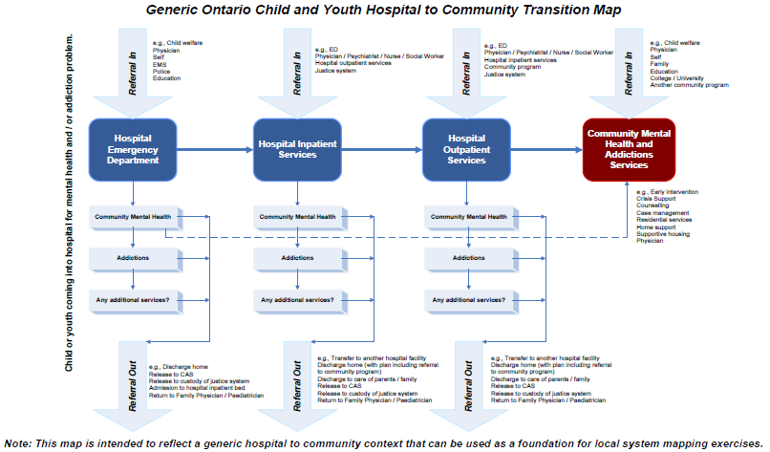
Birth and Development of a Model for Access to Acute Care Child and Adolescent Service
Notes:
*

Slide 13
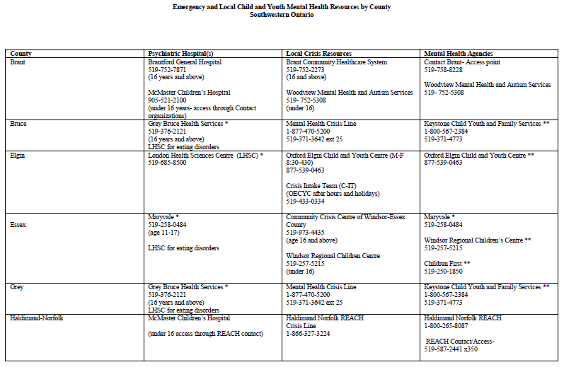
Birth and Development of a Model for Access to Acute Care Child and Adolescent Service
Notes:
*

Slide 14
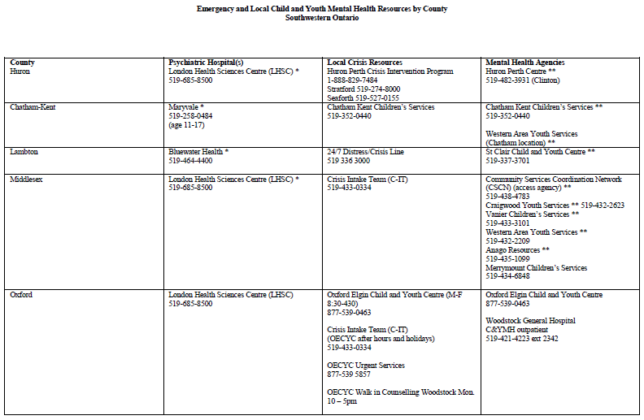
Birth and Development of a Model for Access to Acute Care Child and Adolescent Service
Notes:
*

Slide 15
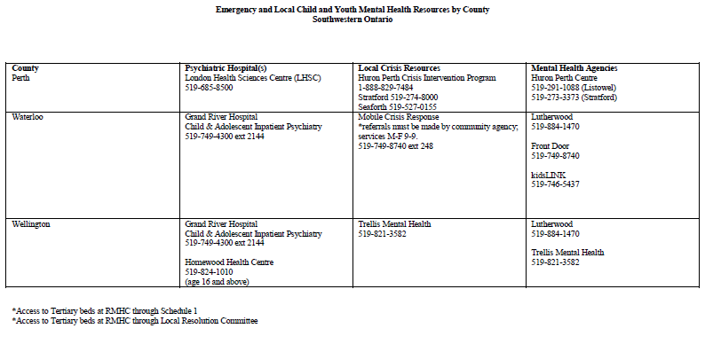
Birth and Development of a Model for Access to Acute Care Child and Adolescent Service
Notes:
*

