Slide 1

Provincial Data – What it tells us and how it can drive decision-making.
Paul Kurdyak MD PhD
AGHPS 12th Leadership Summit 2022
November 10, 2022

Slide 2
Conflicts of Interest
None to declare

Slide 3

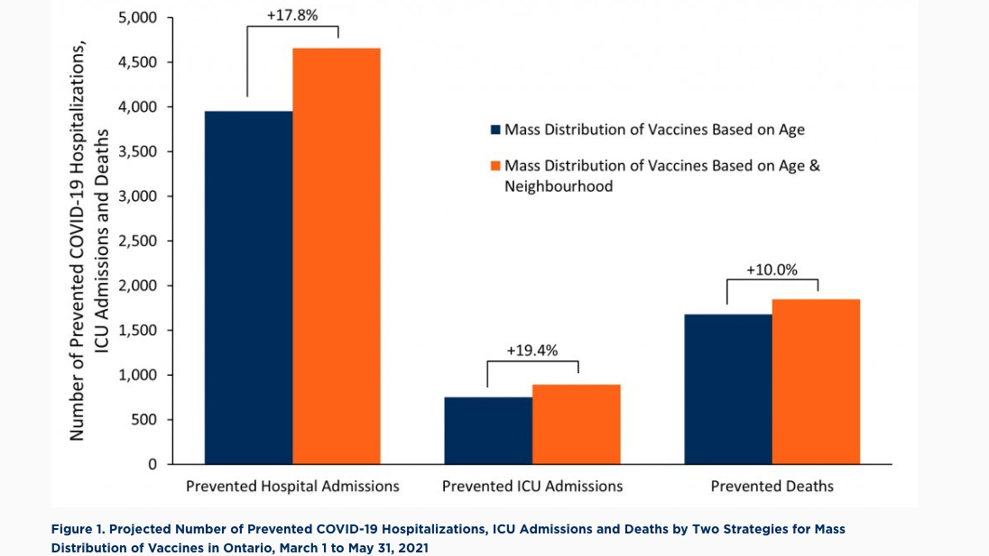
Background – COVID Vaccinations

Slide 4
Vaccination Rates by Diagnostic Group

Slide 5

Question from my CEO
Why is the mental health system so complicated?

Slide 6


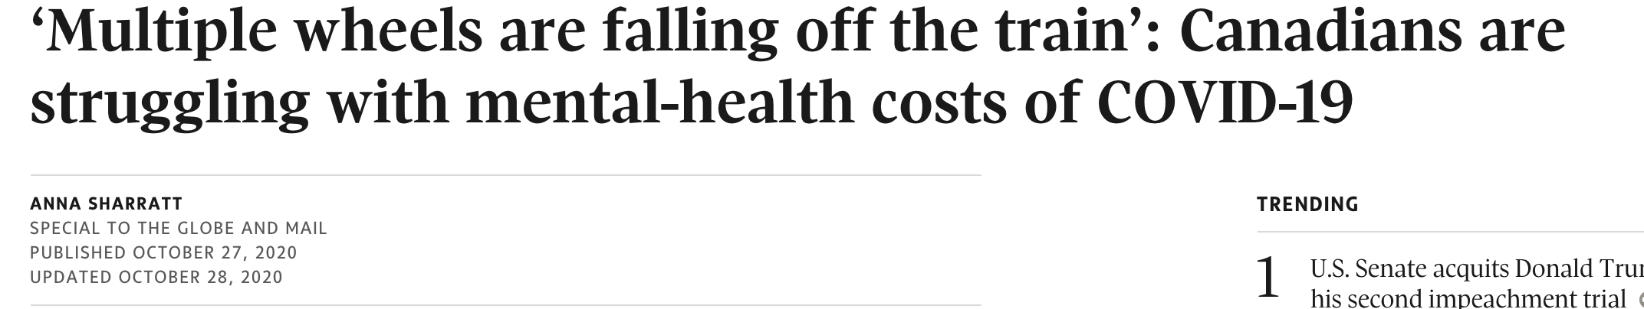


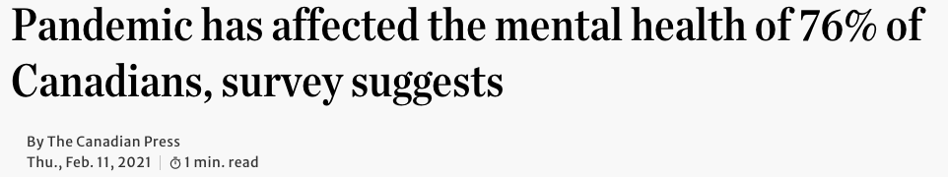
Notes:
Results presented today are primarily the bolded results

Slide 7
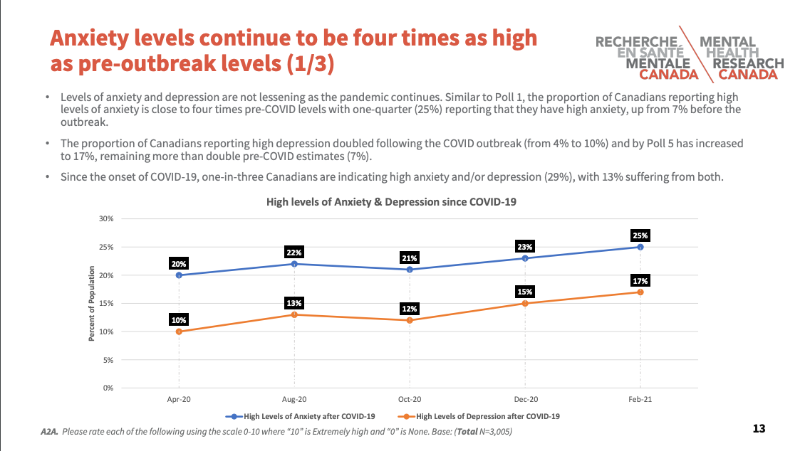
Notes:
Results presented today are primarily the bolded results

Slide 8
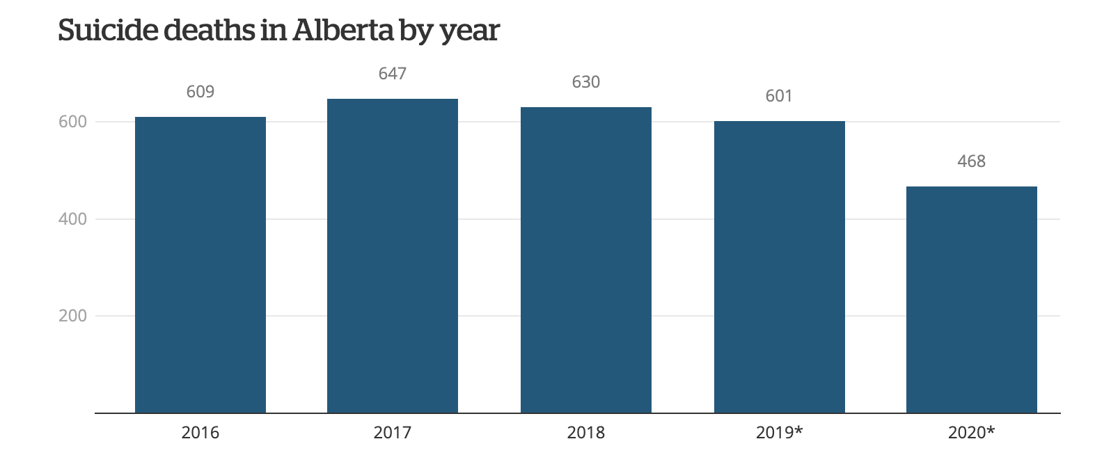
Suicide Deaths in Alberta
Notes:
Results presented today are primarily the bolded results

Slide 9
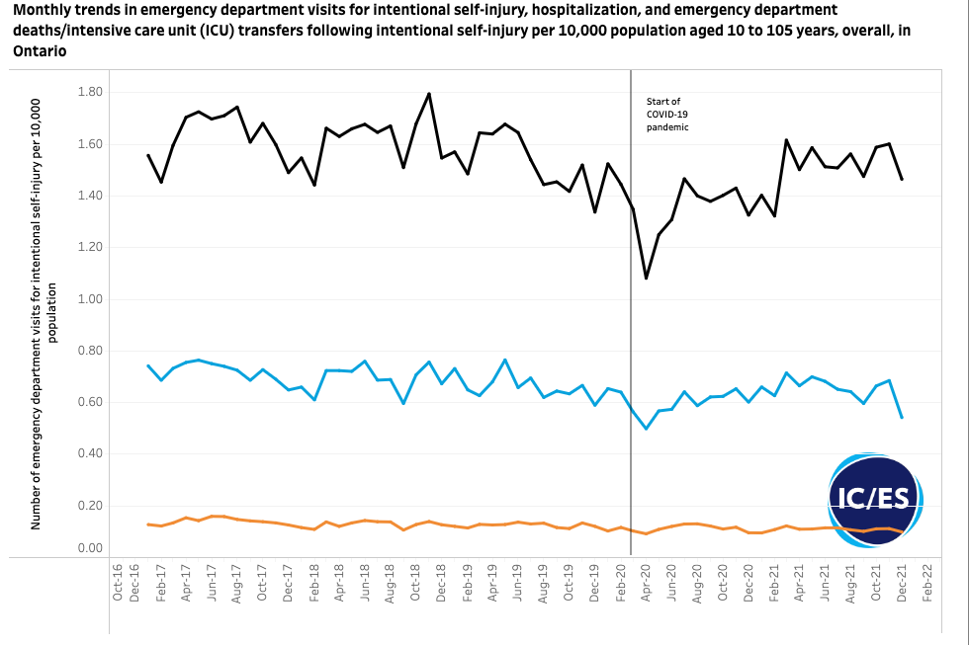
ED Visits for Suicide Attempts - ON
Notes:
Results presented today are primarily the bolded results

Slide 10
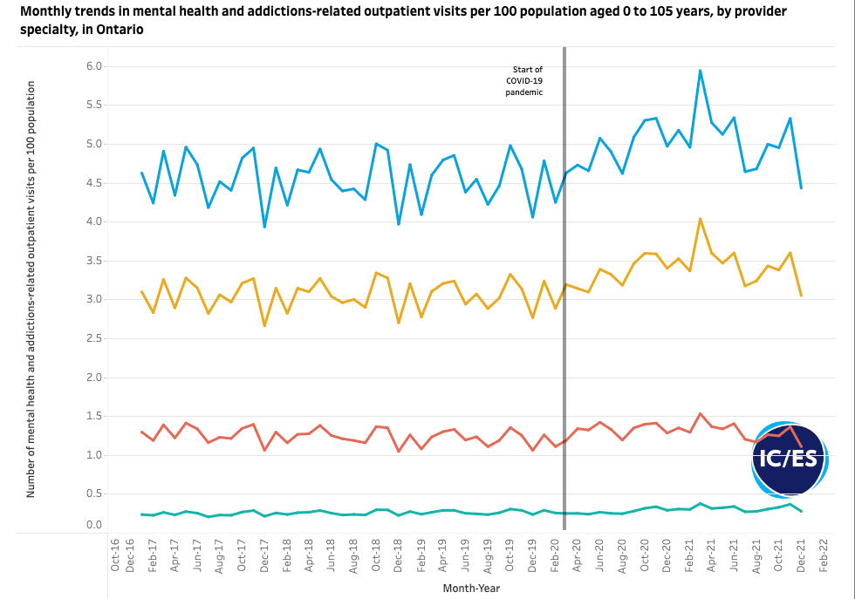
Outpatient Visits
https://www.ices.on.ca/Research/Research-programs/Mental-Health-and-Addictions/MHA-Dashboard
Notes:
Results presented today are primarily the bolded results

Slide 11
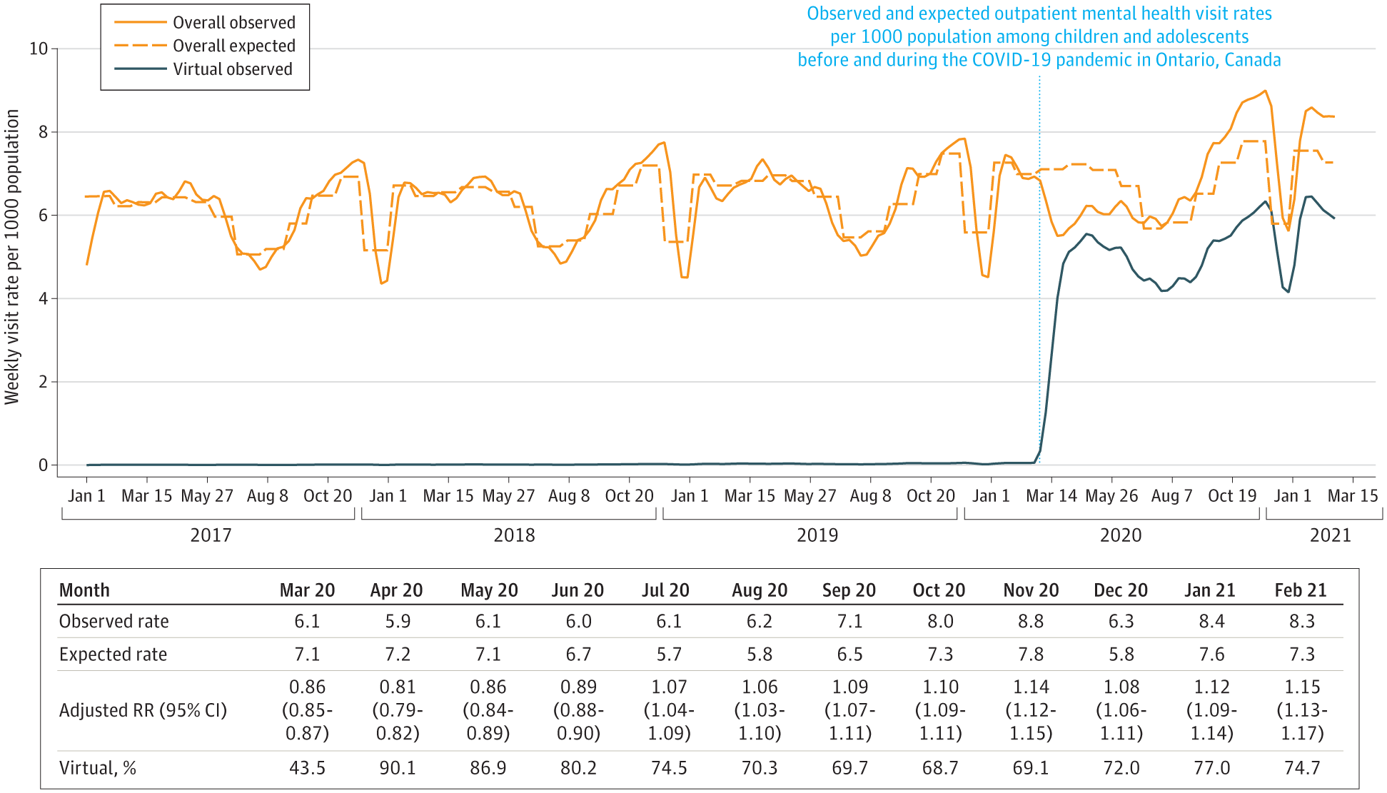
Outpatient Visits Among Children and Youth
Saunders et al., 2022; JAMA Pediatrics, 176(4):e216298

Slide 12
What DON’T we know?
Who is not accessing the system and who should getting care
Whether people get to where they need to go
How long people are waiting to get care (wait times)
Whether people are receiving care that adheres to best evidence and standards of care
Whether people respond to treatment
Whether people are “stepped up” to more intense treatment based on non-response to lower intensity treatment (or treatment is stopped once people have achieved remission/response)
ACCESS
QUALITY

Slide 13
Provincial Program Working Definition
A Provincial Program oversees and coordinates the management and continuous quality improvement for an identifiable disease/condition. A Provincial Program aims to:
Address an identifiable disease/condition that is common and/or burdensome for defined populations
Provide oversight and coordination for disease/condition management to maximize population level benefits and minimize harms
Bridge gaps between evidence and data, policy and clinical practice
Provide supportive infrastructure, coordination and integration through funding, accountability, leadership, communications and stakeholder relations
Have information technology and mechanisms to enable routine monitoring, evaluation and reporting on program and system-level impacts for continuous quality improvement
Longwoods Publishing Corporation. (2015). Stronger Together Cancer Care Ontario's focus on Quality, Performance and Partnership puts patients and the public at the centre. Healthcare Quarterly Vol 17 Special Issue. Retrieved from https://www.longwoods.com/publications/healthcare-quarterly/23991
Provincial Programs Advisory Panel. (2011). Provincial Programs Advisory Council Final Report - Draft. [Internal Document].

Slide 15
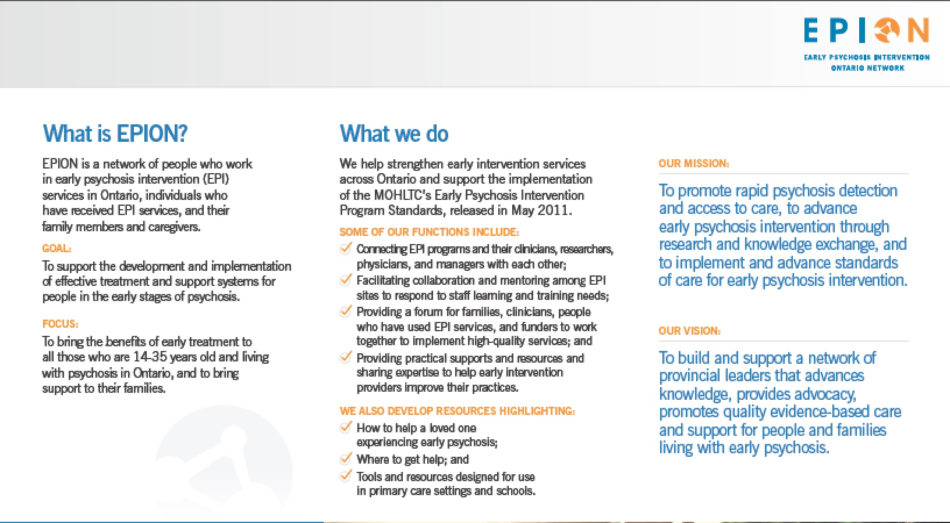
Provincial Infrastructure

Slide 16

EPI Standards
While there is a provincial network and standards . . .
We do not know proportion of individuals who are eligible receive services
We have evidence that fidelity to standards is variable
We do not know outcomes of the services

Slide 17
Early Psychosis Intervention
50% of cases in London did not get referred to the regional EPI program
Factors increasing likelihood of referral
  Male (OR – 1.58; 95% CI 1.24-2.01)
  Psychiatrist at index diagnosis (OR – 7.35; 95% CI 5.43-10.00)
Factors decreasing likelihood of referral
  Living in socioeconomically deprived neighbourhoods (OR – 0.51; 95% CI 0.36-0.73)
  Being diagnosed in an outpatient setting (vs. hospital) (OR – 0.50; 95% CI 0.38-0.65)
  Prior diagnosis of alcohol-related disorder (OR – 0.42; 95% CI 0.28-0.63)
  Prior diagnosis of substance-related disorder (OR 0.68; 95% CI 0.50-0.93)

Slide 18
Early Psychosis – Risk of Mortality
Notes:
1 in 25 if diagnosed in hospital, 1 in 40 if diagnosed as an outpatient

Slide 19
Suicide Risk in Early Psychosis
Followed 75,989 individuals for 10 years
1302 died by suicide
  1.7% of the population
  17 times higher than general population
Age at first diagnosis– 30 (+/- 8.6)
  Many individuals are having their first episode when they have already aged out of provincial programs
Age at death by suicide – 35.4 (+/- 9.2)
  Programs may not be long enough to prevent suicide deaths
Zaheer et al., 2020; SCZ Research; 222:382-88.

Slide 20
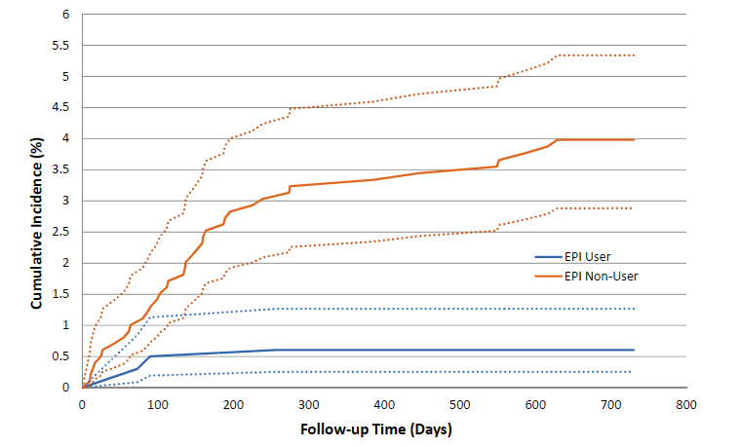
Early Intervention and Mortality
Anderson et al., Am J Psychiatry. 2018 May 1;175(5):443-452

Slide 21
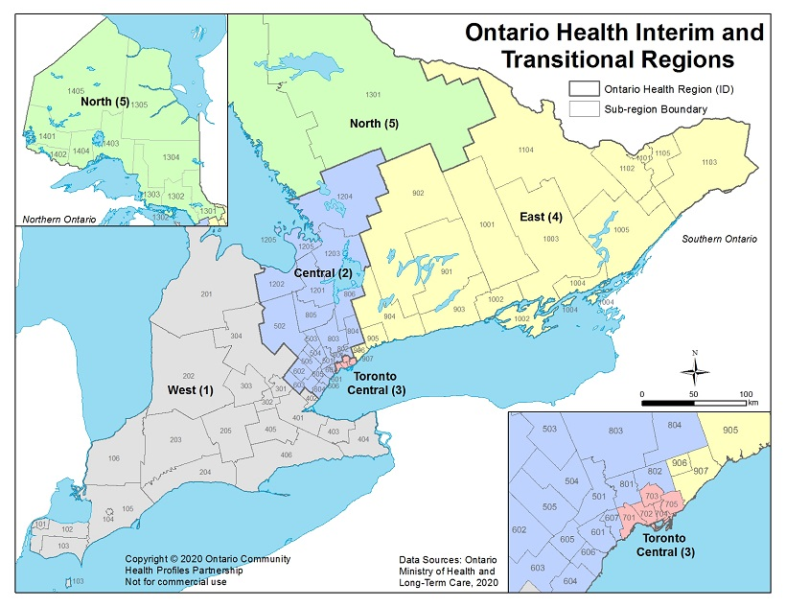
Rates of incident psychosis (nonaffective) by OH Region
16.8 per 10,000
11.0 per 10,000
8.6 per 10,000
10.6 per 10,000
11.2 per 10,000
Notes:
Paul

Slide 22
The Opportunity
EPI is well-positioned to be one of the first areas within the MHA sector to have a systematic and standardized model of care across Ontario that will increase access to high-quality of care for clients receiving treatment for early psychosis:
While these foundational elements exist, there are gaps in the system:
Access to EPI services and eligibility criteria is inconsistent across the province
Fidelity to standards is variable and more current evidence exists
It is unknown whether current service locations aligns with the regional population needs
No mechanism to monitor outcomes
Identifiable population | Infrastructure
Evidence-based treatment programs | Provincial standards
Notes:
Paul
Source that data (Anderson)
Make a point as part of the bottom bullet that this programmatic approach will rely heavily on data which furthers the need for us to get the data and digital work underway in this provider group (more info to come in the latter have of the presentation)
Programmatic Approach – its comparable to what we have seen be done on the cancer/renal side. Add - Bring an example from cancer/renal.
•Identifiable Population ✔
•Evidence-based approach ✔
•Provincial infrastructure ✔
•Provincial Standards ✔ (outdated, but a place to start from)
• Define what the future standardized approach for how we delivery EPI Care will look like…a standardized model of care delivery (we know there are evidence-based models that exist such as NAVIGATE)
•Implementation and evaluation oversight
•Outcomes
•Data and analytics

Slide 23
Closing the Gap: Provincial EPI Program Goals
The Mental Health and Addictions Centre of Excellence will work with people with lived experience, service providers (community and hospitals), and clinical experts to establish a provincial evidence-based EPI program that will:
  Serve a clearly defined client population along a coordinated and integrated client pathway
  Provide high-quality, standardized delivery of services across the province
  Ensure services meet the needs of communities across the province through robust needs-based capacity planning
  Measure and monitor outcomes and experiences of clients to support continuous quality improvement
Notes:
Paul
Explain – what we mean by a standardized model of care.
Not the what (standards) it’s the how we deliver care.
Framing: leveraging the great work that has been done with EPI (existing standards). Context as to why we are starting with EPI. Supporting to ensure resourced adequately.
Slide re: standardized care vs. standards (framing that in advance of this). Work on how we introduce this DDI work that fits into the work above.
May get questions re: NAVIGATE.
Engagement- will be talking to leadership teams at these organizations as well. Exec Directors.

Slide 25
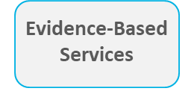
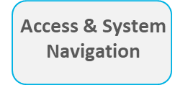
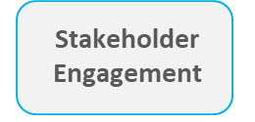
1. Evidence-Based Clinical Model of Care
A standardized evidence-base clinical model of care will include:
Defined eligibility criteria
Coordinated and integrated client pathway, mapping the client journey from first episode psychosis and referral/intake through to post-treatment
  The provincial coordinated access initiative will streamline screening and referral to EPI services
Evidence-based standards which outline the minimum quality expectations for all EPI programs in Ontario. These standards will ensure that all Ontarians meeting the eligibility criteria will receive comprehensive, high quality, evidence-informed care, treatment and support
This work will be designed by the Schizophrenia and Psychosis Advisory Committee and Task Group (chaired by the Provincial Clinical Lead) and will involve robust stakeholder engagement
  Membership will include people with lived experience, service providers (community and hospitals), and clinical experts
Notes:
Monisha
Explain – what we mean by a standardized model of care.
Not the what (standards) it’s the how we deliver care.
Framing: leveraging the great work that has been done with EPI (existing standards). Context as to why we are starting with EPI. Supporting to ensure resourced adequately.
Slide re: standardized care vs. standards (framing that in advance of this). Work on how we introduce this DDI work that fits into the work above.
May get questions re: NAVIGATE.
Engagement- will be talking to leadership teams at these organizations as well. Exec Directors.

Slide 26
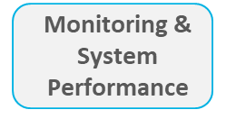
2. System Planning and Delivery Model
The system planning and delivery model will embed client-first principles such as integration, coordination and accessibility.
The system planning and delivery model will:
  Utilize capacity planning to understand the regional supply and demand for EPI services and ensure data-drive decisions to ensure necessary infrastructure for EPI care is in place across the province
  Leverage a hub and spoke model, in which the hubs will be responsible for overseeing the quality of services offered at spoke sites
  Ensure the funding model for EPI is tied more directly to high-quality care that is defined by the provincial clinical model of care
Notes:
Monisha
Explain – what we mean by a standardized model of care.
Not the what (standards) it’s the how we deliver care.
Framing: leveraging the great work that has been done with EPI (existing standards). Context as to why we are starting with EPI. Supporting to ensure resourced adequately.
Slide re: standardized care vs. standards (framing that in advance of this). Work on how we introduce this DDI work that fits into the work above.
May get questions re: NAVIGATE.
Engagement- will be talking to leadership teams at these organizations as well. Exec Directors.

Slide 27
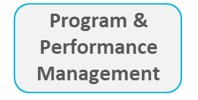
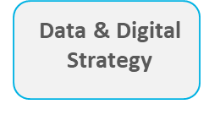
3. Performance Management & Accountability
Key provincial indicators to measure and monitor client outcomes and experiences to ensure the provincial EPI program continues to meet the needs of Ontarians with early psychosis and to drive continuous quality improvement
Clear accountability and expectation for EPI service providers to adhere to clinical quality standards and commit to monitoring and responding to performance results for key provincial indicators
The cornerstone of this work is the MHA CoE's Data and Digital Initiative
The MHA Provincial Dataset will collect client-level, standardized data elements that support direct service delivery and enable consistent and comparable reporting of service utilization, client outcomes & client characteristics.
Once the provincial EPI program has been implemented, a Community of Practice will be established and offer a forum to share lessons learned, best practices, and foster a collaborative improvement culture among EPI service providers
Notes:
Monisha
Explain – what we mean by a standardized model of care.
Not the what (standards) it’s the how we deliver care.
Framing: leveraging the great work that has been done with EPI (existing standards). Context as to why we are starting with EPI. Supporting to ensure resourced adequately.
Slide re: standardized care vs. standards (framing that in advance of this). Work on how we introduce this DDI work that fits into the work above.
May get questions re: NAVIGATE.
Engagement- will be talking to leadership teams at these organizations as well. Exec Directors.

Slide 28
Conclusion
We do not have a mental health system in Ontario
  We have services that we fund annually
We have examples of high quality health care delivery in other areas of the health care sector
Can we apply the “playbook” that has resulted in success elsewhere to the mental health and addictions sector?

