Slide 1
Digitization of Measurement-Based Care in Mental Health: Major Depressive Disorder Integrated Pathway (MDD-ICP)
Notes:
Thank you very much for the invitation and opportunity to present our work on the MDD-ICP and how Digitization of Measurement Based Care was developed and evolved alongside this program. David Rotenberg and I planned to do the presentation together, but unfortunately he was not able to come here today.

Slide 2
1
MDD-ICP
Introduction and Overview
2
Digitization of Measurement Based Care
3
Operational and Clinical Dashboards

Slide 3
Introduction and Overview Major Depressive Disorder Integrated Care Pathway (MDD-ICP)
1

Slide 4

Major Depressive Disorder (MDD)
One of the most prevalent (psychiatric) disorders worldwide
Enormous impact on disability and societal costs
About 2,000,000 Canadians suffer from MDD within one year
About 35% or more patients experience treatment resistant depression (TRD)
Impact on quality of life to patients and their families
Decreased life expectancy caused by up to 20-fold increased risk of suicide and comorbid psychiatric and physical illness
GBoDS (Global Burden of Disease Study) 2013, Lancet 2015; Patten et al, Can J Psychiatry 2015; Chesney et al, World Psychiatry 2014; Fava, Biological Psychiatry 2003, Rush et al, Am J Psychiatry 2006, Trivedi et al, Am J Psychiatry 2006, Fava et al, Psychiatr Clin North Am. 1996, Nobler, 2001, Tokutsu et al, Clin Psychopharmacol Neurosci. 2013, Folkerts et al, Acta Psychiatr Scand. 1997, Khalid et al, J ECT. 2008, McDonald, 2009, Souery et al, J Clin Psychiatry 2007, Kornstein et al, J Clin Psychiatry 2001
Notes:
About 2 million individuals in Canada suffer from MDD. In addition, about 1/3 or more do not sufficiently respond to current treatments.
While there are many factors that contribute to limited improvement of symptoms in MDD, it has been shown that MBC including regular standardized measures and structured care decisions and/or recommendations can improve outcomes for individuals suffering from MDD.

Slide 5
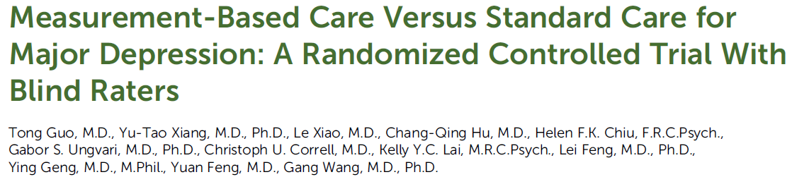
Measurement Based Care in MDD
Am J Psychiatry, 2015
Measurement-based group vs. Standard care group (n=120)
Outpatients with Moderate to Severe MDD
Mirtazapine and Paroxetine
Care decisions: increase, continue, decrease, switch
Measurement Based Care (MBC) group
→ Higher doses of antidepressants from week 2
→ Lower HDRS score from week 2
→ Response rate: 86.9% vs. 62.7%
→ Remission rate: 73.8% vs. 28.8%
→ Time to response: 4.5 vs 8.1 weeks
Notes:
This study by Guo et al has been a prominent example, the study design was simple …

Slide 6
MDD Integrated Care Pathway (MDD-ICP) at CAMH
Benefits of Integrated Care Pathways and MBC
Implementation of evidence based care
→ Collaboration, communication, and teamwork
→ Reduce delay and unstructured variations in care
Objective measurement / outcome-based decisions
Detection of non-response / worsening of symptoms
Improve patient experience of care, patient-centered
Development Process MDD-ICP
→ Clinical pathway based on current evidence
→ Multidisciplinary team (Clinicians, Pharmacy Management)
→ ICP infrastructure at CAMH
→ Review and Approval by CAMH committees
Pharmacological Interventions (Algorithm, Titration Schedule)
Non-Pharmacological Interventions (Behavioural / Psychotherapy, Neurostimulation)
Clinical Team Intervention / Interdisciplinary Collaboration
Measurement Based Care (MBC)
and
Structured Treatment Recommendations
MDD-ICP Components
Lam et al, Can J Psychiatry 2016, Crismon et al, J Clin Psychiatry 1999, Adli et al. Biol Psychiatry 2006; Mulsant et al. Clin Geriatr Med 2014, Adli et al, J Clin Psychiatry 2002, Rush et al, Am J Psychiatry 2003; CANMAT guidelines 2016
Notes:
MBC is often a key component of ICPs. The benefits of ICPs have been demonstrated and include … At CAMH we developed the MDD-ICP based on current evidence and guidelines … Key components of the MDD-ICP include …

Slide 7
MDD-ICP at CAMH – Self-report assessments
Information on psychiatric and medical history
Past treatments
PHQ-9
PHQ-9 – item 9 (suicidality)
GAD-7
Adverse Effects
Adherence / Missed Doses
Substance use
WHODAS (Disability)
WHOQoL (Quality of Life)
OPOC (Perception of Care)
Notes:
In the MDD-ICP we use mainly self-report information and scales, at start of treatment … . At each follow-up patients are asked to provide structured information on …. In addition, we ask patients to provide information on Qol, disability and perception of care

Slide 8
Digitization of Measurement Based Care
Notes:
Initially, self-reports were done on paper when patients came to the clinic. This was however a clear barrier to implementation and required more time from clinicians to review self-reports, document and it was not possible to review course of treatment.

Slide 9

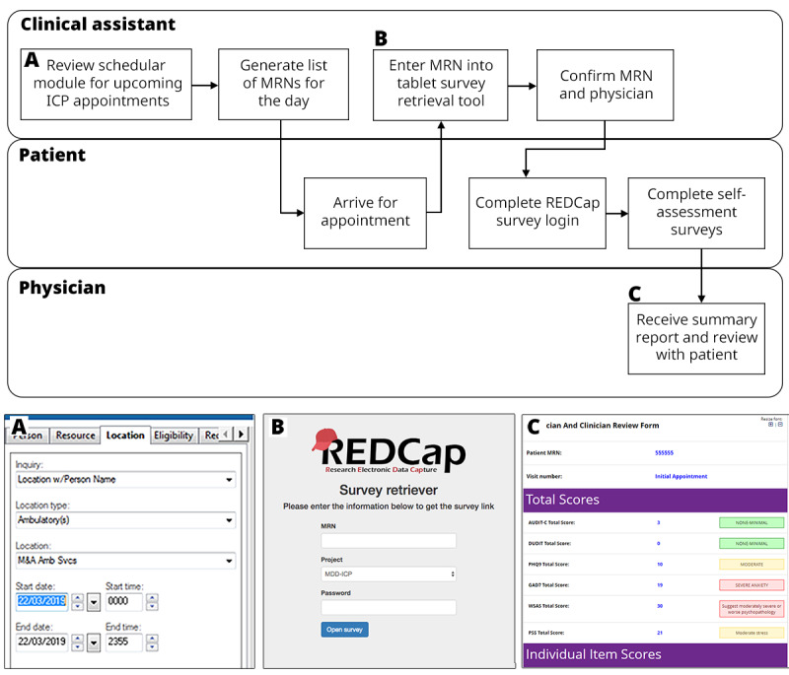
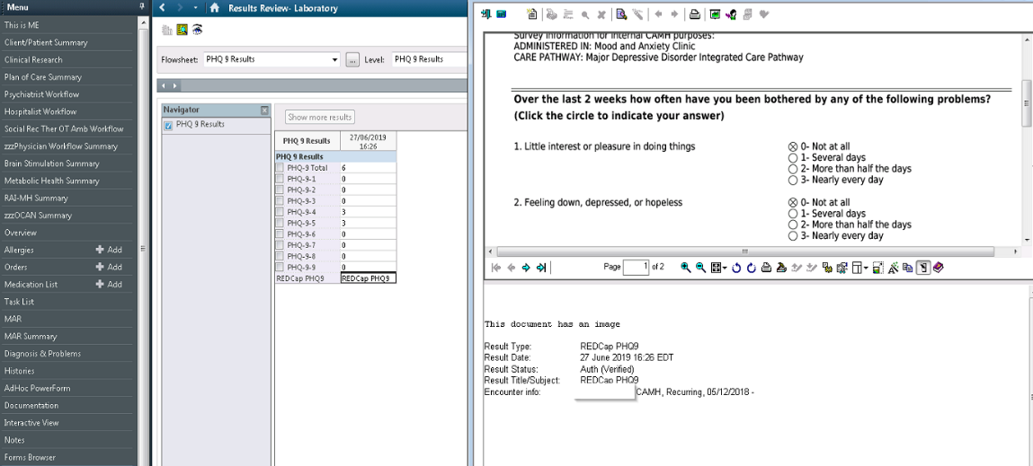

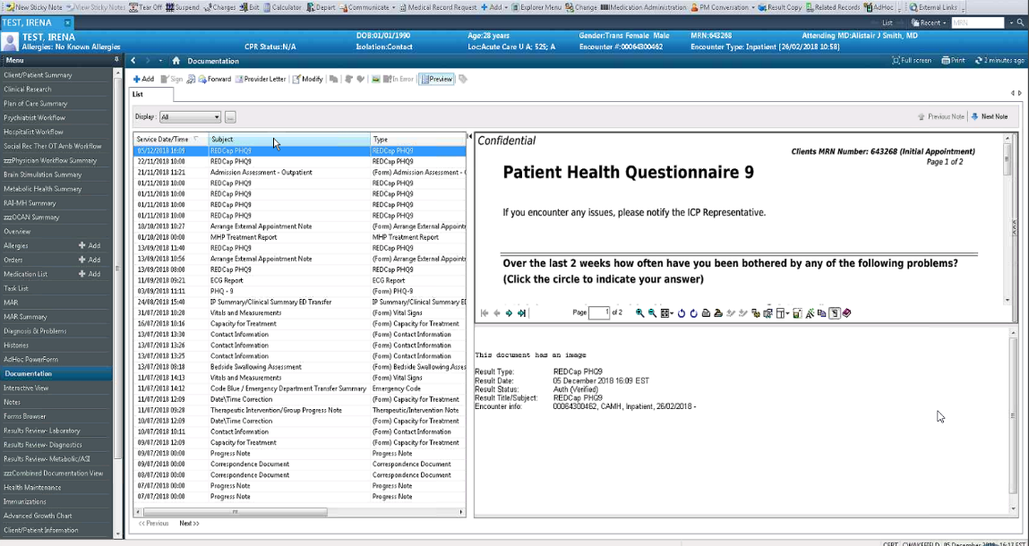
Clinical REDCap for Self Assessments
Hawley S, Digitization of Measurement-Based Care Pathways in Mental Health Through REDCap.
J Med Res. 2021 doi: 10.2196/25656.
Notes:
Initially, a workflow was established to enable collection and administration of measures using REDCap.
In a second step this was integrated with the EHR. Measures from REDCap are automatically sent to I-CARE in both discrete CSV and PDF formats (screen captures show examples for the PHQ-9).

Slide 10
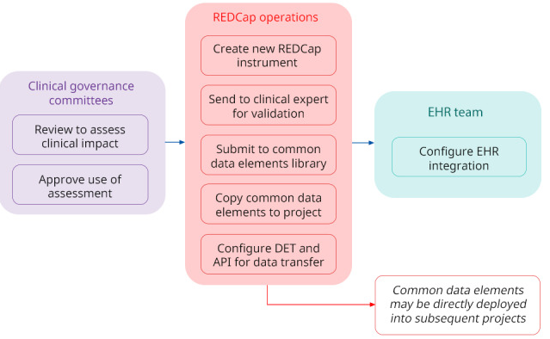
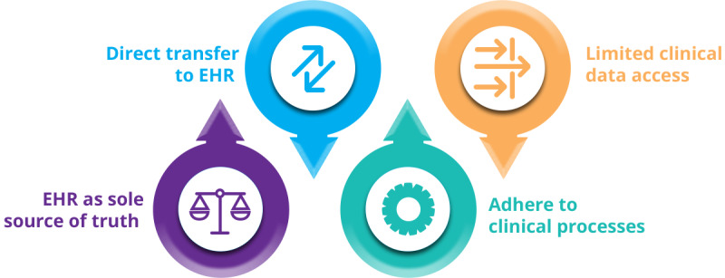
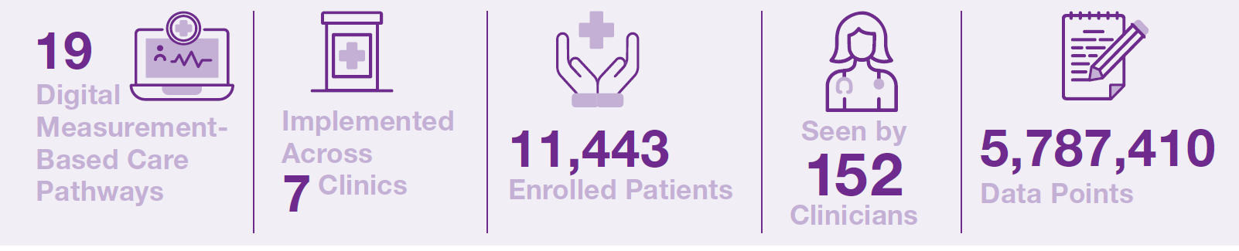
Clinical REDCap for Self Assessments
Notes:
REDCap was launched in alignment with clinical information system governance, adhering to processes, ensuring source of truth and limiting access. This has allowed for the rapid development of new measures and pathways – scaling to 19, across 7 clinics.

Slide 11


Implementation of Digital tools
Reduced time spent on administrative tasks
Reduce non value added wait time
Increased patient-provider interaction time
Eliminate paper-based assessments and “hassle factor”
Tools and results delivered in real-time
Standardized care
Increased value to patients
Increased perceived value of self-report assessments
Patient-centered culture
Better Outcomes
Notes:
We observed benefits of digitization of MBC, received positive feedback from clinicians and patients, e.g. physicians reported it actually reduced time spent on administrative tasks and documentation, patients felt there was more time available during clinical appointments to ask questions and discuss aspects of their care.

Slide 12
Operational and Clinical Dashboards
3
Notes:
In a next and more recent step clinical and operational dashboards were implemented for improving clinic management and care decisions.

Slide 13
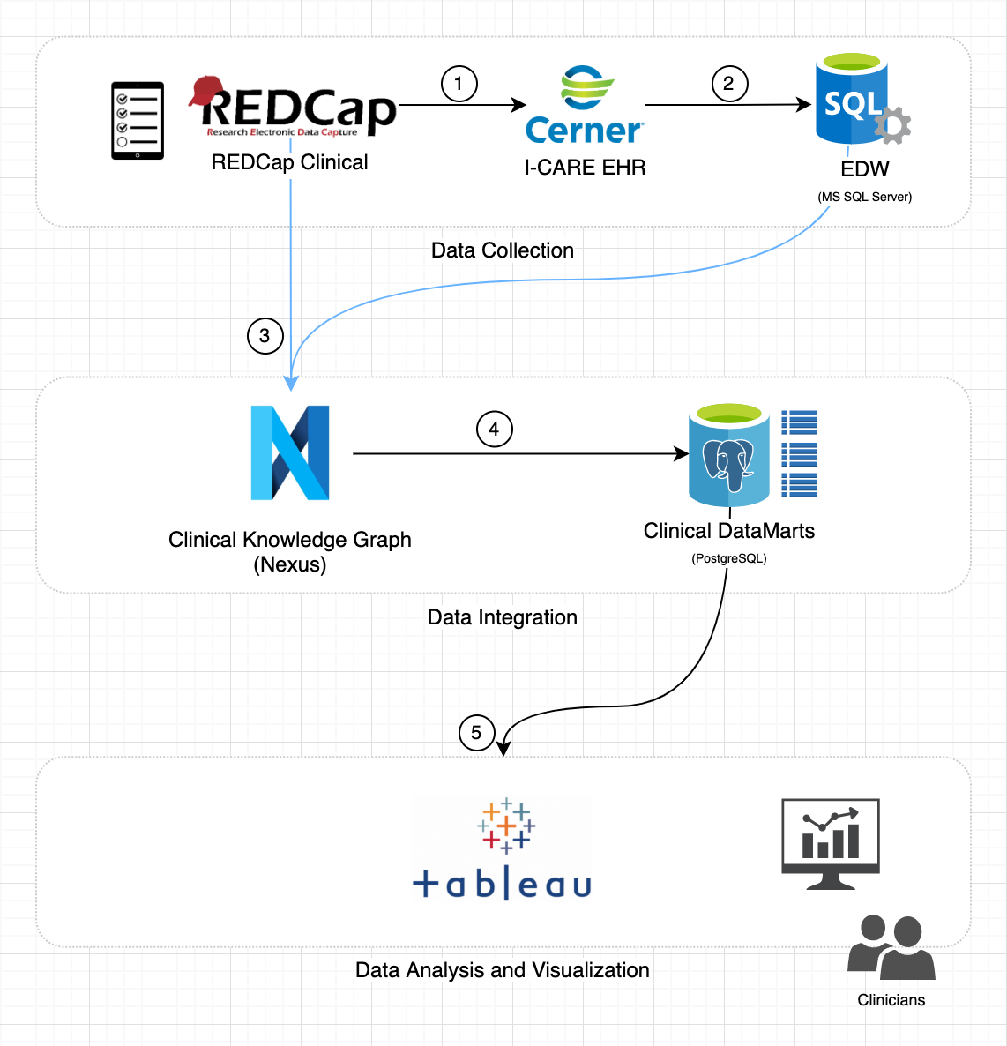
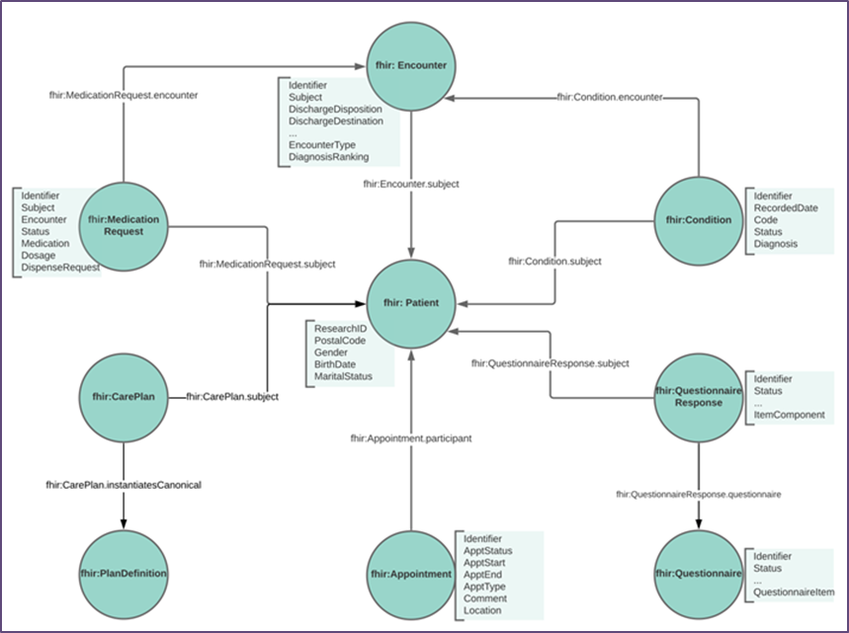


Clinical / Demographics & Assessments
International standard for representing eHR data
Adopted by Ontario Digital Health Strategy and NIH
Flexible integration with various data types
Represent patient data and model care pathways
Notes:
Data from the EHR and Clinical REDCap are integrated and harmonized under the Fast Health Interoperable Resource (FHIR) data model. This is aligned with the provincial direction and allows significant flexibility to present data in relational and semantic formats. These are then made available for visualization and analysis.

Slide 14
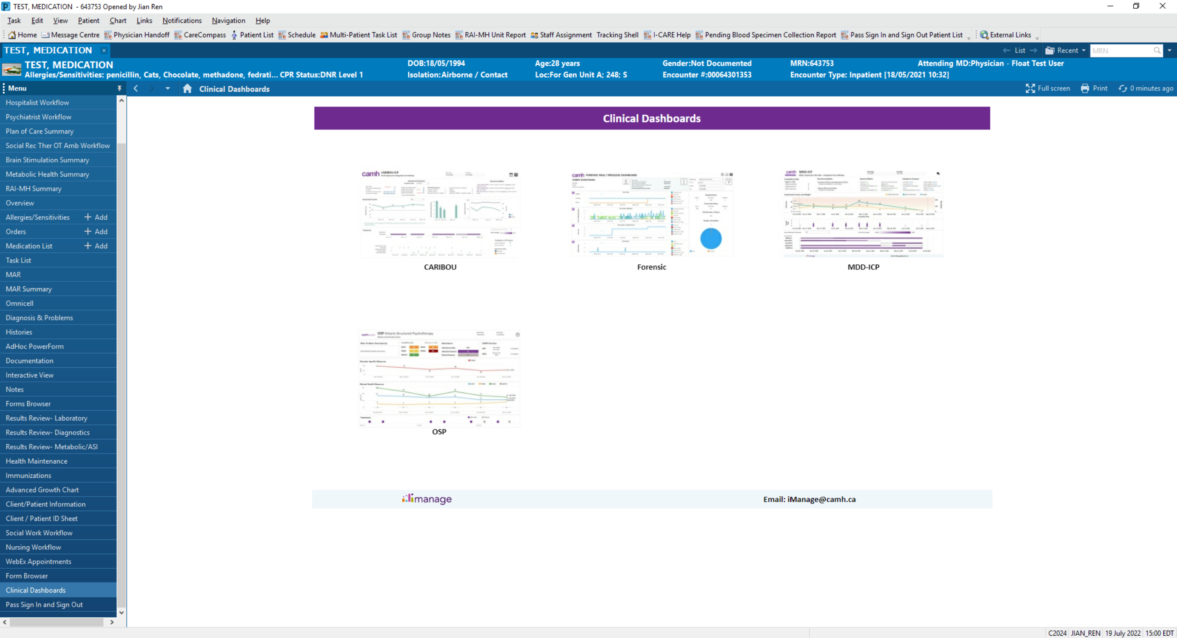
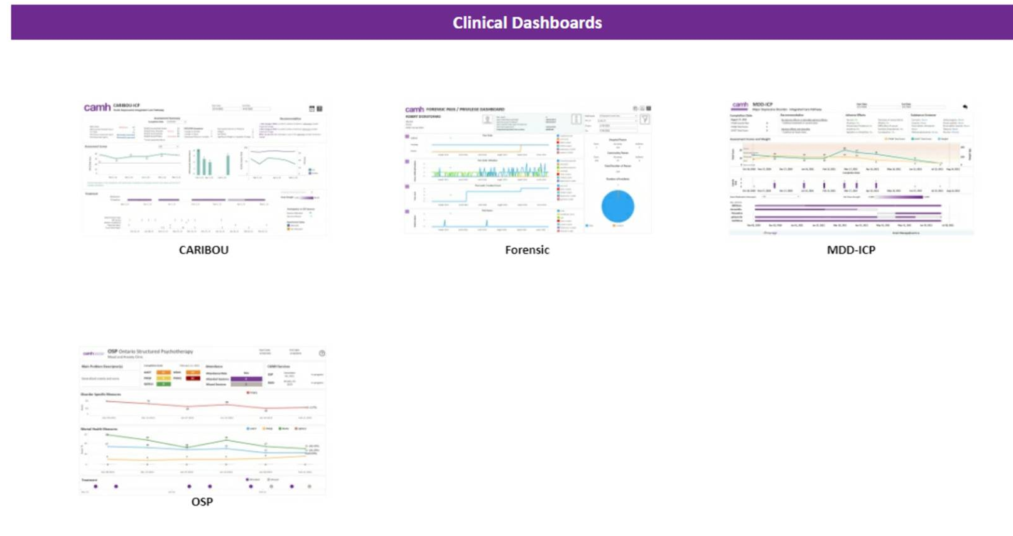
Tableau/CERNER Integration
Clinical Dashboards Landing Page
Measurement-Based-Care Dashboards
Pulls Patient-Specific Content
Notes:
Clinical dashboards displaying the course of treatment of individuals patients can be directly access in their EHR. Multiple pathways are available, and clinicians select the one relevant to their patient flow from a central landing page under “Clinical Dashboards”.

Slide 15
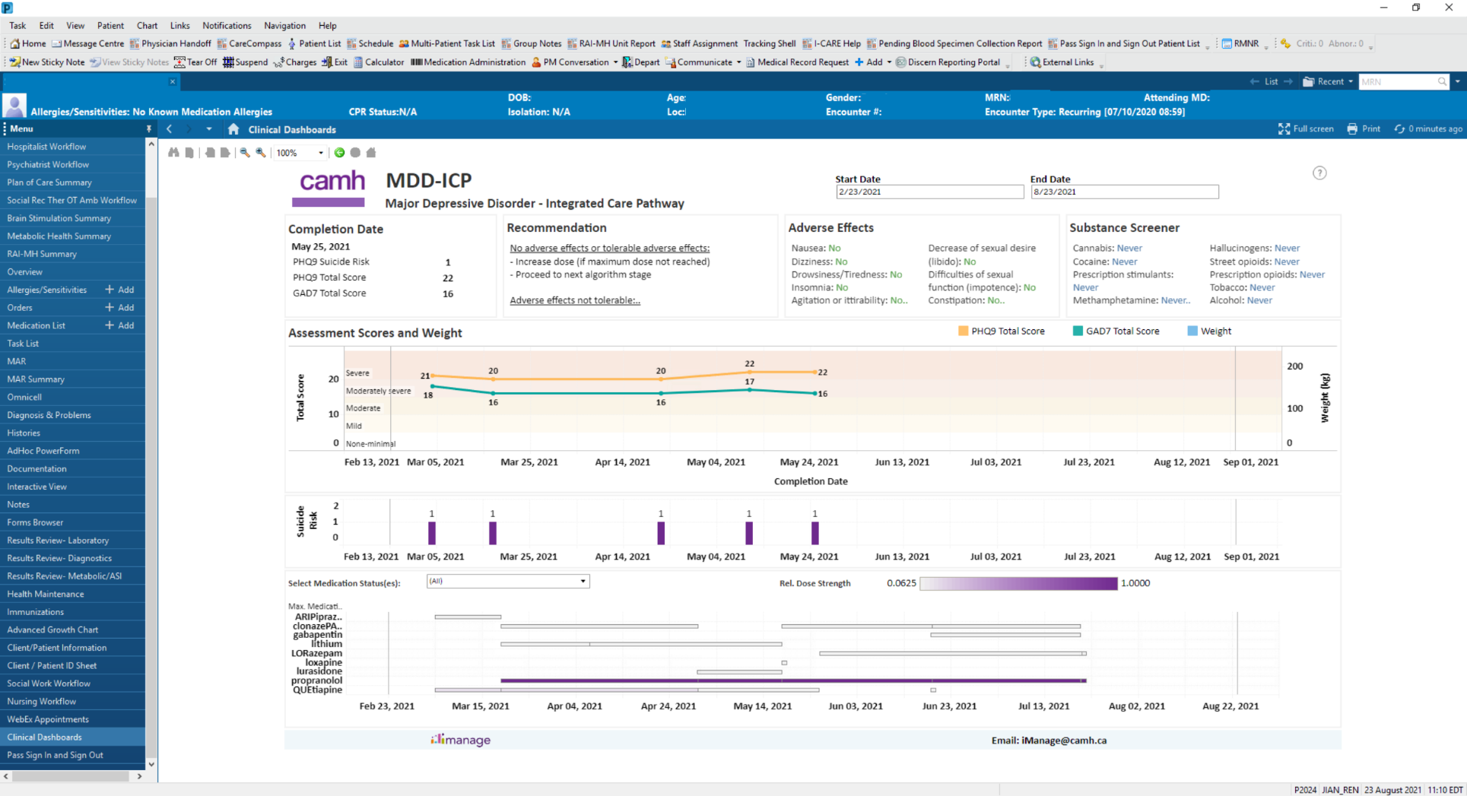
Decision Support Tools
Notes:
Once selected the dashboard automatically shows information for the patient. Clinicians can interact with the dashboard, selecting and reviewing information through the dynamic filters.

Slide 16
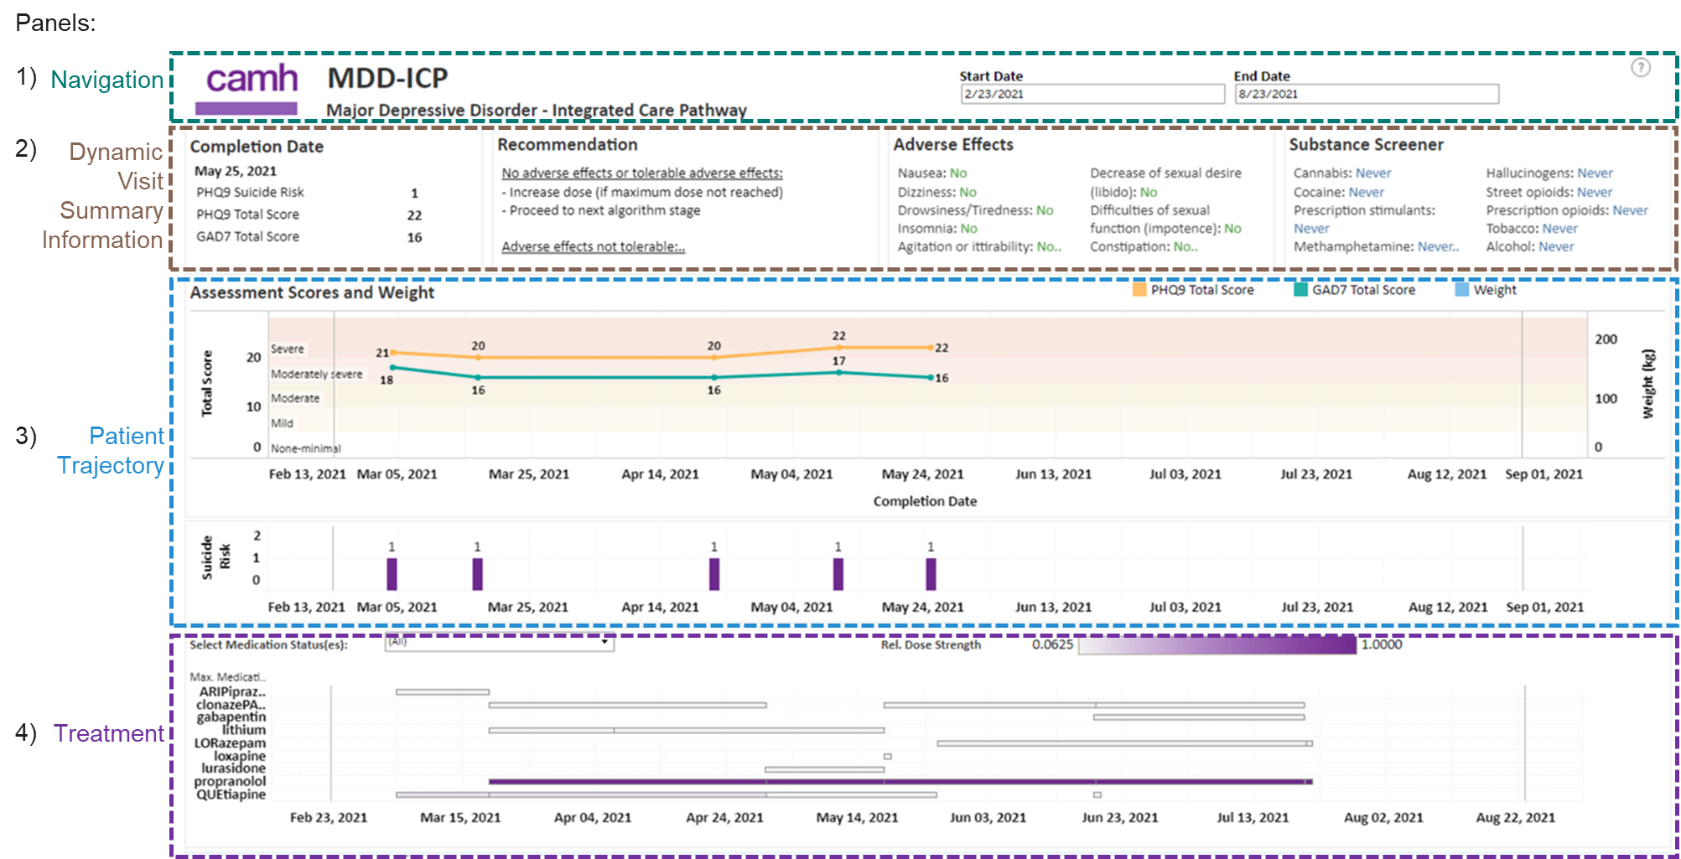
Standardized Structure for Patient-Level MBC Dashboards Integrated with I-CARE
Each of the 4 panels can be customized to specific MBC pathway/program to meet clinician end user needs, see example below.
Notes:
The dashboards were co-developed with patients and clinicians and standardized across pathways. The design consists of three primary panels – Dynamic Visit Summary that provides key information and recommendations; Patient Trajectory showing the trends in relevant measures and suicide risk over time, Treatment, detailing the mode and degree of intervention, typically pharmacological.

Slide 17
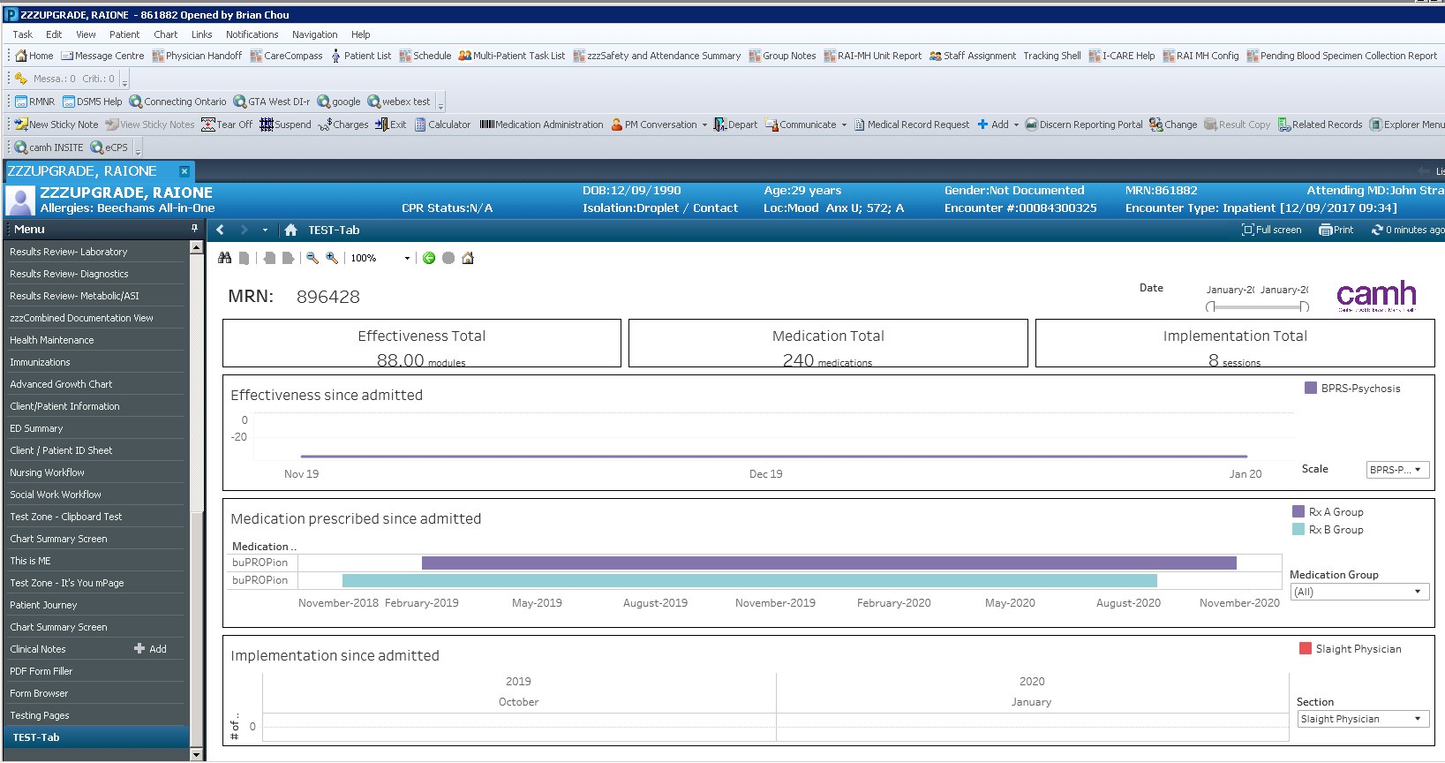
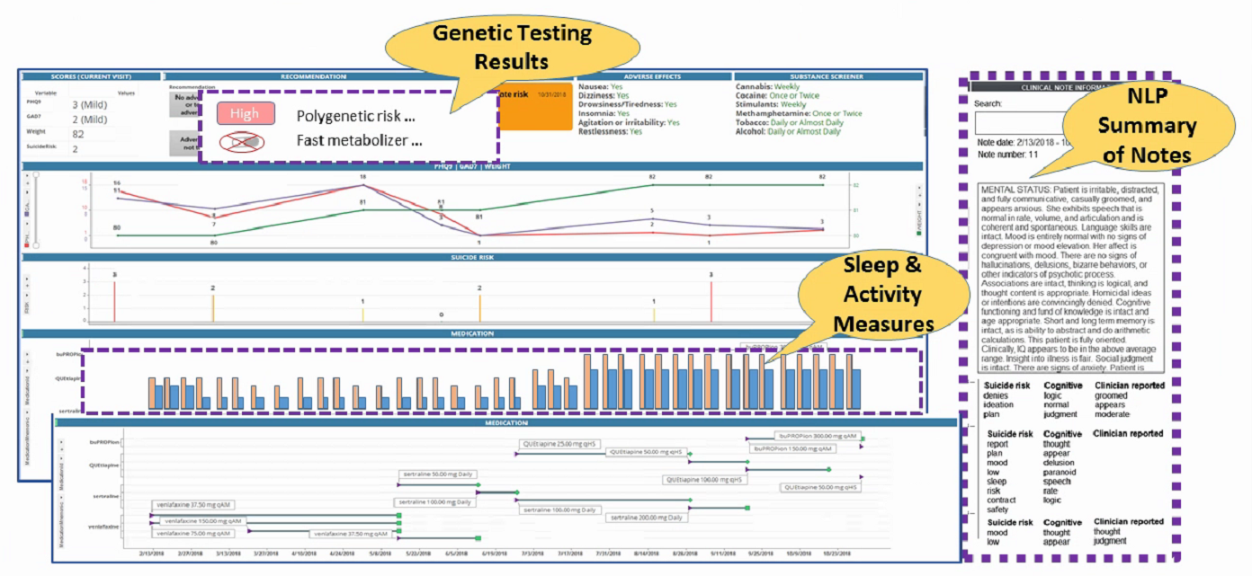
Decision Support Enrichment
Notes:
Based on current clinical research project that occur in parallel, future directions and additional options for the clinical dashboard could include the integration of summarized notes panels leveraging natural language processing, genetic testing and pharmacogenomics results and sleep/activity indicators from wearable devices. Artificial intelligence projects are also underway to provide predictions (e.g. suicide risk, trajectory and treatment response).

Slide 18
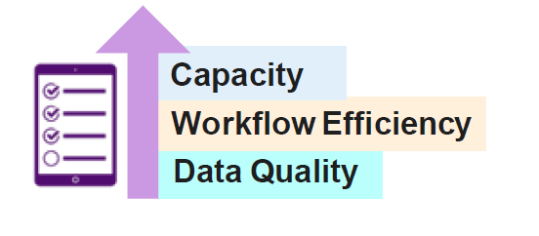
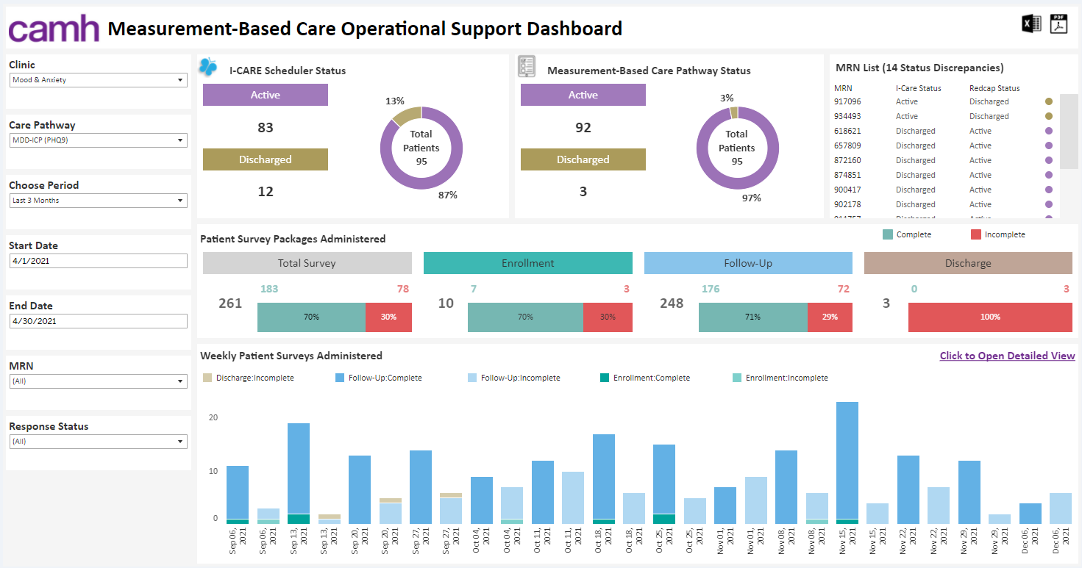
MBC Operational Support Dashboard
MBC Pathway/Program patient flow
Live Dashboard
Notes:
A dashboard was also developed to support MBC operations –providing near real time information on completion of measures and compliance.

Slide 19
Impact on Practice – Clinician Feedback
Great “conversation starter,” as I have an objective reference to rely on. I see it as a guidance not set in stone.
Very efficient! It informs when the patient is ready so I don’t have to guess or go to the lobby and check numerous times.
Provides “progress report” since I may not remember from last appointment. Allows to go back and check.
Did it change my practice? Yes, absolutely! More efficient, pushes me to consider next steps if symptoms linger too long. As a junior staff it actually helped to mitigate anxiety, as allows to see what the next step is. It does NOT diminish clinical judgment, but in complex cases also helped to recognize that something else may be needed (psychotherapy, DBT, brainstim, etc.),
Patient’s accountability. Patients need to re-assess and reflect on changes/progress/lack of progress. Now it’s not only what I think.
19
Notes:
On the next two slides I would like to share some feedback / quotes from clinicians and patients on ICPs, MBC, and experience with dashboards.

Slide 20

Patient Feedback
“Yeah I thought that graphs were really helpful…and…whenever I saw it, I could see the changes in it, and I could sort of tell where they were placed in my own timeline.” -Participant 1
“I struggle with seeing what makes me upset. And so when I look back, I can be like, one week I was really sad… ‘Oh my god, I had three tests that week’… that’s why I was probably not doing so great. So it’s easier when you look back and you look at a graph.” -Patient 2
“After a while, I realized [that] actually tracking if I’m doing well…help[s] me keep track of it, and it kind of made me feel good about myself and just knowing that I’m actually getting better whereas…before I didn’t know…I kind of felt it but I really didn’t know…with the surveys, I actually got like a confirmed answer.” -Patient 3
Notes:
Patient feedback has also been strong, with the visualizations helping to track progress over time.

Slide 21
Acknowledgements

Slide 22



Acknowledgements MDD-ICP
CAMH / UofT
Jeff Daskalakis
Peter Voore
Robert Levitan
Danilo de Jesus
Nazanin Alavi
Ishrat Husain
Alpna Munshi
Yuliya Knyahnytska
Saima Awan
Sarah Waters Schulte
Iman Husain
Muna Osman
ICP Team
Elnaz Haddadi
Jennifer Wilkie
Rachel Solomon
Performance Improvement
Reporting & Analytics
MAAS Team / Management
CAMH Committees
KCNI
Joanna Yu
David Rotenberg
Sean Hill
Adeel Ansari
Farhad Qureshi
Steve Hawley
Nikola Bogetic
Natalia Potapova
Qing Chang
Academic Scholarship Award
Notes:
I would like to thank all individuals and organizations who contributed to this work and thank you for your time.

