Slide 1
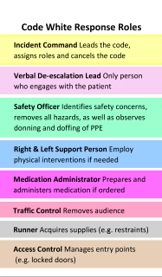
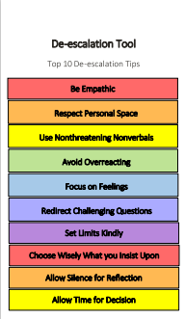
Acute Inpatient Psychiatry Team Learning Challenge (AIP TLC) Simulation Focused Education in Mental Health Health Sciences North (Sudbury, Ontario) Nikki Palangio RN BScN CPMHN©, Ryan Prieur RN BScN, and Traci Franklin MSW
Background: Due to an increase in staff turnover related to the Covid-19 Pandemic, gaps in knowledge, confidence and varying levels of skills were identified on the inpatient unit. Based on learning needs and feedback garnered directly from a staff survey, an innovative education initiative based in simulation was used to teach:
De-escalation techniques
Violence and suicide risk assessments
Recognizing and treating substance withdrawal
Trauma Informed Care
Dealing with Vicarious Trauma for staff
The Sim Event:
Case vignettes focussed on staff’s identified needs
Standardized patients from local medical school trained for accuracy
Multiple room venues, scenarios, and small groups
Guidance from addiction experts regarding substance use and withdrawal
P.E.A.R.L.S. method used for debriefing
Educational packages for each learner contained takeaways for future reference,
Outcomes:
Successes:
Post Survey Ratings noted increased confidence increasing likelihood that behaviour changes will occur in clinical practice, leading to more positive patient experiences and staff outcomes
Staff enthusiasm and genuine interest
Senior and junior staff as well as multi-disciplinary worked together in the scenarios
Challenges:
Staff often pulled from education to front line work due to significant staffing challenges
Goal: Acute Inpatient Psychiatry Team Learning Challenge combined simulation and traditional didactic learning to enhance knowledge, skills, increase self-efficacy, and enhance skills transferred to clinical practice. Simulation based education provides an opportunity for staff to learn and practice new skills in a safe environment, with the aim to:
Reduce future workplace violent events through improved staff response to patients in distress
Model working as a team to manage behaviours and enhance physical and psychological safety for both staff and patients
Future Considerations:
Pre and Post Confidence Rating Scales
Review workplace violent events and staff response to patients in distress via chart audit and qualitative interviews
Qualitative Interviews to ascertain learner’s perceptions of incorporating skills into their practice.
Nikki Palangio: npalangio@hsnsudbury.ca
Ryan Prieur: rprieur@hsnsudbury.ca
Traci Franklin: tfranklin@hsnsudbury.ca

