Slide 1
Data driving quality-based funding for inpatient schizophrenia
November 10, 2022

Slide 2
Overview
Background
  Funding Approaches in Ontario Hospital System
  Introduction of Standardized Data Collection
Movement to Focus on Improvement and Value
Schizophrenia Initiative
  Why Schizophrenia
  Approach
  Early Findings
Next Steps
  Integrated Care

Slide 3

Background

Slide 4
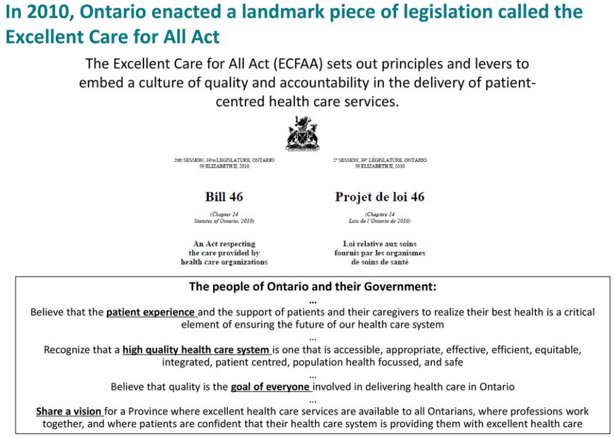
High Quality Health Care System is one that is:
Accessible,
Appropriate
Effective
Efficient
Equitable
Integrated
Patient centred
Population health focused
Safe
Notes:
Imtiaz
1 minute
Start from the beginning; what is the vision for Ontario on its healthcare system?
References:
https://www.oha.com/Documents/OHA%20High%20Performing%20Healthcare%20System%20Paper.pdf
https://slideplayer.com/slide/12251965/

Slide 5
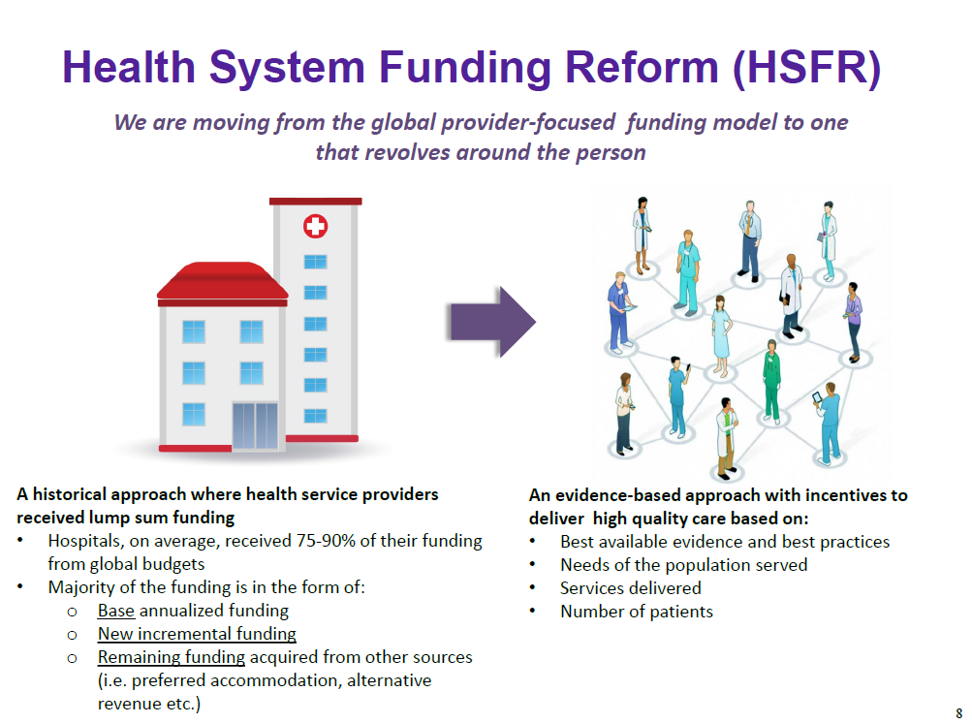
Health System Funding Reform
5
Source: HSFR Governance

Slide 6
Goals: Health System Funding Reform
Reflects needs of the community
Equitable allocation of the health care dollars
Better quality care and improved outcomes
Moderate spending growth to sustainable levels
Adopt/learn from approaches used in other jurisdictions
Phased in over time at a managed pace
Source: HSFR Governance

Slide 7
Ontario’s Patient-Based
Funding Journey
Ontario uses several funding allocations approaches (not mutually exclusive)*:
  Activity-based funding – allocation is primarily based on the volume of services provided while encouraging efficiency
  Performance-based funding – funding is linked to the achievement of specific outcomes (indicators take into account access to care and quality of care)
  Best practice funding – emphasis is on adherence to a clinical procedure – a care protocol and health outcome – that is recognized to deliver quality and efficiency
2004
2007
2008
2012
2015
2018
Wait Times
Strategy (2004)
Activity-based funding initially targeting hip, knee, cancer, cardiac, cataract, MRI, CT
Supported data collection and clinical coaching
Health Based
Allocation Model
(HBAM) (2007)
HBAM approved
in principle
Extensive
international
consultation
Emergency Department (ED) Pay for Results (P4R) (2008)
Pioneer model for P4R in Canada
One-time funding awarded to high volume EDs based on prior year performance on established indicators
Patient-Based
Funding (2012)
HBAM and Quality Based Procedures introduced
Collaborative governance
structure formed
Bundled Care
(2015)
First wave of bundled care launched (further spread in 18/19 to 30+ sites for hip and knee replacement surgery)
Population-Based Integrated Funding
Development of Ontario Health Teams
*Source: Report of the Expert Panel for Patient-Based Funding. Money Follows the Patient: The Implementation of Patient-Based Funding in the Health Sector. Government of Quebec; July 2014.
Notes:
*Note: 2014 report indicates that Quebec had already introduced patient-based funding for elective surgeries
Access to Surgery Program (From “Better Access to Surgery” Technical Report published in 2014)
In general, the funding allocated to participating institutions is the product of the tariff and the number of additional surgeries performed during the fiscal year in question compared with 2002-2003. For each institution, the result may be positive or negative, depending on the change in volumes. It is added to or subtracted from basic funding for surgical output, which continues to be determined using an historical approach. Hospitals that perform these additional surgeries at below-average cost are rewarded for their efficiency, while those with above-average costs are encouraged to reduce their costs to bring them in line with the average.
Results
Improved efficiency as evidenced through shorter lengths of stay
Reduced wait times (most significant decrease – thoracic surgery (-86%) followed by orthopaedic surgery (-31%)) with note that “some people still wait too long”
The current program does not use quality indicators to determine payment
Best Practice Funding
The goal is to structure and price best practice tariffs to adequately reimburse care that is high quality and cost effective, while linking the tariff to compliance with protocols. Best practice funding can meet different objectives:
— encourage the use of a less invasive approach (for example, day surgery instead of hospitalization);
— streamline the care pathway (for example, by reducing the number of appointments after surgery or improving coordination);
— increase the provision of high-quality care based on the evidence available (for example, by encouraging care providers to use recommended clinical interventions when treating patients in order to ensure appropriate patient selection and increased diagnostic efficiency). On this subject, see Section 3 on the Québec Colorectal Cancer Screening Program.

Slide 8
How are hospitals currently
funded in Ontario?
Post Construction Operating
Plan (PCOP)
11%
Priority
Programs and Critical Care
11%
Bedded Capacity
1%
Quality Based Procedures (LHIN-managed)
7%
Quality Based Procedures
(CCO-managed)
7%
Activity Based
Growth and Efficiency Model (GEM)
25%
Non-targeted
Wait Times
1%
CCO Non-QBP Funding
3%
Bundled Care
(subset of QBPs)
1%
Patient Based Funding
Performance Based
Linking Quality to Funding
Evaluation in Progress
Non-targeted
ED Pay for Results (subset of Wait Times)
<1%
Non-targeted
Global and Other Funding
33%
Non-targeted
Global and Other Funding
Global and Other Funding
33%
Non-targeted
Notes:
Imtiaz
1 minute
Funding in Ontario via hospitals and funding for psychiatric services in hospitals

Slide 9

Introduction of Standardized Data Collection

Slide 10
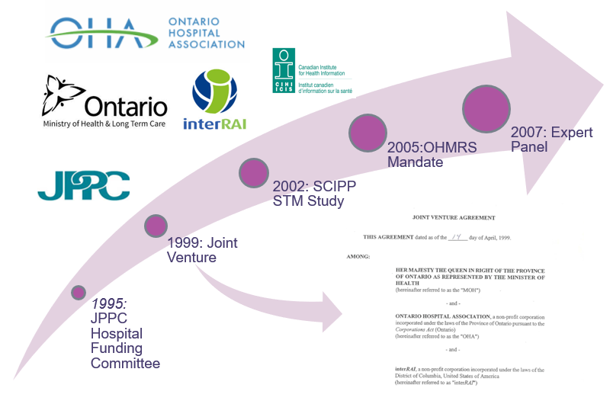
Evolution of Ontario’s Mental Health Patient Classification System and its associated weights
Notes:
Imtiaz
~1 minute
History of the work on understanding inpatient mental health

Slide 11
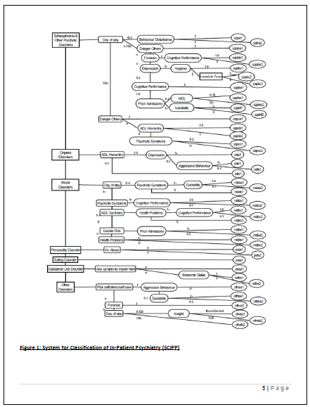
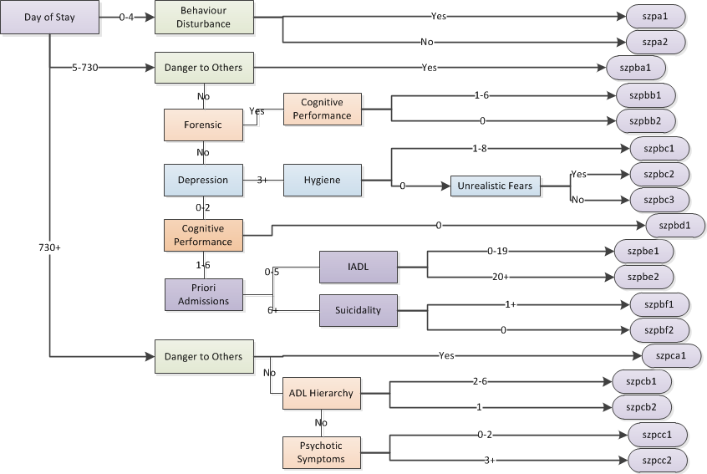
SCIPP Groups: Schizophrenia & Other Psych
11

Slide 12
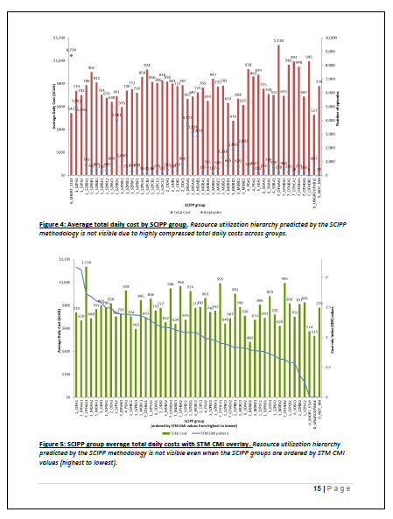
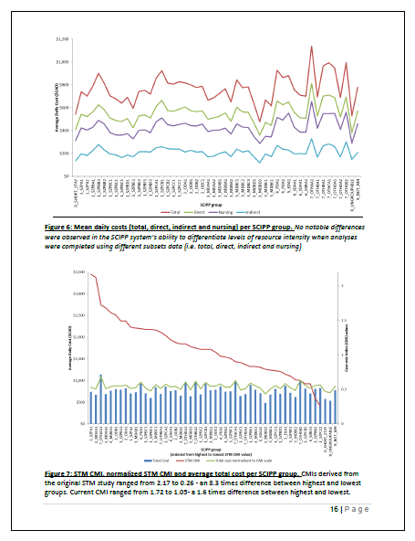
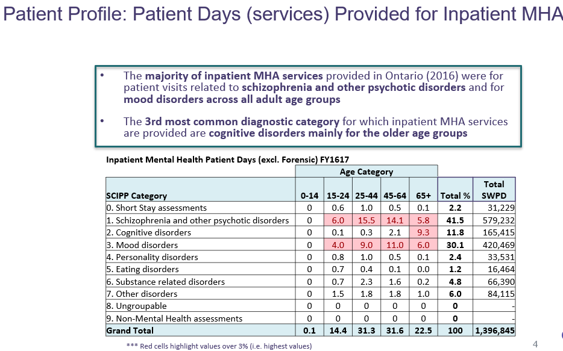
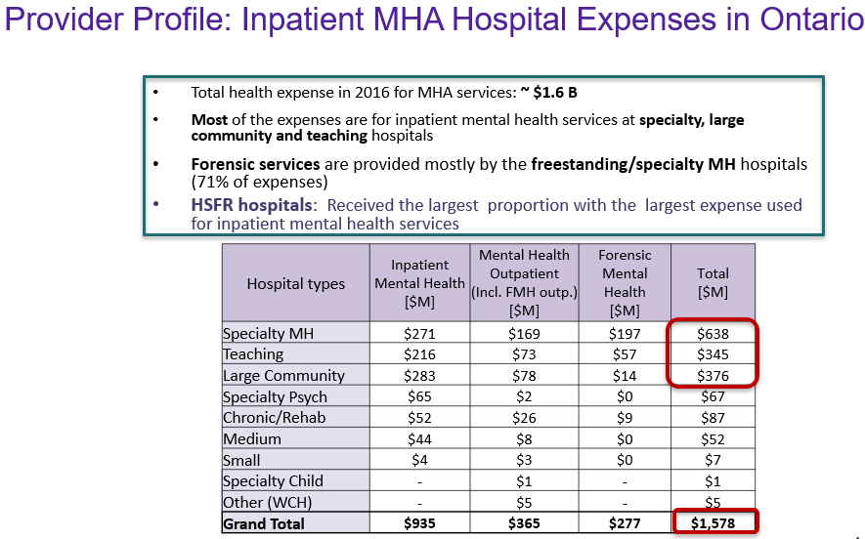
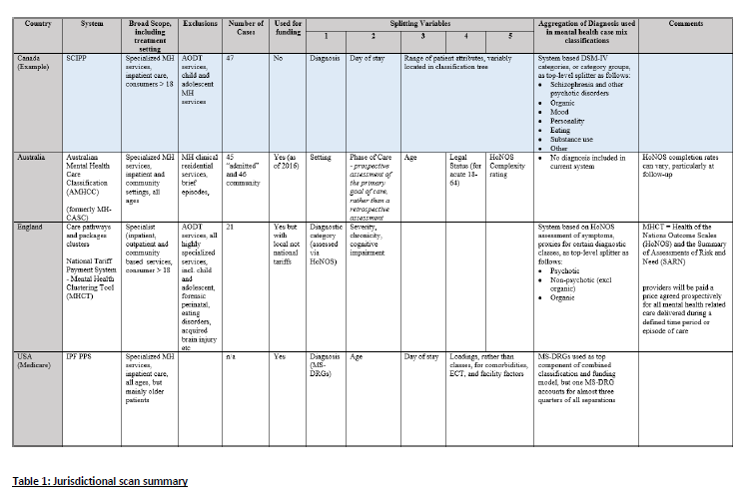
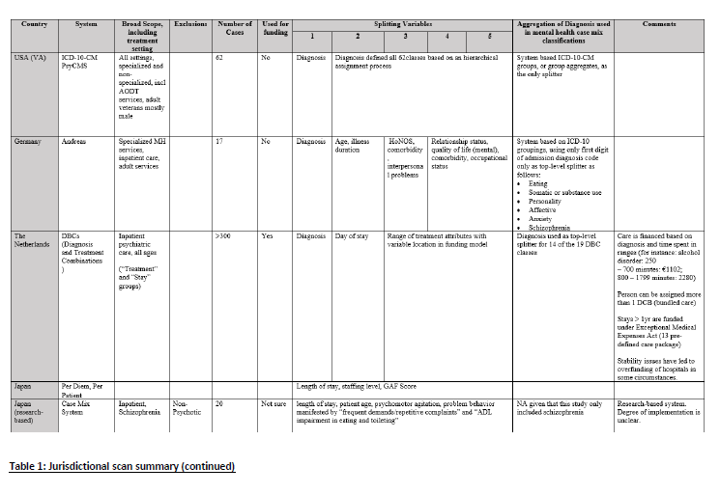
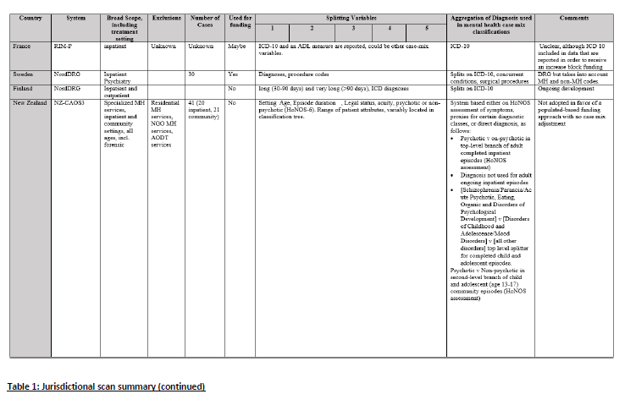
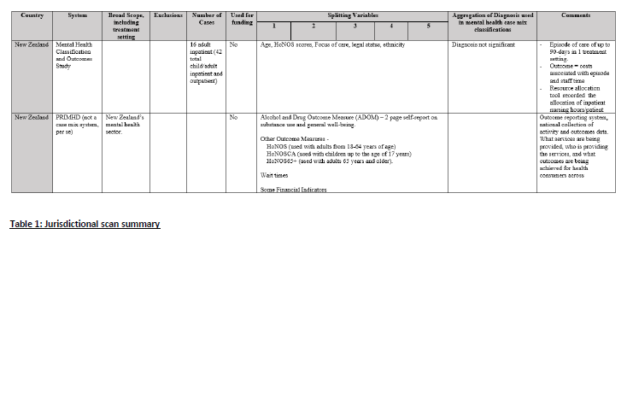
Exploration of Ontario’s Inpatient Mental Health Funding

Slide 13
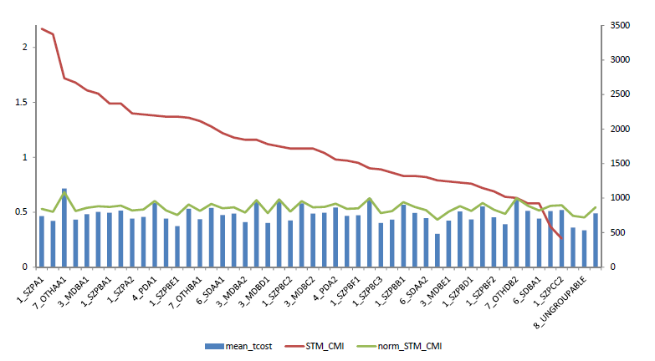
Ontario cost data does not differentiate resource use across case-mix groups (Technical Working Grp)
Case-mix grouping and related weights should help differentiate resource use (i.e. mean total costs, CMI weights) across groups.
The original STM study CMI would suggest a relative CMI difference 0.7 (from 2.2 to 1.5 = ~40%) [red line]
Actual resource utilization from reported data suggests no relative difference between the two groups [green line]
Expected STM results are different from reported data across all SCIPP groups
Mean Total Cost ($)
Case-mix index (weight)
Reference:
Inpatient Mental Health Funding Task Group Report (2017)
Notes:
Similar to the findings of the JPPC back in 2008, the Technical Working Group observed that the CMIs based on patient-level costing only dramatically reduced the ability of the SCIPP system to differentiate levels of resource intensity.
More, comprehensive, research is needed to understand the relationship between the needs of persons with mental illness and their costs of care.

Slide 14
Inpatient Mental Health Funding Task Group (IMHFTG) Directional Recommendations (2017)
  Recommendation 1:
  Partnering with various subject matter experts within the health system, develop a strategy to create an appropriate mental health case-mix system and its associated weights.
  Recommendation 2:
  Develop a strategy to improve data quality and reporting of OHMRS and patient-level costing data for mental health.
  Recommendation 3:
  In the short-term, focus on the field’s adoption of Health Quality Ontario’s quality standards for mental health and explore potential future use for funding.
  Recommendation 4:
  To ensure continued progress and accountability, link the oversight of a mental health funding strategy to the mandate of a provincial council such as the OHA’s Mental Health and Addiction Provincial Leadership Council.

Slide 15


OHA’s 2018 Improving Quality of Care for Mental Health
Patients through Funding Methodologies conference
Please click on this link to access the PDF version of the proceedings.
Notes:
Imtiaz
~1 minute
Introduce the international conference we had with numerous jurisdictions on funding for mental health services
https://www.oha.com/Documents/2018%20Mental%20Health%20Funding%20Methodologies%20Conference%20Proceedings%20-%20Final%20Report.pdf

Slide 16
Shared learnings on mental health funding methodologies
Need strong leadership to take responsibility for the strategic development, implementation, and evaluation to carry through mental health and addictions funding
Funding methodologies and service deliveries should incorporate the continuum of care; it is a way to tie hospitals and communities together
Great desire to pay for value and quality in mental health and addictions services
There is a need to address on data standards and quality throughout the continuum of care in order to consolidate at a system-wide level.
Notes:
Imtiaz
~1 minute
Learnings from the international conference
1. Page 83 “Frank (Germany): There was an impressive level of engagement and stakeholder representation assembled here for the last two days. The false start is a part of the game; Ontario has high skill level, but needs someone to take responsibility and leadership. Figure out what you want to do, restrict yourself, implement, and evaluate. Political leaders, such as the Ministry of Health and Long-Term Care, need to be at the table.”
Imtiaz (OHA): "I heard a lot about voodoo, and it feels like the mental health system has a bit of voodoo going on." I have heard that we need a vision for improvement initiatives with limited resources, and a proper accountability mechanism. For example, Robert's NHS [England] chose to focus on IAPT, decided what the indicators were, and developed a process to implement. Ontario has the ingredients, but lacks a strategist to get to that goal. The recent Ministry-struck group led by Dr. Devlin is a starting point, and we need today's discussion to feed into that.”
2. Page 82: Jacob (PCSI): PCSI has always tried to create a platform to share information with others around the world, especially in regards to mental health case-mix systems. This conference allowed for plenty of time to present what was done in each country, and I hope that these two days will plant a seed for further discussion on how to develop our systems. From the perspective of integrated care, we have to find a way to bring the community and the hospitals together, and that includes funding methodologies, not just service delivery.
Jeff (CIHI): There are a couple of key questions that stand out: who is accountable for the patient across the continuum of care? What are the problems that we are trying to solve, and what are the solutions for that? We need evidence to support our decisions, such as a minimum dataset across the province. Tying the data-streams together across the [hospital and community] continuum will help us come up with solutions to move things forward in Ontario.
Joanne (Australia):…If you only focus on admitted patients, then you're building a hospital-based structure and service delivery. Although exploring the community-based services may be hard and challenging, that is where the benefits and gains will be, and where we need innovation and transformation with funding methodologies.
3. Page 8 – summary of the IMHFTG 2017? – Joanne (Australia): We also had a slow start on our [Australia's] mental health classification system,
but have made huge strides over the last few years. I agree with Frank [Heimig], "buy standards, not outcomes" and a key lever may be to figure out how to pay hospitals to receive cost data. (Page 82)
4. Page 62 - The current state of MHA data in Ontario is messy. There is not a lot of consolidation and uniformity, and there are many sources where data is captured – especially in the community sector. Dr. Kurdyak remarked on how the MHA sector is especially bottom-up, developed organically, which makes these data processes harder to consolidate at a system-wide level. There are a number of data initiatives currently underway. Hence, Dr. Kurdyak warned that stakeholders have to be careful not to misalign, or they will run the risk of further duplication and redundancy on top of an ever-increasing documentation burden.
Page 84 - Jacob: The Netherlands has introduced care standards that will be applied on a regional setting to individual patients, and part of these quality standards is an information standard that specifies data definitions. Eventually, we will want to create clinical pathways that can lead into an individual, integrated care plan for the patient that is coordinated by the region. FAIR data standards ("findable, accessible, interpretable, and reproducible") allows for better access, which can be used to close gaps that currently exist.

Slide 17

Movement to Focus on Improvement and Value

Slide 18


New Momentum for Value-Based Care in Mental Health
The Mental Health and Addictions Funding Initiative is coordinated through the OHA and HAC to explore funding approaches that support and incentivize improved quality of care for Ontarians. It has two key priorities:
  Given the high volume of inpatient activity related to patients with schizophrenia, the Initiative is exploring approaches to linking hospital and community-based quality standards to funding with an emphasis on assuring improvement in quality of care, and
  Developing a strategy to ensure concordance to the quality standards can be measured.
Notes:
As we've seen in other parts of the health system, there must be a new approach to funding to incentivize value and ensure providers are appropriately funded.

Slide 19
Mental Health Initiatives to improve value & quality of care
Hospital Advisory Committee
Mental Health and Addictions Funding Advisory Committee
MHA Quality Standards Funding Working Group
MHA Administrative Data Quality Working Group
Schizophrenia Integrated Care Initiative Steering Committee
Clinical and Technical Working Group(s)
MHA Case Mix Working Group
Southlake Community OHT
Greater Hamilton Health Network
Ontario Shores/SHN/CMHA Durham Partnership
Central OHT for Specialized Populations
Notes:
As the Ontario health system transforms, the re-convened Hospital Advisory Committee (HAC) established with an Advisory Committee and three working groups to move forward with the four IMHFTG recommendations. They will advise the HAC on approaches for patient-based funding models for mental health and addictions

Slide 20
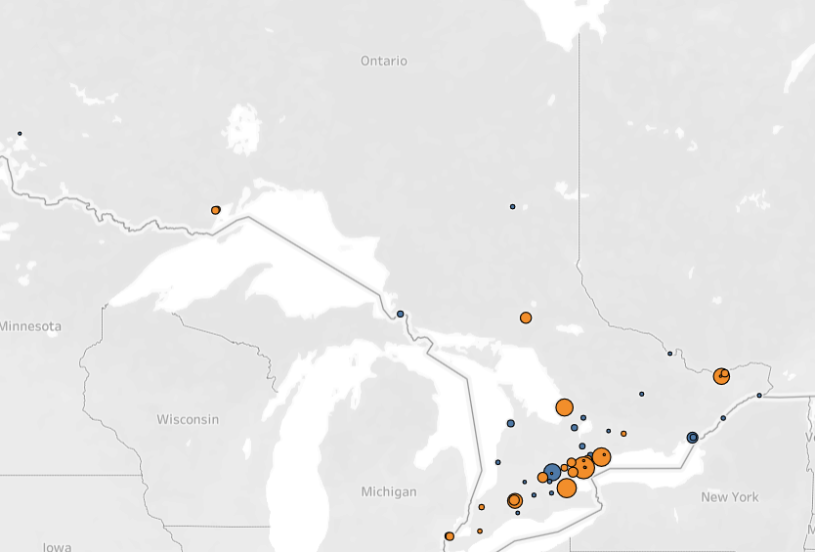
Advisors to the Initiative
There are 121 members involved in the initiatives:
  Membership include a mix of 23 hospitals, community mental health organizations, OH, MoH, and academic institutions.
  Four networks composed of 3 OHTs and one hospital-community partnership are developing the prototype model for the Schizophrenia Integrated Care Initiative
Yellow: Participating hospitals
Size of bubble dependent on MH&A activity
Notes:
As the Ontario health system transforms, the re-convened Hospital Advisory Committee (HAC) established with an Advisory Committee and three working groups to move forward with the four IMHFTG recommendations. They will advise the HAC on approaches for patient-based funding models for mental health and addictions

Slide 21

Why focus on Schizophrenia Care?
Notes:
Imtiaz
1-2 minutes
Before diving deeper into our approach, I want to highlight why we started with schizophrenia care
Schizophrenia is a severe mental illness (SMI) characterized by a range of symptoms, including positive symptoms, such as delusions and hallucinations; negative symptoms, such as withdrawal and amotivation; and cognitive symptoms, such as memory deficits.
Schizophrenia incurs a substantial burden of disease in terms of lifetime costs, employment, health, and social well-being.
Indirect costs, such as productivity losses related to absenteeism, presenteeism, and premature mortality, contributed to at least half (50%-85%) of the total costs estimates
Schizophrenia is in the top 20 causes of years lived with disability and is the most prevalent SMI.
People with SMI face higher rates of premature mortality than the general population, typically dying 10 to 20 years earlier largely due to preventable comorbid physical diseases, such as cardiovascular disease.
People with schizophrenia have increased morbidity and reduced quality of life due to several factors: comorbid physical and mental health problems, cognitive impairment, social exclusion (stigma and discrimination), side effects from treatment, and reduced opportunities related to work and education.
Caregiver burden is significant, resulting in illhealth in caregivers, reduced time for other activities, and reduced well-being.
Indirect costs, such as productivity losses related to absenteeism, presenteeism, and premature mortality, contributed to at least half (50%-85%) of the total costs estimates – maybe closer to 70% in Canada in 2005.

Slide 22
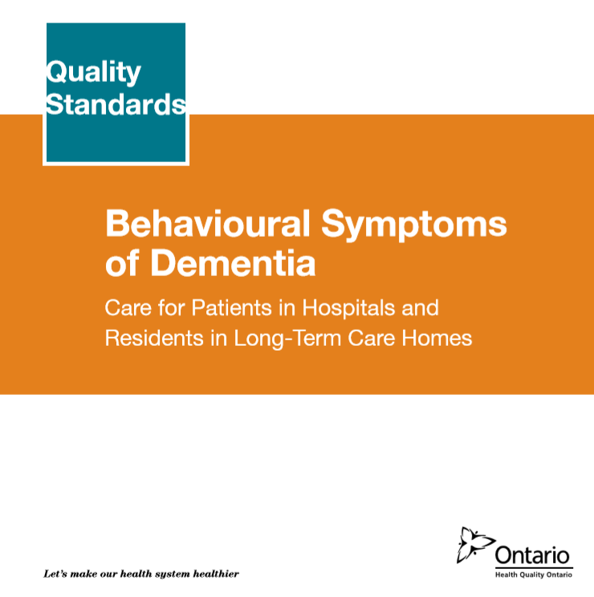
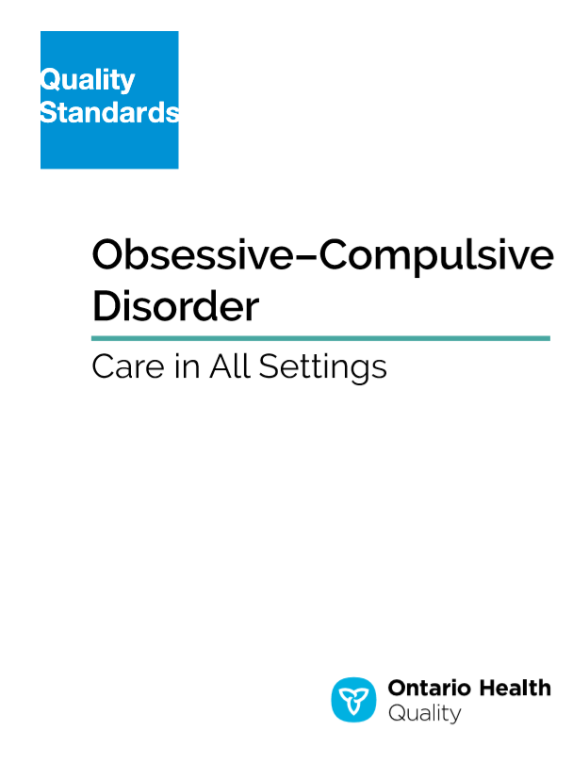


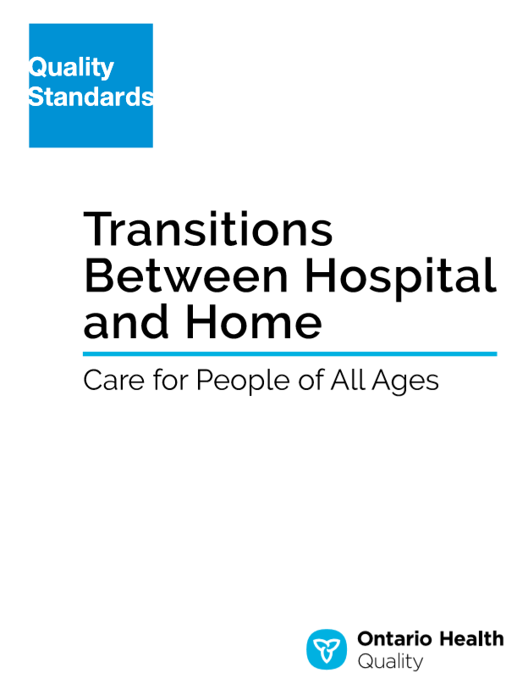



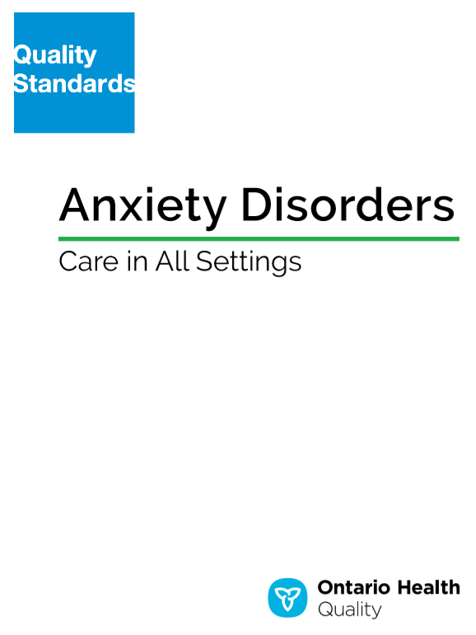

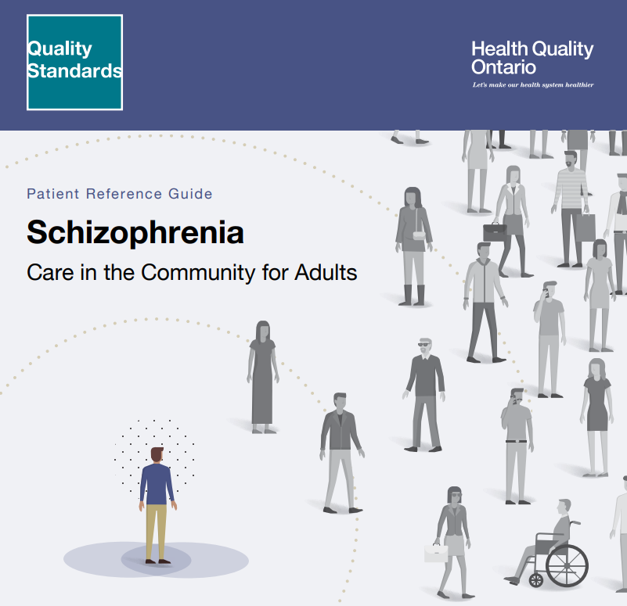
Ontario Health Quality Standards for mental health and addictions
Notes:
Imtiaz
1 minute
So the group had to think of how to develop a way to link quality to funding, starting with schizophrenia care. It had to be a model that could be potentially scaled across other quality standards in mental health and beyond.

Slide 23
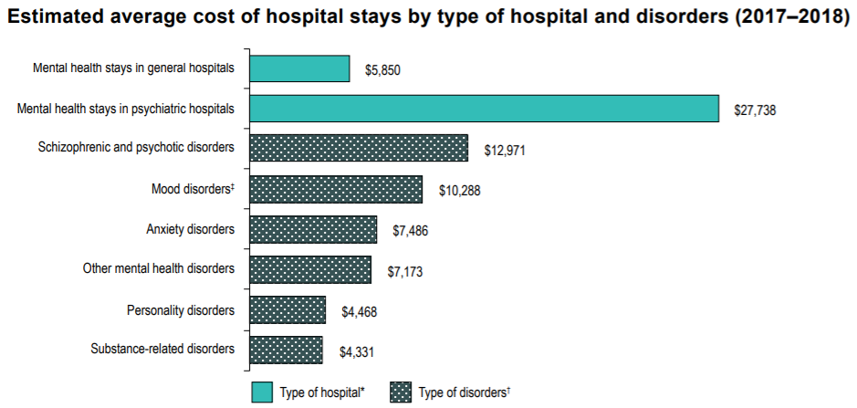
50% of cost for hospital stays related to mental health are for services that help patients with schizophrenia and psychotic disorders.
Source: CIHI
Patients diagnosed with schizophrenia
Schizophrenia, schizotypal and delusional disorders were listed as top 10 high-volume inpatient hospitalizations with the longest average length of stay
Province | Rank | Most responsible diagnosis for inpatient hospitalizations in 2020–2021 | Number of inpatient hospitalizations in 2020–2021 | Percentage* of inpatient hospitalizations in 2020–2021 | Average acute† length of stay of inpatient hospitalizations in 2020–2021
Ont. | 1 | Giving birth | 131,753 | 13.2 | 1.9
 | 2 | Heart failure | 24,790 | 2.5 | 8.3
 | 3 | Acute myocardial infarction | 23,009 | 2.3 | 4.4
 | 4 | Osteoarthritis of the knee | 19,931 | 2.0 | 1.8
 | 5 | Mood (affective) disorders | 19,810 | 2.0 | 10.7
 | 6 | COVID-19 | 18,506 | 1.9 | 10.8
 | 7 | Schizophrenia, schizotypal and delusional disorders | 17,342 | 1.7 | 14.3
 | 8 | Neurocognitive disorders | 17,198 | 1.7 | 13.6
 | 9 | Other medical care (e.g., palliative care, chemotherapy) | 15,720 | 1.6 | 7.7
 | 10 | COPD and bronchitis | 15,239 | 1.5 | 6.4
Age group | Rank | Most responsible diagnosis for inpatient hospitalizations in 2020–2021 | Number of inpatient hospitalizations in 2020–2021 | Percentage* of inpatient hospitalizations in 2020–2021 | Average acute length of stay of inpatient hospitalizations in 2020–2021
18–64 | 1 | Giving birth | 342,775 | 25.1 | 2.1
 | 2 | Substance use disorders | 47,509 | 3.5 | 4.9
 | 3 | Schizophrenia, schizotypal and delusional disorders | 39,311 | 2.9 | 16.4
 | 4 | Mood (affective) disorders | 33,485 | 2.5 | 11.3
 | 5 | Diseases of the appendix | 27,136 | 2.0 | 2.0
This mental health condition was also third most prevalent for age group 18-64 in Canada
Notes:
Imtiaz
1 minute
In Canada, schizophrenia is listed as one of the top 10 most responsible diagnosis for inpatient hospitalizations. It is the third most prevalent condition for all inpatient hospitalizations between ages 18-64, and 50% of the cost for hospital stays for inpatient mental health are for people admitted for schizophrenia.

Slide 24
Identifying Inpatient Mental Health services in hospital
The majority of inpatient MHA services provided in Ontario (2018) are for patient visits related to schizophrenia and other psychotic disorders and for bipolar and depressive disorders across all adult age groups
The 3rd most common diagnostic category for which inpatient MHA services are provided are neurocognitive disorders mainly for the older age groups
Inpatient Mental Health Patient Days (excl. Forensic) FY1819
 | Age Category
CIHI SCIPP Category (DSM-V) | 0-14 | 15-24 | 25-44 | 45-64 | 65+ | Proportion of Total Patient Days | Total Patient Days
0. Short Stay assessments | 0.0 | 0.8 | 1.2 | 0.5 | 0.1 | 2.6 | 33,650
1. Schizophrenia and other psychotic disorders | 0.1 | 6.6 | 16.7 | 13.8 | 5.7 | 42.9 | 554,861
2. Neurocognitive Disorders | - | 0.1 | 0.3 | 2.5 | 8.2 | 11.1 | 144,042
3. Bipolar and Depressive Disorders | 0.1 | 4.3 | 9.7 | 10.8 | 5.7 | 30.6 | 396,072
4. Personality disorders | 0.0 | 0.8 | 1.0 | 0.4 | 0.1 | 2.3 | 29,910
5. Feeding and Eating Disorders | 0.1 | 0.4 | 0.4 | 0.1 | 0.0 | 1.0 | 12,661
6. Substance-Related and Addictive Disorders | - | 0.9 | 2.7 | 1.6 | 0.2 | 5.3 | 68,685
7. Other disorders | 0.1 | 1.0 | 1.4 | 1.1 | 0.6 | 4.2 | 54,187
9. Not mental health | - | - | - | - | - | - | -
Grand Total | 0.3 | 14.9 | 33.3 | 30.8 | 20.7 | 100 | 1,294,068
Notes:
Imtiaz
1 minute
We see this in the Ontario context as well. Almost 50% of costs for mental health hospital stays come from patient with schizophrenia and other psychotic disorder, ($13K to $28K) as seen on this graph.

Slide 25
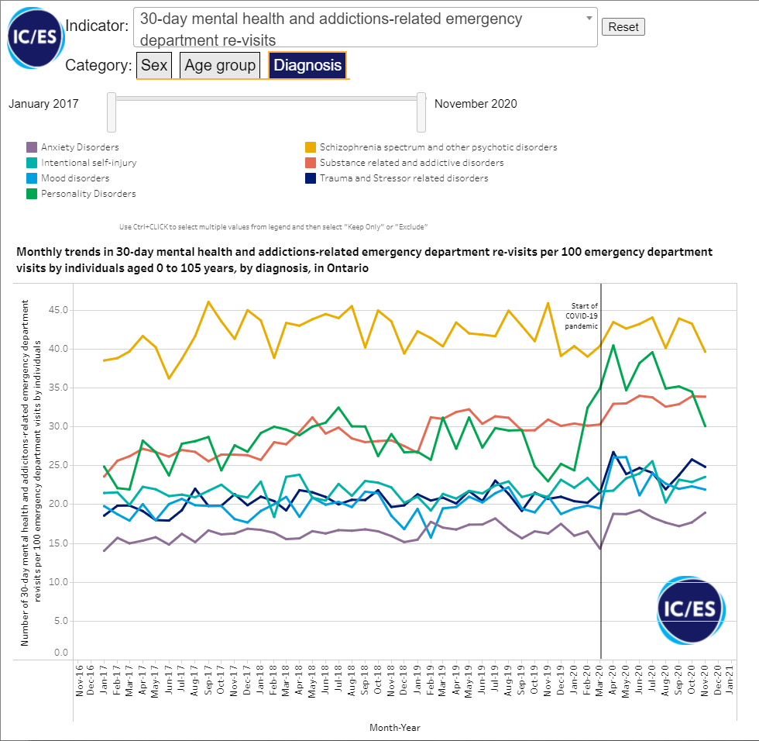
30-day ED department re-visits for Schizophrenia in 2020
Over 40 ED patients per 100 in Ontario return after 30-days for schizophrenia care.
Notes:
Imtiaz
1 minute
Even from 2017 onwards, over 40 ED patients per 100 in Ontario return to the ED after 30 days due to schizophrenia.

Slide 26
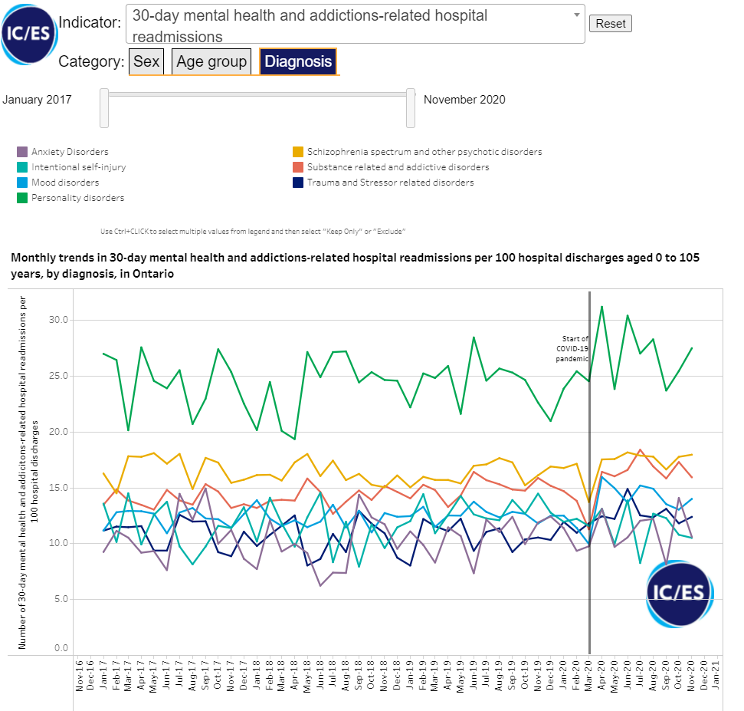
Schizophrenia Readmissions
Approximately 17% of Schizophrenia Patients are readmitted within 30-days.
One of the highest readmissions for MHA related hospital readmissions
Notes:
Imtiaz
1 minute
We consistently see that they are one of the highest readmissions for MHA related hospital readmissions
. Approximately 17% of Schizophrenia Patients are readmitted within 30-days.

Slide 27


Exploring how to link quality to funding in MHA
Notes:
Imtiaz
1 minute
Members identified a funding methodology and a framework to adapt the model. The next step would be to create a consensus-based measurement approach to the model. The focus was to measure quality of care based on the standards.

Slide 28
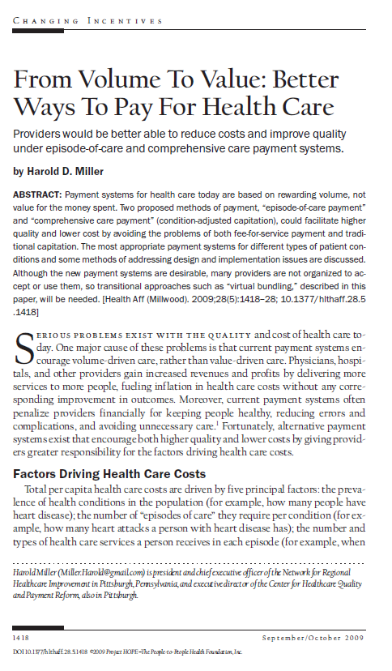
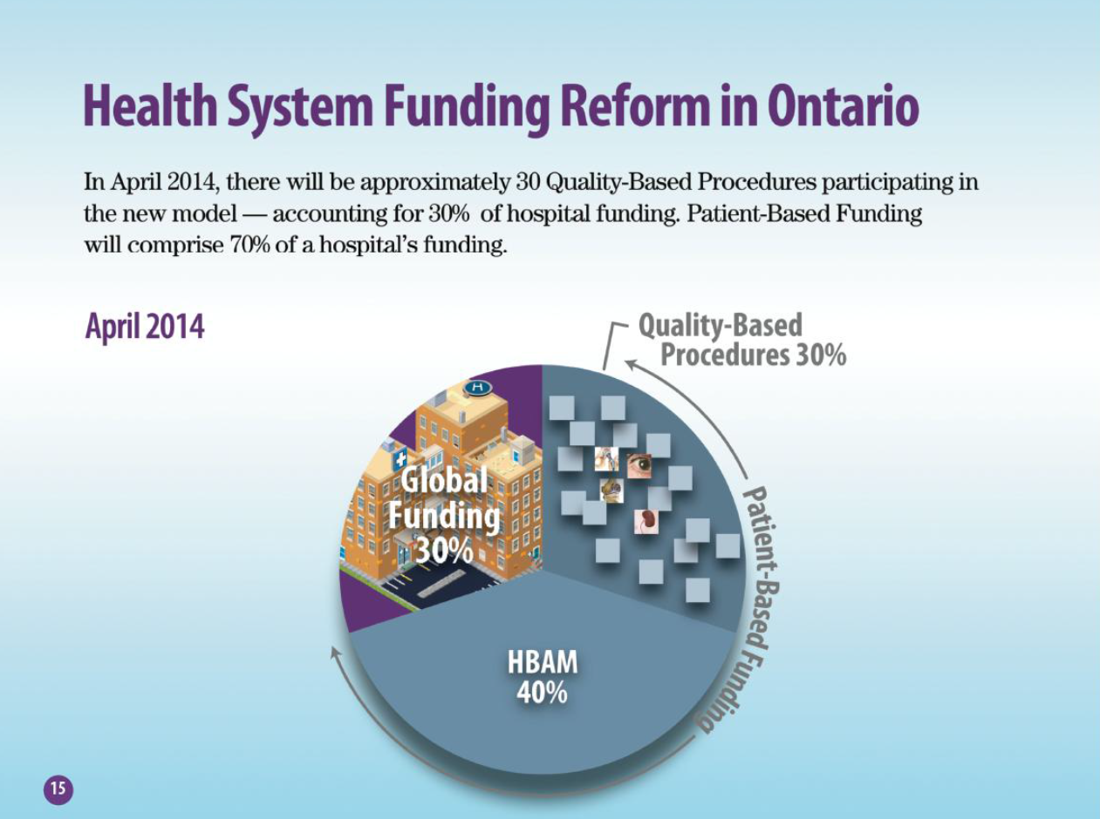

Evolution of funding approaches: from volume to value-based healthcare
Patient Based Funding
Miller HD. From volume to value: better ways to pay for health care. Health Aff (Millwood). 2009 Sep-Oct;28(5):1418-28. doi: 10.1377/hlthaff.28.5.1418. PMID: 19738259.
*“Aligning Outcomes And Spending: Canadian Experiences with Value-Based Healthcare” Canadian Foundation for Healthcare Improvement, August 2018
Global and Other Funding
Performance Based
Activity Based
Un-targeted
Targeted
Targeted
Global
Volume
Value

Slide 29
Supporting Value and Improving Patient Outcomes
Outcomes that Matter to Patients
Value*
=
Costs Throughout the Patient Journey
Measurement of outcomes needs to be connected to a strong quality improvement approach.
If an Integrated Care Funding Model is to improve patient outcomes, funding for quality of care requires a strong performance management infrastructure that includes:
  Reporting
  Benchmarking
  Targeted Management
  Prioritizing change ideas for improvement and providing coaching, if required
  Audit and Feedback
The process will be an iterative and phased approach to incorporate lessons learned.
* “lays out a breakthrough framework for redefining health care competition based on patient value”
*“Aligning Outcomes And Spending: Canadian Experiences with Value-Based Healthcare” Canadian Foundation for Healthcare Improvement, August 2018
Notes:
Imtiaz
1 min
This is only the beginning to supporting value and improving patient outcomes. We still have much to do for mental health and addictions.
Value-based purchasing (VBP) and pay-for-performance (P4P) systems established to improve quality, safety, efficiency, and the overall value of healthcare.
Links quality, performance and payment.
Fundamental characteristics are measurement, transparency and accountability
In the US, the drivers are IOM’s reports on quality, safety and need to have new payment systems to improve.
In Ontario, P4R was established to reduce nonurgent patients’ wait times in EDs.
Achieving the goals of VBP/P4P depends on the design and implementation.

Slide 30
Approaches for Paying for Quality
Requires development of a generic patient pathway to identify resources to create the avg. cost of care;
Develop the care model and identifying recommended practices, including a review of the evidence;
Develop performance indicators to measure the care delivered.
Quality-Based Procedures
Bundle Care Payment
Payment for Results
Selection of performance indicators to incentivize a desired outcome
Thresholds to be developed
Methodology to rank performance and allocate funding based on relative performance.

Slide 31
Payment for Results - Ontario ED P4R
Rewards hospital sites for both continued performance improvement as well as sustained high performance.
The hospitals are ranked annually against peers on six indicators:
    Length of Stay in Emergency for All Patients Admitted to Hospital;
    Length of Stay in Emergency for High-Urgency Patients Not Admitted to Hospital;
    Length of Stay in Emergency for Low-Urgency Patients Not Admitted to Hospital;
    Time to First Assessment by a Doctor; in Emergency for All Patients;
    Time to In-Patient Bed; and
    Ambulance Offload Time

Slide 32
The development of the MHA Pay for Quality (P4Q) funding methodology
We conducted a modified Delphi process to select quality statements and its indicators to measure performance to be used in MHA P4Q funding approach
11 quality statements, 22 indicators
4 quality statements, 8 indicators
4 quality statements, 4 indicators
Notes:
Imtiaz
1 minute
The process of identifying the quality indicators to start with measuring and considering for linkage to funding was a collaboration that had clinical input, advice from decision support and administrative programs, and considerations highlighted even those external to the committee.
The Committee and Working Groups reviewed

Slide 33

Schizophrenia Care in Hospital - Quality Statements (in brief)
Quality Statement 1: Comprehensive Interprofessional Assessment
Adults who are admitted to an inpatient setting with a primary diagnosis of schizophrenia undergo a comprehensive interprofessional assessment that informs their care plan.
Quality Statement 2: Screening for Substance Use
Adults who present to an emergency department or in an inpatient setting with a primary diagnosis of schizophrenia are assessed for substance use and, if appropriate, offered treatment for concurrent disorders.
Quality Statement 3: Physical Health Assessment
Adults who are admitted to an inpatient setting with a primary diagnosis of schizophrenia undergo a physical health assessment focusing on conditions common in people with schizophrenia. This assessment informs their care plan.
Quality Statement 4: Promoting Physical Activity and Healthy Eating
Adults who are admitted to an inpatient setting with a primary diagnosis of schizophrenia are offered interventions that promote both physical activity and healthy eating.
Quality Statement 5: Promoting Smoking Cessation
Adults who are admitted to an inpatient setting with a primary diagnosis of schizophrenia are offered behavioural and pharmacological interventions to alleviate nicotine-withdrawal symptoms and to help them reduce or stop smoking tobacco.
Quality Statement 6: Treatment With Clozapine
Adults who are admitted to an inpatient setting with a primary diagnosis of schizophrenia who have failed to respond to previous adequate trials of treatment with two antipsychotic medications are offered clozapine.
Quality Statement 7: Treatment With Long-Acting Injectable Antipsychotic Medication
Adults who are admitted to an inpatient setting with a primary diagnosis of schizophrenia are offered the option of a long-acting injectable antipsychotic medication.
Quality Statement 8: Cognitive Behavioural Therapy
Adults who are admitted to an inpatient setting with a primary diagnosis of schizophrenia are offered individual cognitive behavioural therapy for psychosis either in the inpatient setting or as part of a post-discharge care plan.
Quality Statement 9: Family Intervention
Adults who are admitted to an inpatient setting with a primary diagnosis of schizophrenia are offered family intervention.
Quality Statement 10: Follow-Up Appointment After Discharge
Adults with a primary diagnosis of schizophrenia who are discharged from an inpatient setting have a follow-up appointment within 7 days.
Quality Statement 11: Transitions in Care
Adults with a primary diagnosis of schizophrenia who are discharged from an inpatient setting have a team or provider who is accountable for communication and the coordination and delivery of a care plan that is tailored to their needs
Notes:
Recommendation #1 to integrate indicators from the Quality Standard – Schizophrenia Care in the Community for Adults within 3 years.
Recommendation #6 to pursue exploration of an integrated care funding approach: creation of an integrated care funding model for schizophrenia care.

Slide 34
MHA – P4Q Indicators for funding considerations (Phase 1)
Quality Statement 6: Treatment With Clozapine | 6-1 Clozapine offered 6-2 Clozapine received Recommended by panel of pharmacy experts Primary data collection until standardized data mechanism available
Quality Statement 7: Treatment With Long-Acting Injectable Antipsychotic Medication | 7-1 LAI offered 7-2 LAI received Recommended by panel of pharmacy experts Primary data collection until standardized data mechanism available
Quality Statement 10: Follow-Up Appointment After Discharge | 10-1 Follow-up with any care provider (to be monitored) Potential future indicator when community data available 10-2 Follow-up with physician Proceed with IC/ES consultation
Quality Statement 11: Transitions in Care | 11-1 Care plan made available Primary data collection until standardized data mechanism available 11-2 Homelessness (to be monitored)
Notes:
Imtiaz
1 minute
These are the indicators selected in the first phase of the project. We’re starting small as this will bring a lot of changes in hospitals. We will then have the opportunity to review and iterate where needed.
As a result, the project team will proceed to collaborate with IC/ES and others (including our group) to determine how all of the indicators can be calculated, whether it would be for now or in the future as part of the recommendation of our report to the HAC.

Slide 35


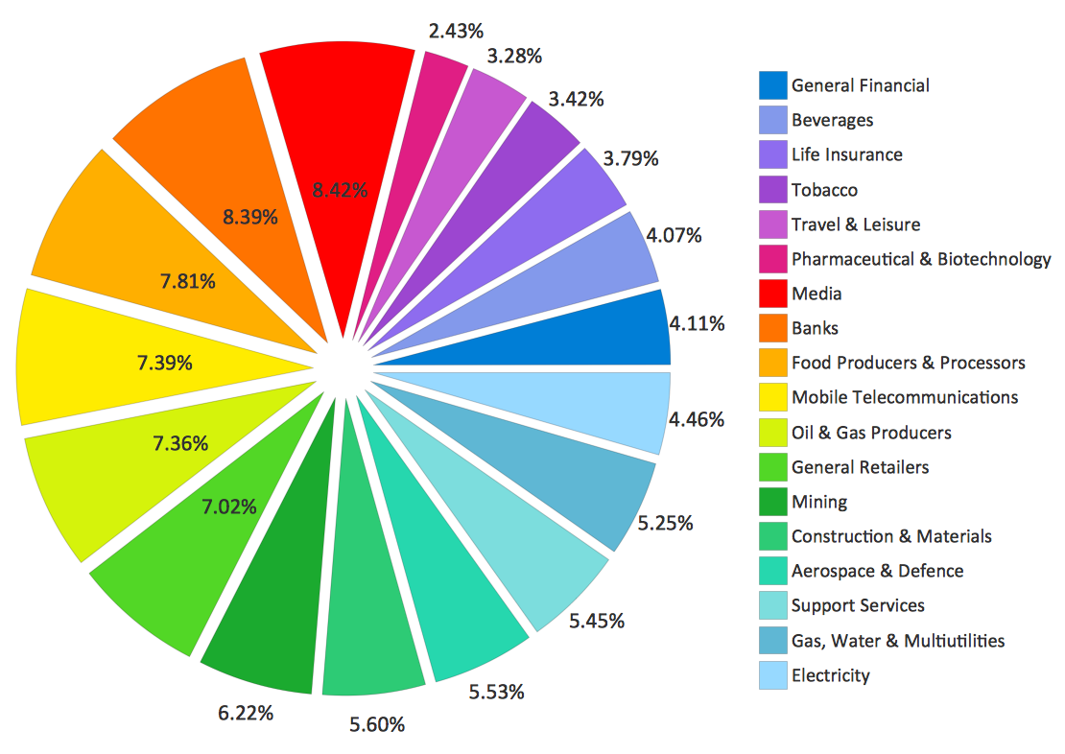
The P4Q Approach for Schizophrenia
Links funding to quality
A funding approach to incentive quality improvement in the mental health and addictions sector, a first for Ontario
Uses quality statement developed by Ontario experts based on consensus of opinion and best practice evidence.
Learnings can be scaled to other chronic diseases with similar or less severity and complexity
1. Performance Score
2. Improvement Score
x #%
Ranked relative to hospitals
x #%
Ranked relative to hospitals
3. % Relative Performance Score
3. % Relative Improvement Score
3. Combined Weighted Score
4. Adjustment to indicators
5. Funding Score (combining Adjusted scores for ALL indicators)
Hospital A
Hospital B
Hospital C
Hospital D
Hospital E
Hospital F
Hospital G
Hospital H
Hospital I
Hospital J
Hospital K
Hospital L
Hospital M
Hospital N
Hospital O
Hospital P
Hospital Q
Hospital R
6. Funding calculation
Notes:
Imtiaz
1 min
These are the advantages to this quality initiative that links to funding. We’ll be incorporating improvement into the model once data are available.

Slide 36
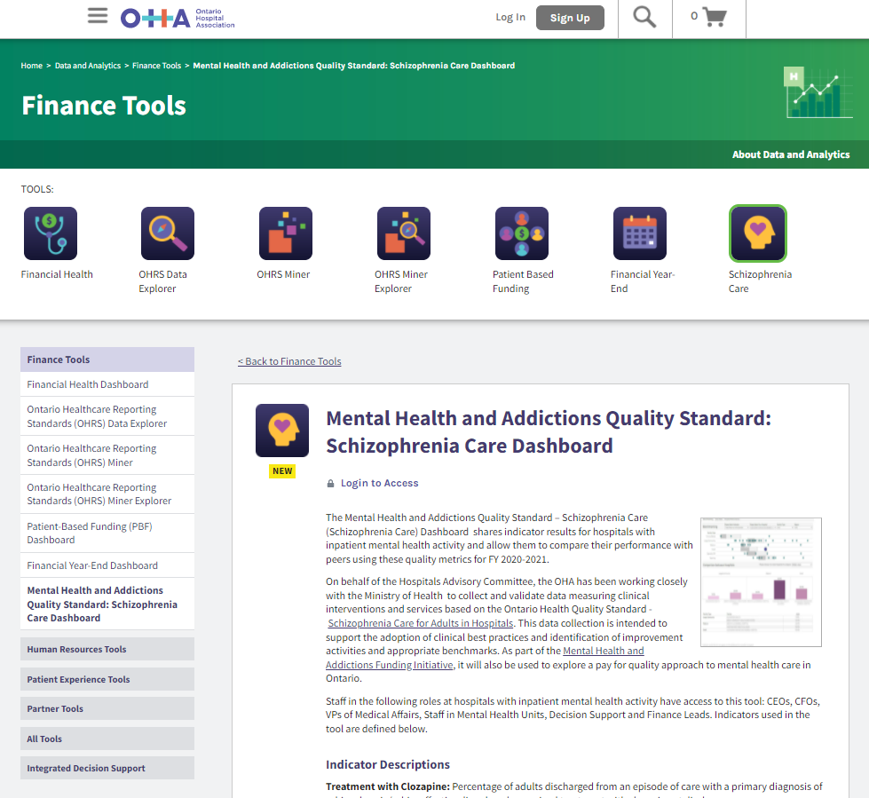
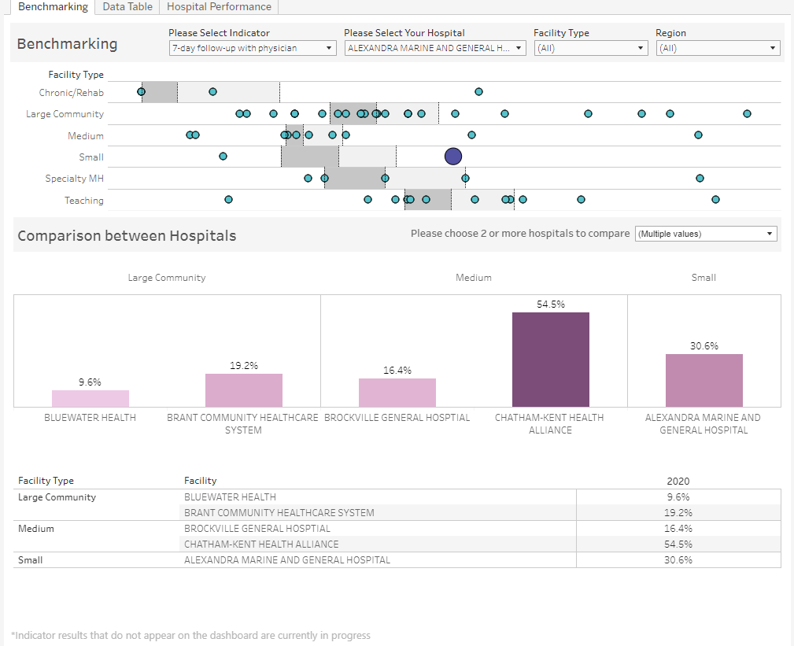
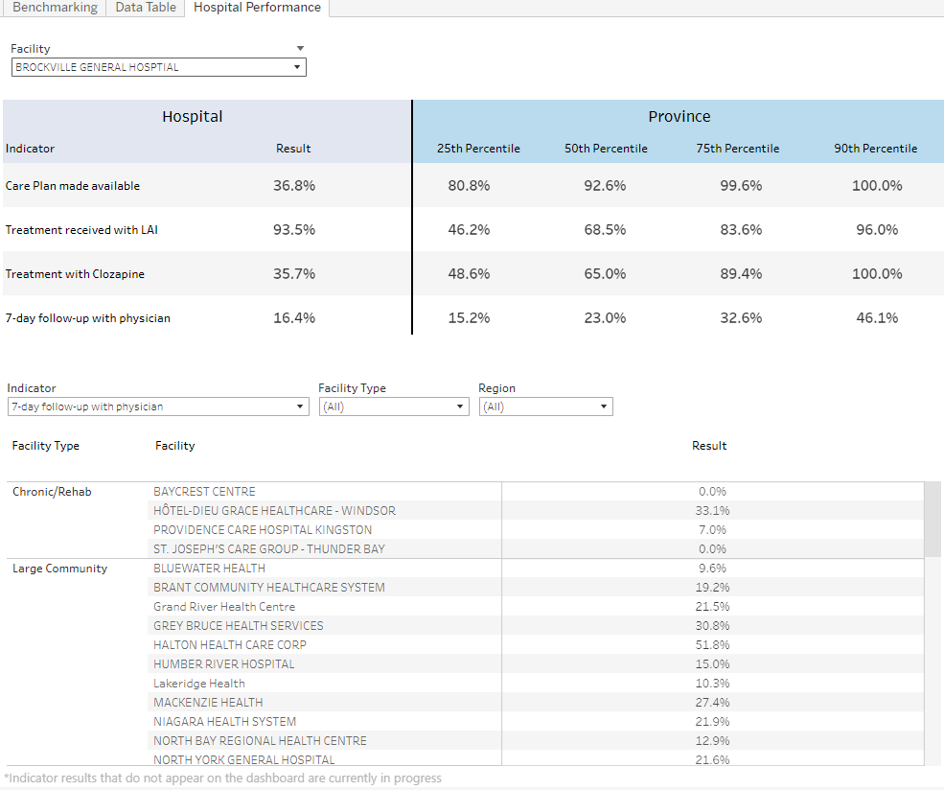
Reporting back: OHA Quality Standard Schizophrenia Care in Hospital Dashboard
A dashboard was developed to provide hospitals the ability to review the results of their quality measures and allow comparisons to others. This allows hospitals to connect with peers to learn about their successes on adoption of the quality statements.
Hospital Names
Hospital Name
https://www.oha.com/data-and-analytics/finance-tools/mental-health-and-addictions-quality-standard-schizophrenia-care-dashboard
Notes:
Imtiaz
1 minute
As part of the performance measurement framework, we developed a mechanism to report back.
Next slide: Melisssa/Karim to present the recommendations

Slide 37

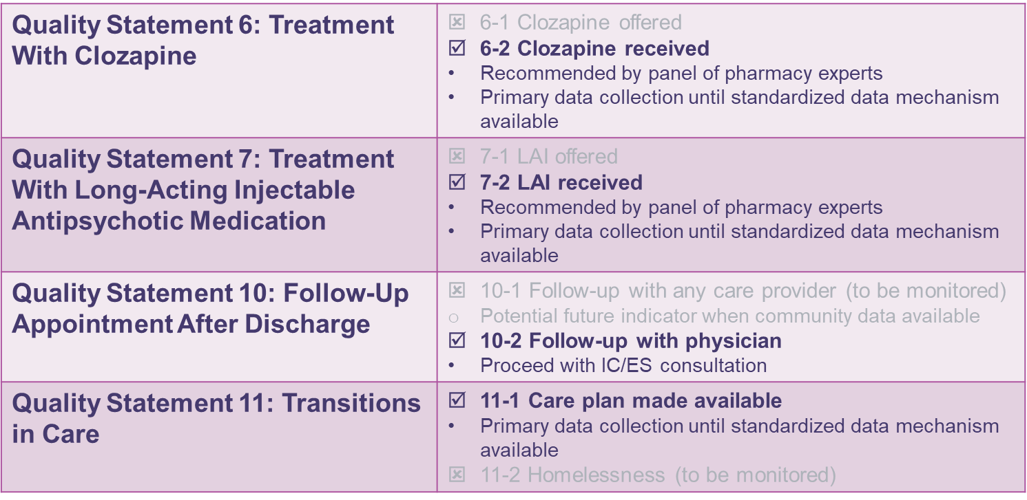
Changes to reporting for hospitals with inpatient mental health activity
Clozapine and LAI indicators will be calculated using record level data from OMHRS
OMHRS changes April 1st, 2022
Notes:
Imtiaz
1 min
We’re going to continue with this initiative and have a established a standardized process to collecting the data. Through the collaboration with the Ministry and CIHI.

Slide 38
Early Findings

Slide 39
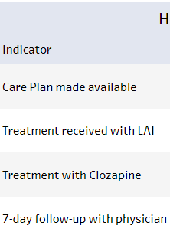
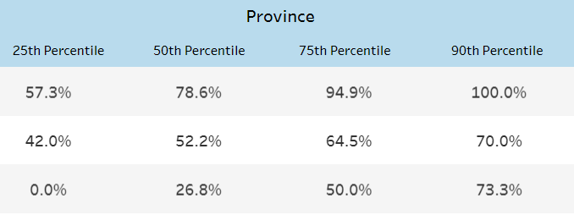
Overall provincial average for FY2022/23 Q1*
57.3% | 78.6% | 78.6% | 94.9%
42.0% | 52.2% | 64.5% | 70.0%
21.4% | 40.0% | 56.2% | 92.0%
15.2% | 23.0% | 32.6% | 46.1%
*
*Note: 7-day follow-up with physician indicator results based on FY2019/20; pending FY2020/21 results from the Ministry of Health

Slide 40
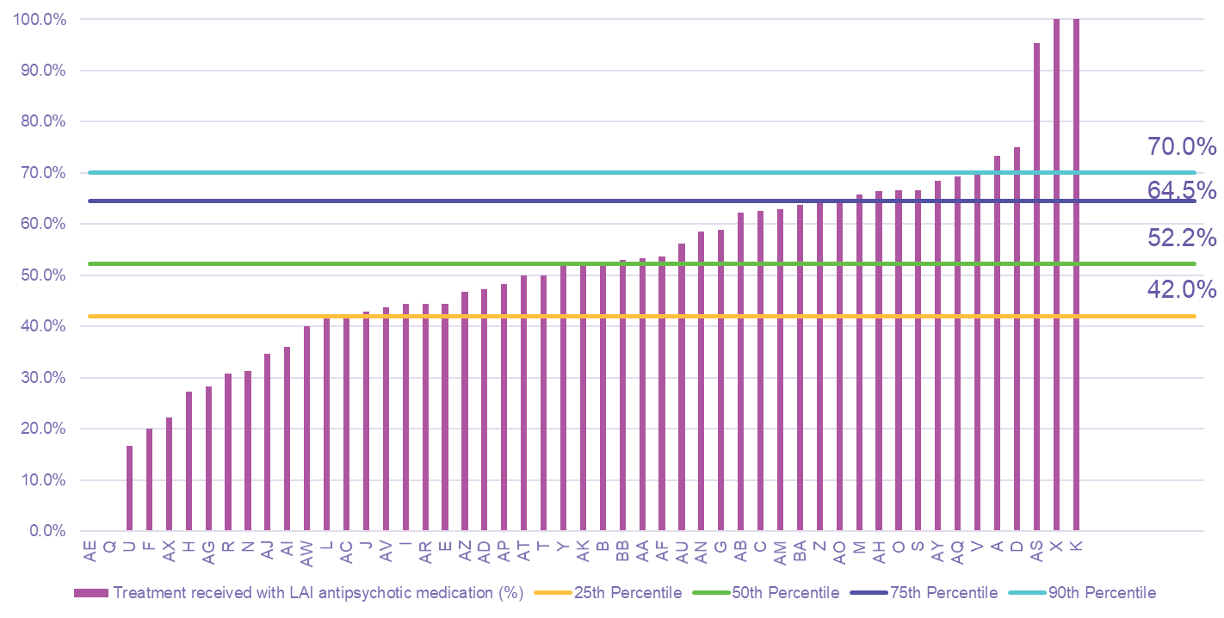
FY2022/23 Q1 – Treatment received with LAI antipsychotic medication

Slide 41
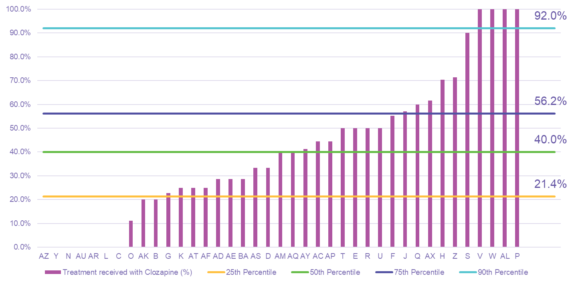
FY2022/23 Q1 – Treatment received with Clozapine

Slide 42
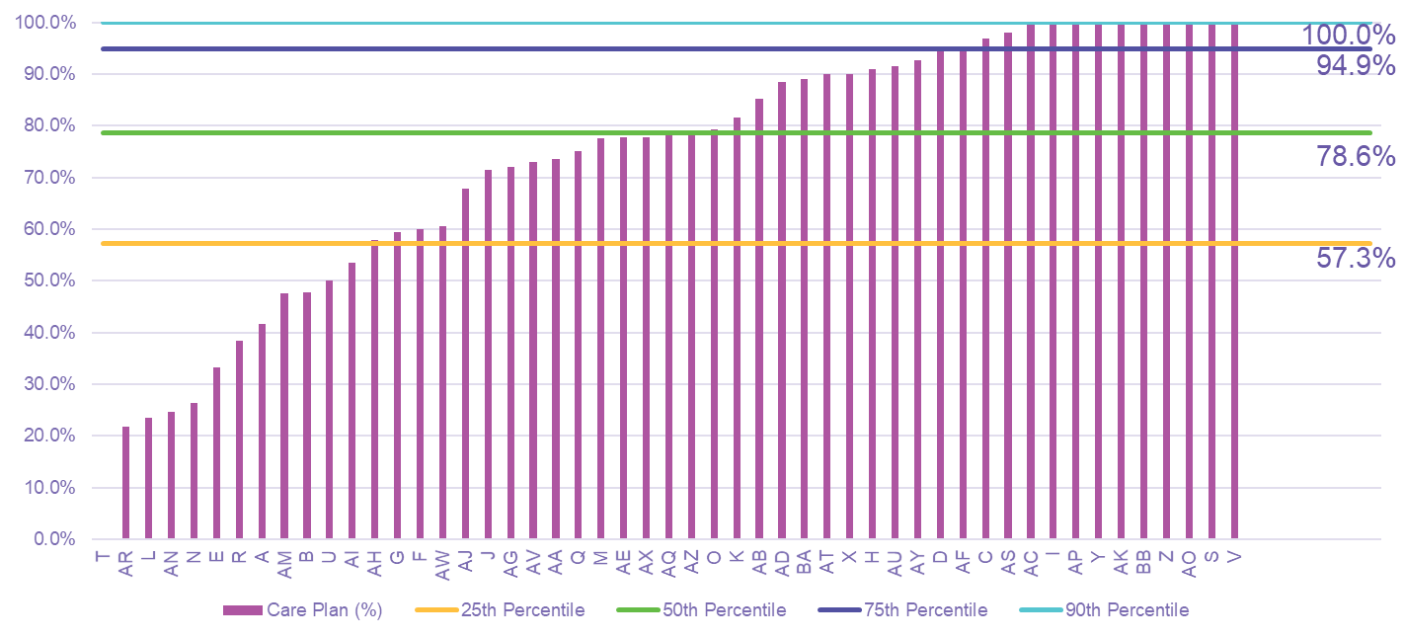
FY2022/23 Q1 – Care plan made available within 7 days of discharge from hospitalization

Slide 43
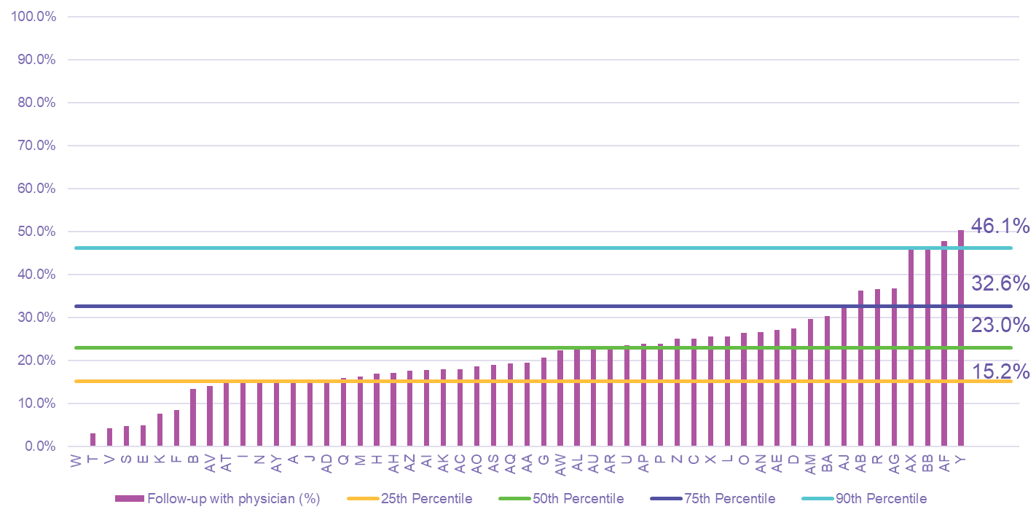
FY2019/20 – Follow-up with physician within 7 days of discharge

Slide 44
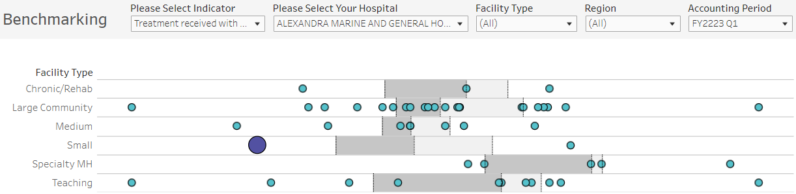
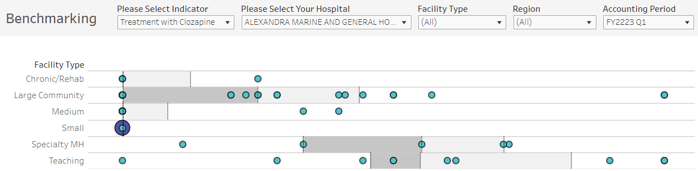
Quality indicator results for treatment received with LAI and Clozapine

Slide 45
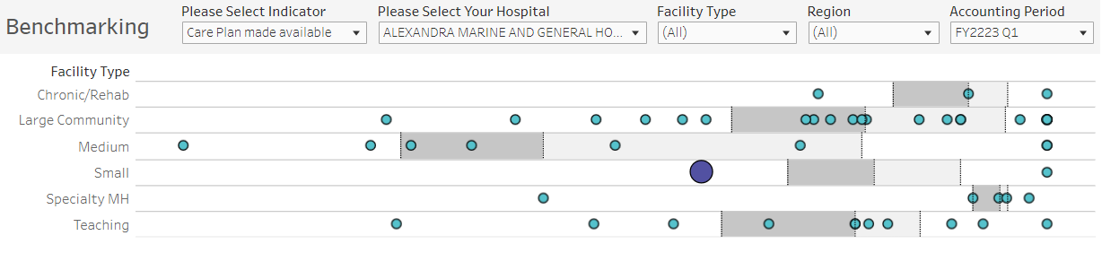
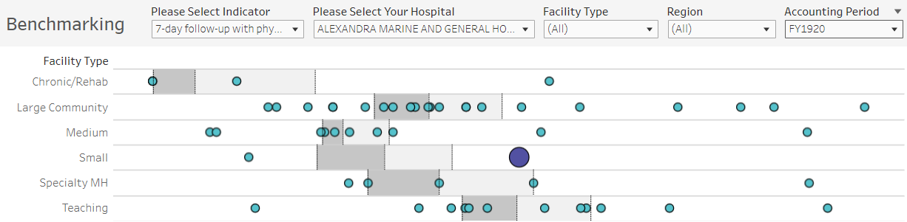
Quality indicator results for Care Plan made available and physician follow-up* within 7 days of discharge
*Note: 7-day follow-up with physician indicator results based on FY2019/20; pending FY2020/21 results from the Ministry of Health

Slide 46
MHA Funding Initiative Report Recommendations
MHA Funding Initiative Recommendations
Recommendation 1: Use a multi-year payment approach to incentivize quality of care commencing in FY2022/23 using the Quality Standard – Schizophrenia Care for Adults in Hospitals and proceed to integrate the Quality Standard – Schizophrenia Care in the Community for Adults within 3 years.
Recommendation 2: Commitment to a dedicated incremental funding envelope that would fund the adoption of the Quality Standards taking into consideration projected volume increases, evolving models of care, and inflationary costs.
Recommendation 3: Ensure standardized, reliable and timely data are available for measuring performance of care across settings as identified by the Quality Standards.
Recommendation 4: The Ministry, Ontario Health, OHA, and community mental health and addictions associations should collaborate with health providers to provide the necessary tools and communication to health care providers across care settings to ensure knowledge translation and supports for the P4Q program.
Recommendation 5: There should be an annual review and adjustments of the MHA P4Q funding methodology to ensure transparency and continuous improvement of the initiative.
Recommendation 6: In the Fall 2021, the MHA Funding Advisory Committee will pursue exploration of an integrated care funding approach: creation of an integrated care funding model for schizophrenia care.
Recommendation 7: Within FY2021-2022, The MHA Funding Advisory Committee will engage with the Ministry to develop a plan for the refinement/development of a case-mix system and its associated weighting methods to fund resource utilization for adult mental health and addictions care activities.
Recommendation 8: The MHA Funding Advisory Committee will develop a multi-year workplan for other MHA Quality Standards using the MHA-P4Q approach.
Confidential. Please do not distribute.
Notes:
At the September 17th HAC meeting, we presented the eight recommendations from the Mental Health and Addictions Funding Advisory Committee and its Working Group. These eight recommendations will lead to develop a patient-based funding model for mental health and addictions in Ontario.

Slide 47

Integrated Care Initiative

Slide 48


Integrated Care – leveraging efforts in hospital to the full continuum of care
Notes:
Imtiaz
1 min
This process has built a lot of discussions between clinicians, decision-makers, quality improvement leads, and administrators across the hospital and mental health sector. It is building up to something bigger.

Slide 49

Integrated Care Prototypes using OHTs and Partnerships
Ontario Shores-SHN-CMHA Durham Partnership
.
.
.
.
.
.
.
.
.
.
.
.
Central OHT for Specialized Populations
.
.
.
.
.
.
.
.
.
.
.
.
Greater Hamilton Health Network
Southlake Community OHT
Confidential. Please do not distribute.
Notes:
Imtiaz
1 min
The initiative is proceeding with integrating Community quality statements in the MHA P4Q approach using 4 prototypes. It will support recommendations #1 and #6 of our report (integrate the Quality Standard – Schizophrenia Care in the Community for Adults and pursue exploration of an integrated care funding approach):
The Southlake Community Ontario Health Team
Greater Hamilton Health Network
Central Ontario Health Team for Specialized Populations
Collaboration of local health providers – Scarborough Health Network, Ontario Shores Centre for Mental Health Sciences and CMHA – Durham.

Slide 50







































































Integrated Care MHA Prototypes – We are in this together!
Ontario Shores – SHN – CMHA Durham & Toronto Partnership

Slide 51

Schizophrenia Care in Community - Quality Statements (in brief)
Quality Statement 1: Care Plan and Comprehensive Assessment
Adults with schizophrenia have a care plan that is regularly reviewed and updated, and that is informed by a comprehensive assessment.
Quality Statement 2: Physical Health Assessment
Adults with schizophrenia receive a physical health assessment on a regular basis.
Quality Statement 3: Self-Management
Adults with schizophrenia have access to information and education that supports the development of self-management skills.
Quality Statement 4: Family Education, Support, and Intervention
Families of adults with schizophrenia are given ongoing education, support, and family intervention that is tailored to their needs and preferences.
Quality Statement 5: Access to Community-Based Intensive Treatment Services
Adults with schizophrenia have timely access to community-based intensive treatment services based on their needs and preferences.
Quality Statement 6: Housing
Adults with schizophrenia have a safe, affordable, stable living environment that reflects their needs and preferences.
Quality Statement 7: Antipsychotic Monotherapy
Adults with schizophrenia are prescribed a single antipsychotic medication, whenever possible.
Quality Statement 8: Treatment With Long-Acting Injectable Antipsychotic Medication
Adults with schizophrenia are offered the option of a long-acting injectable antipsychotic medication.
Quality Statement 9: Treatment With Clozapine
Adults with schizophrenia who have not responded to previous adequate trials of treatment with two different antipsychotic medications are offered clozapine.
Quality Statement 10: Continuation of Antipsychotic Medication
Adults with schizophrenia whose symptoms have improved with antipsychotic medication are advised to continue their antipsychotic medication for the long term.
Quality Statement 11: Cognitive Behavioural Therapy for Psychosis and Other Psychosocial Interventions
Adults with schizophrenia are offered cognitive behavioural therapy for psychosis and other evidence-based psychosocial interventions, based on their needs.
Quality Statement 12: Promoting Physical Activity and Healthy Eating
Adults with schizophrenia are offered readily accessible interventions that promote physical activity and healthy eating.
Quality Statement 13: Promoting Smoking Cessation
Adults with schizophrenia who smoke tobacco are offered pharmacological and nonpharmacological interventions to help them reduce or stop smoking tobacco.
Quality Statement 14: Assessing and Treating Substance Use Disorder
Adults with schizophrenia are asked about their substance use and, if appropriate, they are assessed for substance use disorder and offered treatment.
Quality Statement 15: Employment and Occupational Support
Adults with schizophrenia who wish to find work or return to work are offered supported employment programs. Adults with schizophrenia who are not seeking paid work are supported in other occupational or educational activities, in accordance with their needs and preferences.
Notes:
15 quality statements to select for the Schizophrenia Integrated Care Initiative
QS 1 has 3 indicators
QS 5 has 4 indicators
QS 8 has 2 indicators
QS 11 has 5 indicators

Slide 52
Discussion

Slide 53
Imtiaz Daniel
Chief, Research and Analysis
idaniel@oha.com

