Slide 1
Provincial Coordinated Access: A Systems Approach
Association of General Hospital Psychiatric Services Leadership Summit
October 27, 2023 | 11:45 AM to 12:30 PM
Dr. Paul Kurdyak, Vice President, Clinical, Mental Health and Addictions Centre of Excellence
Terra Cadeau, Director, Mental Health and Addictions Centre of Excellence

Slide 2
Objective
To share an overview of the proposed approach to implement a strategy for Provincial Coordinated Access

Slide 3
Ontario Regional Psychiatrist Supply

Slide 4
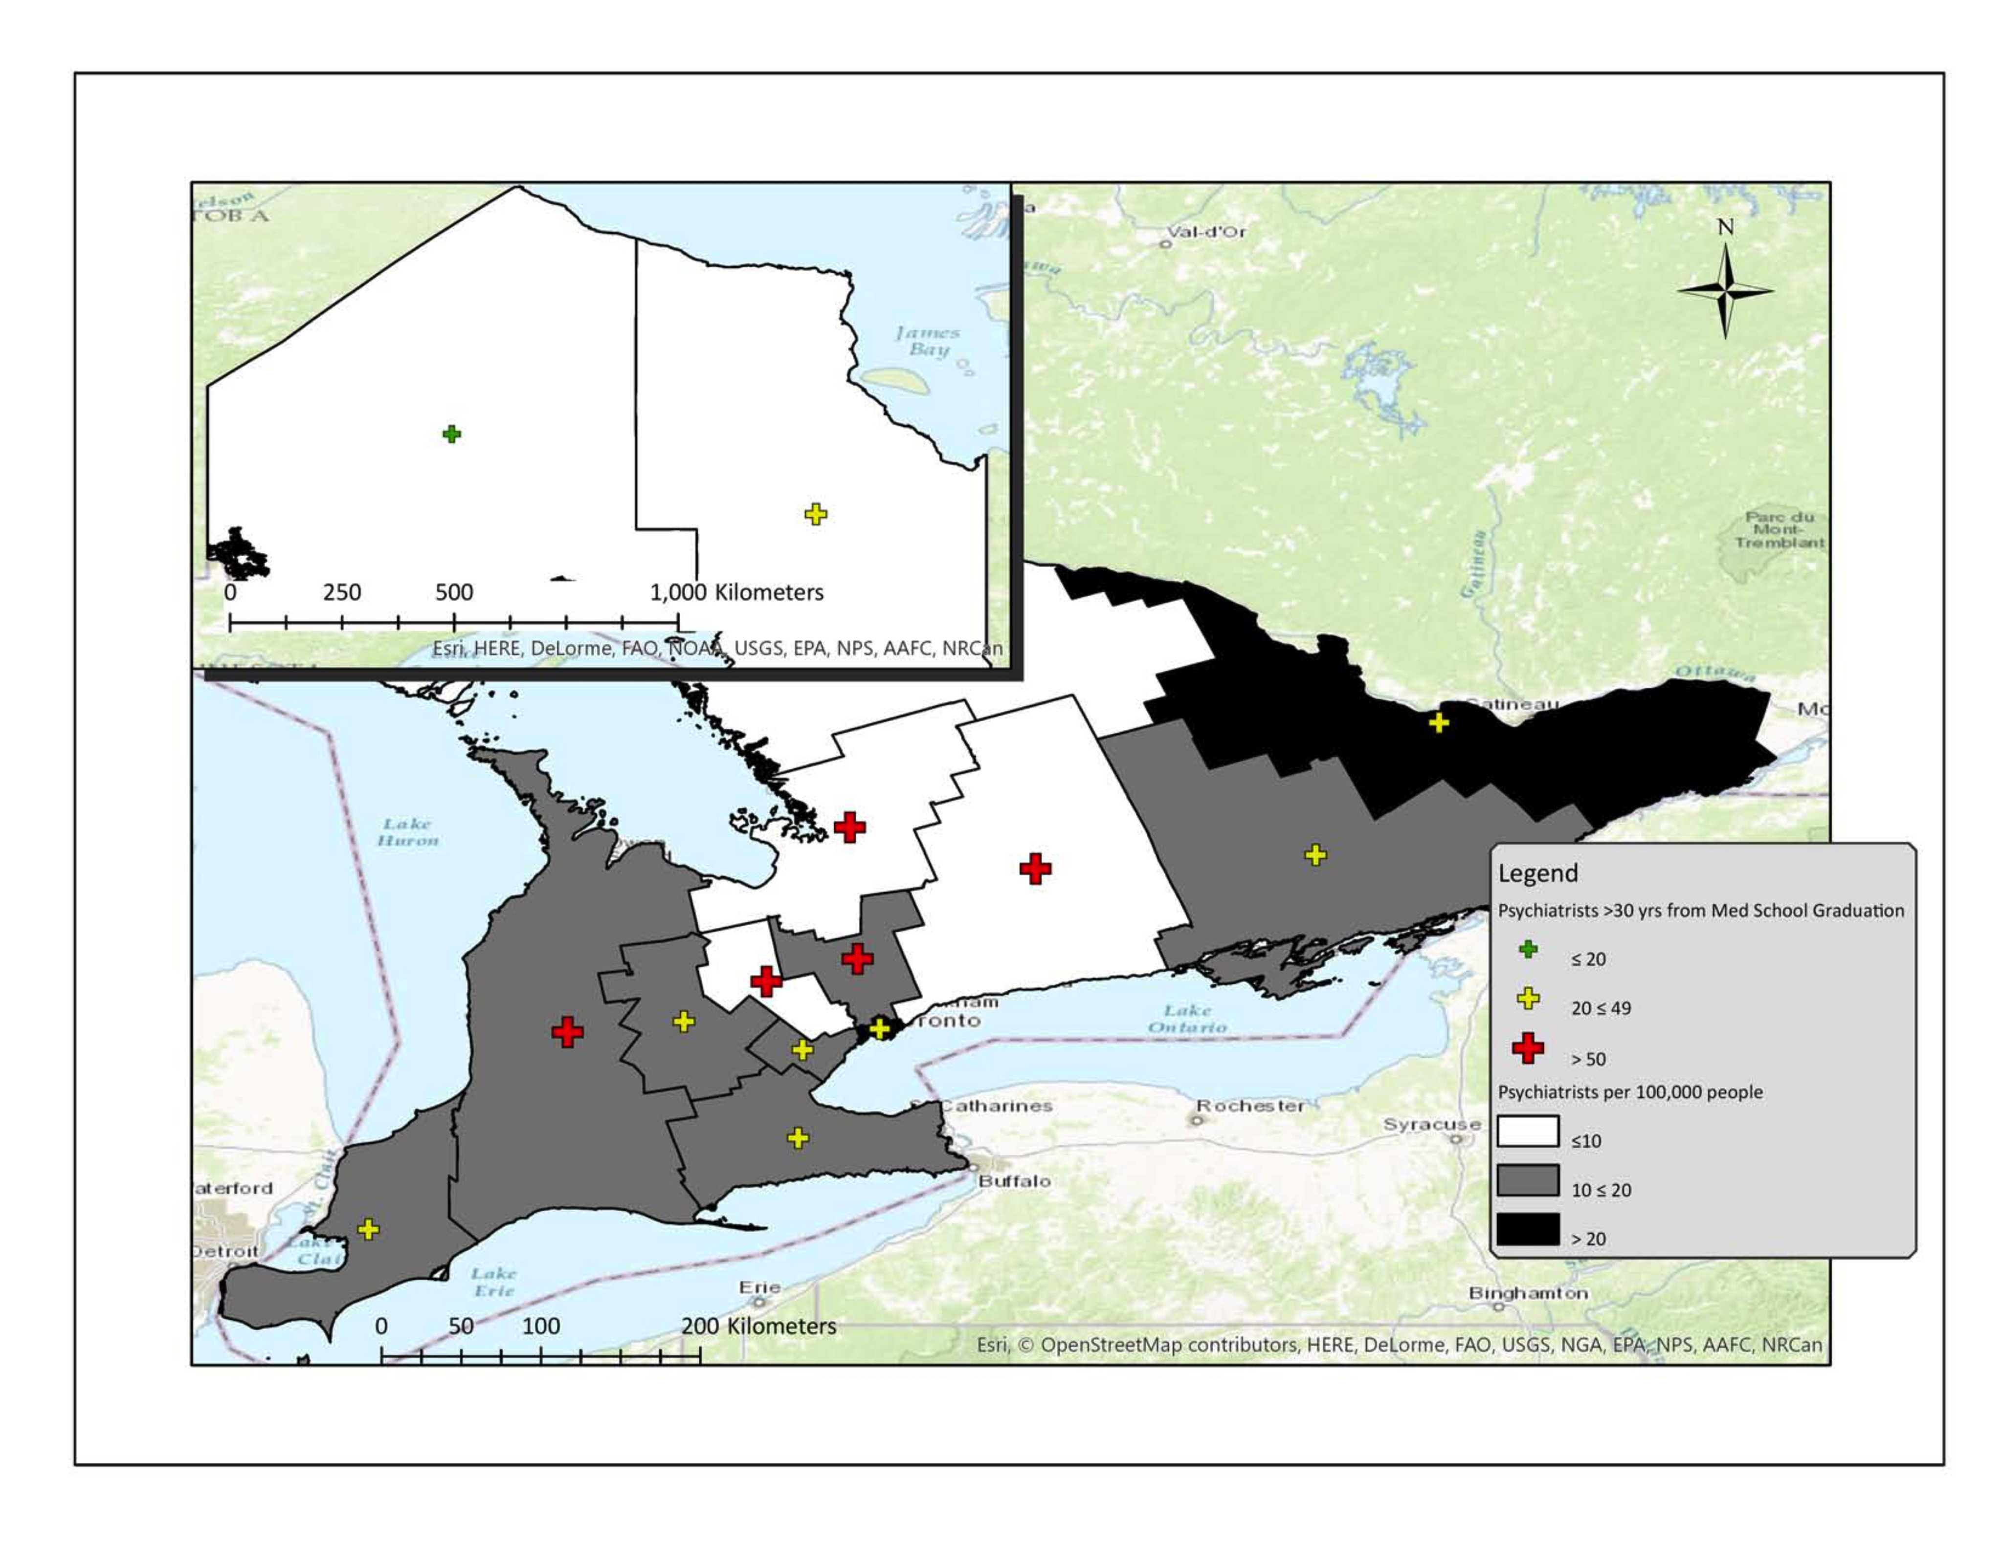
Supply, Psychiatrist Age and Region

Slide 5
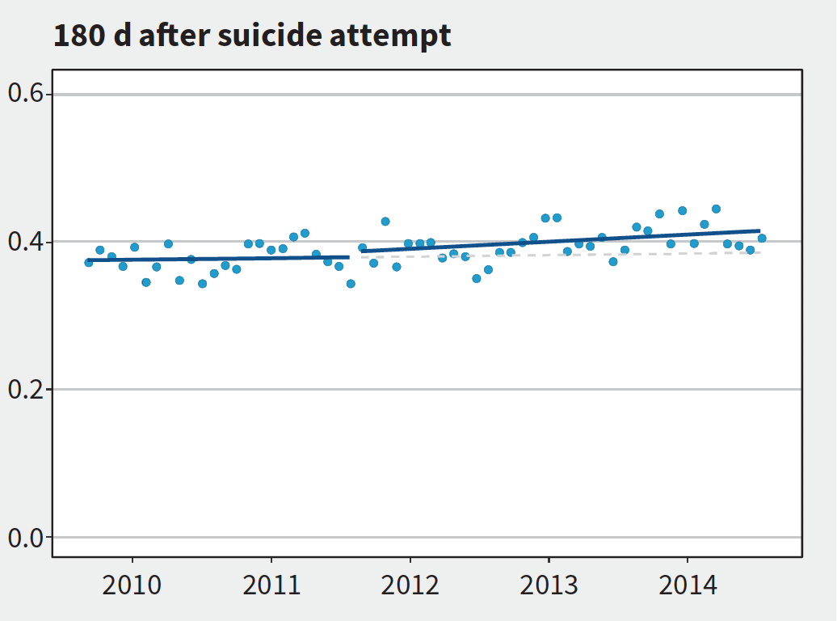
Psychiatrist Visit 180 Days Post-Suicide Attempt
Incentive Date

Slide 6
Impact of Addiction Diagnosis on Psychiatric Access

Slide 7
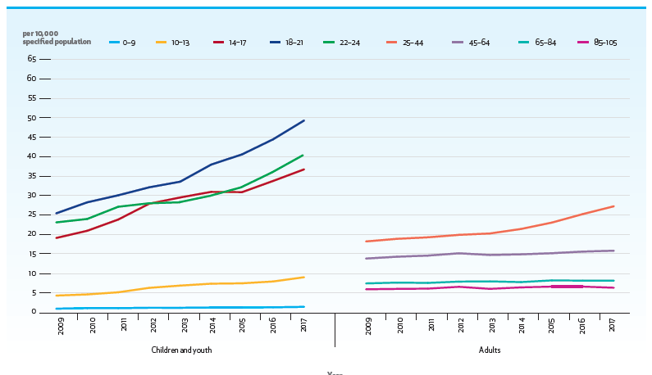
The rate of individuals who had an Emergency Department visit for mental health and addictions-related care increased (by almost 50% for transitional-aged youth between 2006 and 2014).
Year

Slide 8
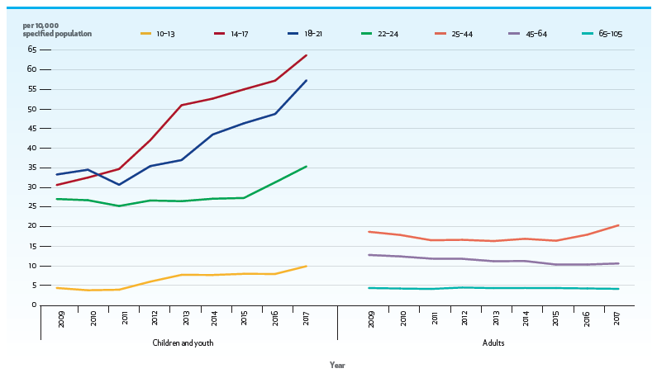
Rates of ED Visits for Intentional Self-Harm (2009-2017)
Year

Slide 9
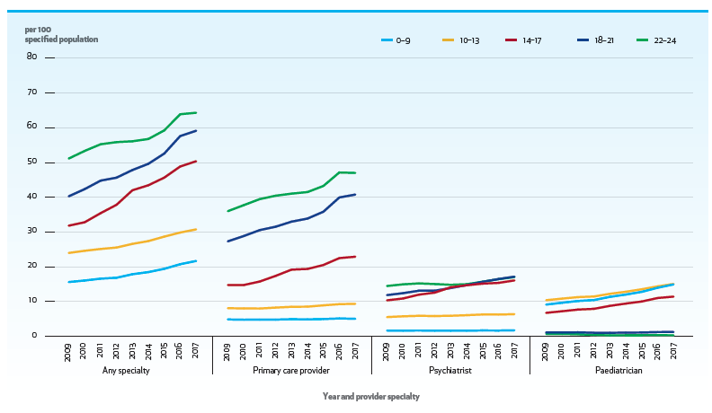
Mental Health and Addictions-Related Outpatient Visits

Slide 10
What DON’T we know?
Who is not accessing the system and who should be getting care
Whether people get to where they need to go
How long people are waiting to get care (wait times)
Whether people are receiving care that adheres to best evidence and standards of care
Whether people respond to treatment
Whether people are “stepped up” to more intense treatment based on non-response to lower intensity treatment (or treatment is stopped once people have achieved remission/response)
ACCESS
QUALITY

Slide 11
What DON’T we know?
Who is not accessing the system and who should be getting care
Whether people get to where they need to go
How long people are waiting to get care (wait times)
Whether people are receiving care that adheres to best evidence and standards of care
Whether people respond to treatment
Whether people are “stepped up” to more intense treatment based on non-response to lower intensity treatment (or treatment is stopped once people have achieved remission/response)
ACCESS
QUALITY

Slide 12
Provincial Coordinated Access
Background
Mental Health and Addictions (MHA) supports and services vary across the province, are not well integrated, and experiences of care vary regionally.
People are unaware of where to go for help; they do not know which services are available to them; and they face challenges navigating these services.
As a result, people often connect with multiple providers and, inevitably, repeat their story each time before receiving the needed treatment.
People are not getting the right MHA care at the right time.

Slide 13
Current State: Access to Services
Multiple access points, multiple wait lists, fragmented care and broken communication

Slide 14
Provincial Coordinated Access
Opportunity: A key priority of the Roadmap to Wellness
The MHA Centre of Excellence (CoE), with guidance from a Provincial Coordinated Access Advisory Committee, will establish a provincial strategy for Coordinated Access that will include standards that must be in place in each region to ensure consistency and connectedness across the province.
To establish this strategy, the CoE will leverage prior/existing work conducted by the OH Regions, the Ministry of Health, and others. We will work with the OH Regions to plan for, implement, and monitor the Provincial Coordinated Access strategy.
Initiative Rationale
Having Provincial Coordinated Access to MHA services will provide Ontarians seeking care with equitable, seamless, and easy-to-navigate access to the right MHA service or support, at the right time. People in need will know where to go for help and what services are available. Most importantly, they will be connected to the appropriate MHA service based on urgency and level of need.
With standardized data collection along the entire client journey, Coordinated Access will help us better understand the demand for MHA services in Ontario.

Slide 15
Provincial Coordinated Access
Coordinated care and organized care system.

Slide 16
Coordinated Access
Coordinated Access is a central point of contact from where clients can access services offered by multiple providers*.
Intake is done primarily on behalf of other service providers, using agreed upon tools and processes with a common information management system to enable information sharing and standardized data collection*.
Intake/
Screening
Referral/
Matching
Client contacts central access point
Client is screened and briefly assessed using evidence-based, standardized tools to determine level of need and urgency
Client is referred/matched to the most appropriate service and level of care and is prioritized;
additional assessment may be required
* “MHA Provincial Coordinated Access Current State Report”. Ministry of Health, Mental Health and Addictions Division, March 2022 (DRAFT)

Slide 17
Equitable, Seamless, and Easy-to-Navigate Access to the Right MHA Care at the Right Time​
Advancing the Roadmap to Wellness
Leveraging and integrating existing provincial and regional assets, investments, and strategies
Linking to OH and MHA CoE provincial priorities
Enabling broader health system transformation
Provincial MHA Coordinated Access
OHT 24/7 Navigation
Health Service Providers
Primary Care Providers
Regional Access Points / Hub Sites
Digital Front Door
Health811
Central Waitlist Manage-ment
Connex Ontario
People connected to the most appropriate MHA service, based on urgency and level of need
People seeking MHA care
*Standardized data collection along the entire process

Slide 18
Understanding the Demand for MHA Services via Provincial Coordinated Access
Current State
There is no true understanding of system demand, capacity, wait-times, and performance for MHA services
Future State
Standardized data collection for clear understanding of demand, capacity, wait times and outcomes
MHA Data and Digital Strategy, the MHA Provincial Data Set, and the asset mapping work
Data will drive service performance and future investments

Slide 19
High-Level Approach
PCA Implementation Plans Developed
FY 23/24
FY 24/25 – FY 26/27
Establish Oversight for PCA
Conduct Current State Assessment
Develop PCA Standards
Service model, clinical tools & protocols
Data & Digital
Performance Measurement
Enable Implementation of PCA
Regional implementation and optimization of CA services, based on provincial standards
Continued Implementation of PCA & Ongoing Performance Measurement & Evaluation
Stakeholder Engagement, Communications & Branding
Ongoing Identification of Funding Needs & Sustainability Planning
Note: Some of the steps in this high-level approach may occur in parallel, and not necessarily in a sequential approach
PCA: Provincial Coordinated Access; CA: Coordinated Access

Slide 20
Provincial Coordinated Access: Provincial and Regional Roles
Seamless, easy-to-navigate, and equitable access to the right MHA care at the right time, no matter where you live in the province ​
Establish Oversight for PCA
PROVINCIAL
REGIONAL
Develop overall strategy for Provincial Coordinated Access and establish provincial oversight
Complete a provincial current state assessment of existing Coordinated Access services
Define standards for Provincial Coordinated Access that must be in place within each region (i.e., service model, clinical tools & protocols, data & digital)
Develop and implement performance measurement and monitoring framework
Support and monitor regional implementation
Secure and allocate multi-year funding
Establish regional oversight and governance
Complete the regional component of the provincial current state assessment
Develop regional implementation plans for Coordinated Access that meet provincial standards
Lead implementation and operations of Coordinated Access within the region, in alignment with provincial standards and performance measures
Inform funding requirements and sustainability plans
Note: Each region is at a different state of readiness for Coordinated Access.
Conduct Current State Assessment
Develop PCA Standards
Enable Implementation of PCA & Monitoring
Continued Implementation & Performance Measurement & Evaluation

Slide 21
Provincial Coordinated Access (PCA) Oversight Model
OH Leadership & Ministry of Health (i.e., CIQP Leadership & OH Board of Directors)
MHA OVERSIGHT & ENGAGEMENT*
Ontario MHA Oversight Table
Clinical Council
Supported by Clinical Priority Advisory Tables
OH Regional Leadership Council
Planning & Performance Council
PCA OVERSIGHT
REGIONAL OVERSIGHT
MHA Provincial Coordinated Access Advisory Committee
Regional MHA Advisory Committees
Time-Limited Task Groups**
Focused on specific topics, as needed
Regional Coordinated Access Working Groups
CoE ELT & Project Team
People with lived/living experience are/will be members of these groups.
*MHA Oversight & Engagement Structures (e.g., Clinical Council, Planning & Performance Council), will play a key role providing guidance and advice to PCA & Regional Oversight Structures
**Task group focus areas may include: equity, digital, performance measurement, clinical tools, protocols & standards, and implementation.
Note: OHT representation will be considered for inclusion across several of the oversight structures (e.g., Provincial Coordinated Access Regional Working Groups, Regional MHA Advisory Committees, MHA Provincial Coordinated Access Advisory Committee
OH: Ontario Health; MHA: Mental Health & Addictions; PCA: Provincial Coordinated Access ; ELT: Executive Leadership Team; OHT: Ontario Health Team

Slide 22
Guidance for the Work
Literature review
Existing models in mental health and health sector
Current state assessment
MOH reports
CoE strategic priorities

Slide 23
Critical Success Factors
Defining Scope & Roles: Clear goals, objectives, roles, responsibilities & accountabilities
Stakeholder Engagement & Co-Design: successful partnership, collaboration & communication with OH Regions, teams across OH, PWLE, and system stakeholders (e.g., MHA Services, Primary Care, OHTs)
Existing assets and provincial investments are leveraged and integrated (e.g., Health811, OHT 24/7 navigation, CWM, etc.)
Sustained Funding to support regional implementation and sustain operations
OH: Ontario Health; PWLE: People with Lived/Living Experience; MHA: Mental Health & Addictions; OHT: Ontario Health Teams; CWM: Central Waitlist Management.

Slide 24
Next Steps
Advisory Committee to begin development of provincial standards (including service model, clinical tools & protocols, data and digital requirements, and performance measurement)
Initiate provincial current state assessment, building upon the regional work completed and underway
Continue to work collaboratively with the OH Regions to establish regional leadership and operational supports
Secure multi-year funding to enable ongoing provincial and regional implementation and operations

Slide 25
Impact of Coordinated Access on Providers and Organizations
May increase volumes because of a removal of a structural barrier
May define patients seen (vs. seeing who walks through a door or happens to be referred)
Will encourage defining patient populations amongst different providers

Slide 26
Impact of Coordinated Access on the System
Patients who seek treatment will get closer to population-based need
Characterize demand for the first time
Opportunity to align supply (number and types of services) to demand
Fund services according to demand

Slide 27
Questions?

