Slide 1
RAI-MH Information – What and How?
Association of General Hospital Psychiatry Services
Leadership Summit Meeting
Toronto, November 9, 2012

Slide 2
Ontario Mental Health Reporting System
Data and information for adult inpatient mental health and addictions services in designated beds across Ontario
Based on the RAI-MH clinical assessment instrument
RAI-MH developed by Ontario, in partnership with interRAI
Full Ontario participation since 2005-06
Currently ~ 68 Ontario sites participating

Slide 3
OMHRS: The “little big” database
As of September 1, 2012
666,894 records
Representing 358,520 episodes
From 76 facilities

Slide 4
The OMHRS Team (omhrs@cihi.ca)
Clinical Specialists:
Karen Luyendyk and Jennifer Berger
Education and client support for coding and data quality
Analysts:
Jerry Li and Shannon O’Connor
Support for data submission, error correction, data quality
Production of quarterly reports, data requests, MOH data files, etc.
Program Lead: Connie Paris
Keeping the ship moving forward and away from icebergs

Slide 5
From current agreement between CIHI and Ontario
“The Ontario Mental Health Reporting System (OMHRS) serves to standardize the capture of mental health clinical and administrative data within a singular reporting framework.”
“The Ontario Mental Health Reporting System (OMHRS) serves to standardize the capture of mental health clinical and administrative data within a singular reporting framework.”

Slide 6
Capture Once, Use Often
System
Comparing Results
Accountability
Facility
Resource allocation
Individual
Clinical decision-making
Evaluating care
Research
Common language
Program Evaluation

Slide 7
What Are the Various RAI-MH Components?
Minimum Data Set – Mental Health
Outcome Scales
Quality Indicators
Case Mix
(SCIPP)*
Clinical Assessment Protocols
* System for the Classification of Inpatient Psychiatry

Slide 8
Minimum Data Set for Mental Health (MDS-MH)
High-level, section by section overview

Slide 9
MDS-MH components: Identifiers
Identification Information
Case Record Number
Health Card Number
Facility Number
Birth Date
Sex
Intake and Initial history
Date Stay Began
Reasons for Admission
Who Lived with at Admission
Residential Stability
Number of psychiatric admissions
Age at first hospitalization

Slide 10
MDS-MH components: Clinical Assessment
Assessment Information
Date of assessment
History of involvement with the criminal justice system
Mental Health Indicators
Mood disturbance
Psychosis
Anxiety
Substance use and Excessive Behaviours
Alcohol
Substance Use
Withdrawal
Harm to Self and Others
Self-injury
Violence
Behaviour Disturbance
Behaviour Symptoms
Extreme Behaviour Disturbance
Cognition
Memory/Recall Ability
Cognitive Skills for daily decision-making
Cognitive Decline

Slide 11
MDS-MH components: Clinical Assessment
Self Care
Activities of Daily Living (ADL) self-performance
Instrumental Activities of Daily Living (IADL) capacity
Communication/Vision
Hearing
Vision
Making self understood
Health Conditions and Medication Side Effects
Signs and Symptoms
Extra-pyramidal signs and symptoms
Self-rated health
Skin or foot problems
Medical Diagnoses

Slide 12
MDS-MH components: Social & Treatment History
Stressors
Life Events and History
Response to life events
Other Indicators
Medications
Medication Refusal
Stopped Taking Psychotropic Medication
Acute Control Medications
Service Utilization/Treatment
Formal Care
Nursing Interventions
Focus of Intervention
Control procedures/Observation
Control Interventions
Close or Constant Observation
Psychiatric Intensive Care Unit
Nutrition
Height and Weight
Nutritional Problems
Indicators of Eating Disorders

Slide 13
MDS-MH components: Relationships
Role Functioning and Social Relations
Family Roles
Social Relations and Interpersonal Conflict
Social Relationship
Resources for Discharge
Available Social Supports (Family and Friends)
Discharge Readiness
Projected Time to Planned Discharge

Slide 14
MDS-MH components: Diagnostics & Medication
Psychiatric Diagnostic Information
DSM-IV Provisional Diagnostic Category
Psychiatric Diagnosis
Intellectual Disability
Medications
Prescribed Medications
List of Medications prescribed for use

Slide 15
MDS-MH components: Discharge
Discharge Information
Discharge Date
Service Interruption Start/End Dates
Total Days away from Bed

Slide 16
Assessment Completion
Admission assessment within 3d of admission date
Discharge assessment
Quarterly assessment if LOS > 92d
Short Stay if LOS < 3d (smaller data set)
Change in Status can be completed as needed

Slide 17
RAI-MH: A “snapshot” in time
3d
3d
Assessment window
Assessment window
→ OMHRS Quarterly reports reflect those snapshots

Slide 18
Submission Timelines
Q | Reporting Period | Submission Deadline | CIHI Data Cut | OMHRS Reports Available By
1 | Apr 1 – Jun 30 | August 31 | September 1 | September 30
2 | Jul 1 – Sept 30 | November 30 | December 1 | Early January
3 | Oct 1 – Dec 31 | February 28 | March 1 | March 31
4 | Jan 1 – March 31 | May 31 | June 1 | June 30
Timeliness of Reports
OMHRS Reports available 3 months after end of quarter
Balance between allowing time to capture and submit complete data vs timely access to information

Slide 19
RAI-MH Outputs
Minimum Data Set – Mental Health
Outcome Scales
Quality Indicators
Case Mix
(SCIPP)
Clinical Assessment Protocols

Slide 20
Outcome Scales
Various scales highlighting
Aggressive behaviour
Cognitive performance
Depression
Presence of positive symptoms
Risk of self-harm
Risk of harm to others

Slide 21
Quality Indicators
Reported at Facility Level
Physical Restraints
Use of Acute Control Medications
Capacity to Manage Finances
Capacity to Manage Medications
Self-Injury (non-suicidal)

Slide 22
Case Mix
(SCIPP)
System for the Classification of Inpatient Psychiatry
Groups assessments into homogeneous groups
Basis for reporting SCIPP-Weighted Patient Days (SWPD)
SPWD reports are used by the MOHLTC as part of the new funding model

Slide 23
Clinical Assessment Protocols
A tool to support care planning
interRAI released the new Mental Health CAPs Sept 2011
Significant improvement over previous Mental Health Assessment Protocols (MHAPs)
Primary intent: Support information-based care planning
Bonus side effect: Improved information accuracy
The catch: Not currently part of vendor-licensing requirements
Facility CAPs reports available starting December 2012

Slide 24
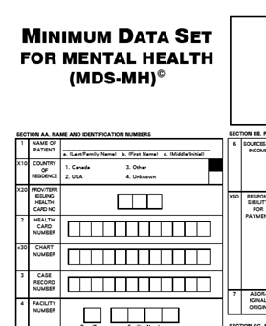
At the Bedside
Vendor software
Clinical Summary
Outcome Scale scores
Clinical Assessment Protocols
Individual Care Plan

Slide 25
RAI-MH Input…

Slide 26
Individual Output Report

Slide 27
Aggregate Reporting from CIHI
Facility
CIHI Database
Secure CIHI site
Quarterly Reports
Demographics
Outcome Scales
Quality Indicators
Clinical Assessment Protocols
Case Mix
CIHI Privacy and Security Policy Framework

Slide 28
OMHRS Quarterly Reports

Slide 29
Report Basics
Separate reports for Admission, Quarterly, Short Stay and Discharge assessments
Key components:
Basic demographics
Summary outcome scales
Quality Indicators
Summary results for submitting site
Columns for Peer, LHIN and Province results
Further broken down by
Diagnostic category
Unit type

Slide 30
Report Basics
New report types added last year:
Facility-identifiable
Year-to-date
Posted on CIHI’s secure website until end of FY
Need access? Email omhrs@cihi.ca.

Slide 31
How Are OMHRS Reports Being Used?
What Reports?
Regular reporting to board and senior staff
Decision support resources
Reporting back to clinical staff
And everything in between…

Slide 32
Quarterly Reports – A Closer Look

Slide 33
Quarterly Reports – Zooming In

Slide 34
Quarterly Reports – Zooming In

Slide 35
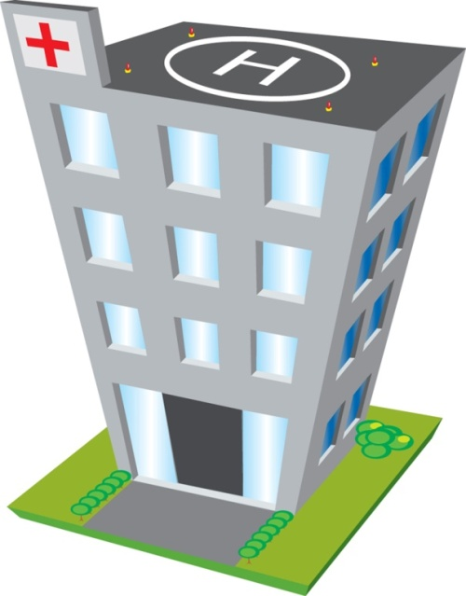
Your Facility – Population Profile at Admission
Volumes
Admissions last year: 425
Average LOS: 17.5d
Demographics
Avg. age: 42yrs
49% Male
Employed: 27%
Top Three Admission Diagnostic Categories
Mood Disorders (42%)
Schizophrenia & Other Psychotic Disorders (33%)
Substance-Related Disorders (15%)
Aggressive Behaviour Score 6-12 on Admission (Severe Aggression) 8.6%
Cognitive Performance Score Indicating Moderate/Severe/Very Severe Impairment: 8.2%
Readmission in Less Than 30d: 13%

Slide 36
Comparing with Peers – Admission Profile

Slide 37
Comparing with Peers – Discharge Profile

Slide 38
Asking Key Questions
What information is critical to my work?
Why do our numbers look like that?
How do we compare with our peers?

Slide 39
How Do You Know It’s Good Data?
At CIHI
Series of validation rules and checks
Annual vendor and facility testing
Quarterly data quality reports available for each site
Regular internal assessments lead to improvements
Support/education around coding assessment
Facility-Level: Critical success factors
Staff must buy in to the process
Shared, multidisciplinary approach
RAI-MH as a clinical rather than administrative tool
Ability of staff to see and discuss outputs at patient/facility level
Support from Senior Management

Slide 40
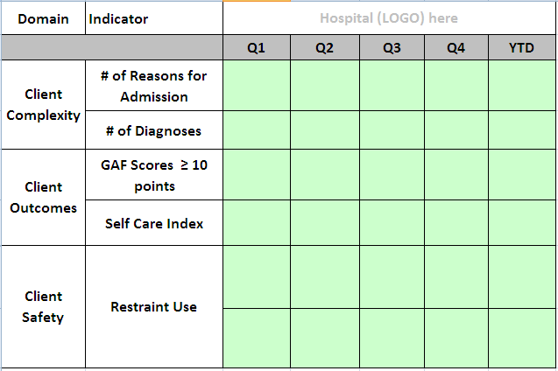
Public Reporting of RAI-MH: MHAQI Initiative

Slide 41
Public Reporting of RAI-MH: Health Quality Ontario
HQO considering including RAI-MH indicators in their June 2013 Quality Monitor Report
Currently looking at:
Restraint Use
Capacity to Manage Medications/Finances
Adherence to Medication
Readmission to ED within 30d of mental health discharge

Slide 42
Circling Back…
System
Comparing Results
Accountability
Facility
Resource allocation
Individual
Clinical decision-making
Evaluating care
Research
Common language
Program Evaluation

Slide 43
What Can We Do For You?
We want to hear about how YOU are using RAI-MH reports? What are your key questions?
What do you need more of? Less of?
Feedback, requests for change always welcome

Slide 44
Contact information
Nawaf Madi
Manager, Rehabilitation and Mental Health
(613) 694-6314
nmadi@cihi.ca
Connie Paris
Program Lead, Mental Health & Addictions
(613) 694-6312
cparis@cihi.ca
OMHRS team
omhrs@cihi.ca

