Slide 1

Schizophrenia Care in the Community for Adults
Quality Standard
Guiding evidence-based
care for people living with schizophrenia in Ontario

Slide 2
Objectives
Overview of Quality Standards
Inside the schizophrenia care in the community quality standard
Implementation of Quality Standard: The EQIP Example
Q&A

Slide 3

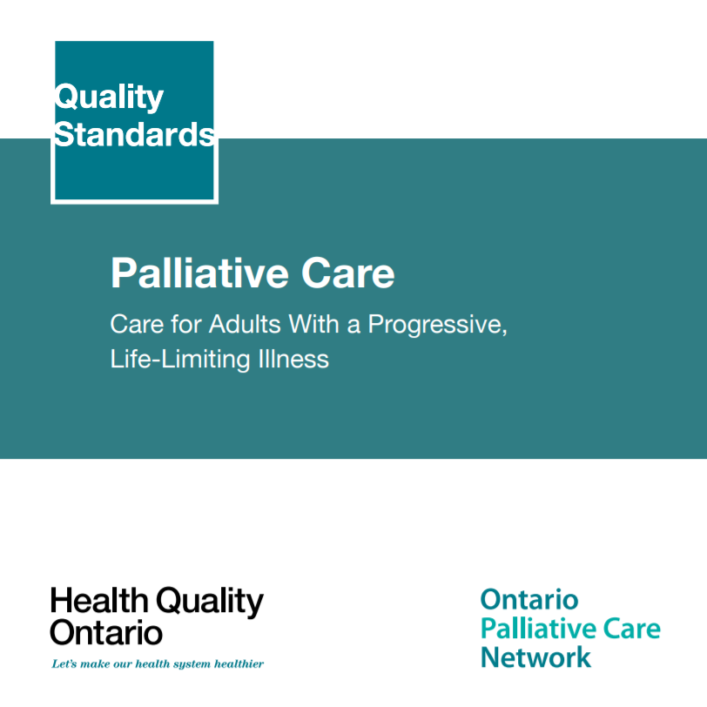

Quality Standards
Inform clinicians and patients what quality care
looks like
Focus on conditions where there are large variations
in how care is delivered, or where there are gaps between the care provided in Ontario and the care patients should receive
Are grounded in the best available evidence
Notes:
Quality standards are a smaller set of high impact statements that describe optimal care where identified quality gaps exist in Ontario.​
Voluntary and aspirational in nature​
Designed to “raise the ceiling” with the goal of having the best possible care available to all Ontarians, regardless of where they live in the province
There are many guidelines, professional standards, and other recommendations that contribute to the evidence ecosystem. Quality standards complement these resources.
Quality standards outline the what of care that should be delivered but is agnostic on who should be delivering it (unlike other CPGs, BPGs).
Quality standards are:
Concise: 5 to 15 strong, evidence-based statements focused on high priority areas for improvement
Accessible: help clinicians and provider organizations offer the highest quality care; and patients to know what to discuss with their care providers (compared to CPGs that are quite dense, these are very accessible, also written in plain language)
Measurable: each statement is accompanied by one or more quality indicators (structure, process or outcome), with a set of outcome measures for the overall standard
Implementable: quality improvement tools and resources support each standard, to fuel adoption

Slide 4
Quality Standards
Help health care professionals know what care to offer, based on evidence and expert consensus
Help health care organizations measure, assess, and improve the quality of care they provide
Help ensure consistent, high quality care across the province
Help patients, residents, families, and caregivers know what to ask for in their care
Notes:
Patients, caregivers and the public can use quality standards to understand what excellent care looks like, what they should expect from their health care providers, and how to discuss the quality of their care.
LHINs and disease agencies can use quality standards to measure health outcomes, hold health service providers accountable for delivering high-quality care, and inform regional improvement strategies.
Provider organizations can use quality standards to measure and audit their quality of care, identify gaps, guide organizational improvement strategies, and inform clinical program investments.
Health care professionals can use quality standards to evaluate their practice and identify areas for personal and organizational quality improvement, and can incorporate the evidence-based statements into professional education
Government can use quality standards to identify provincial priority areas, inform new data collection and reporting initiatives, and design performance indicators and funding incentives.

Slide 5
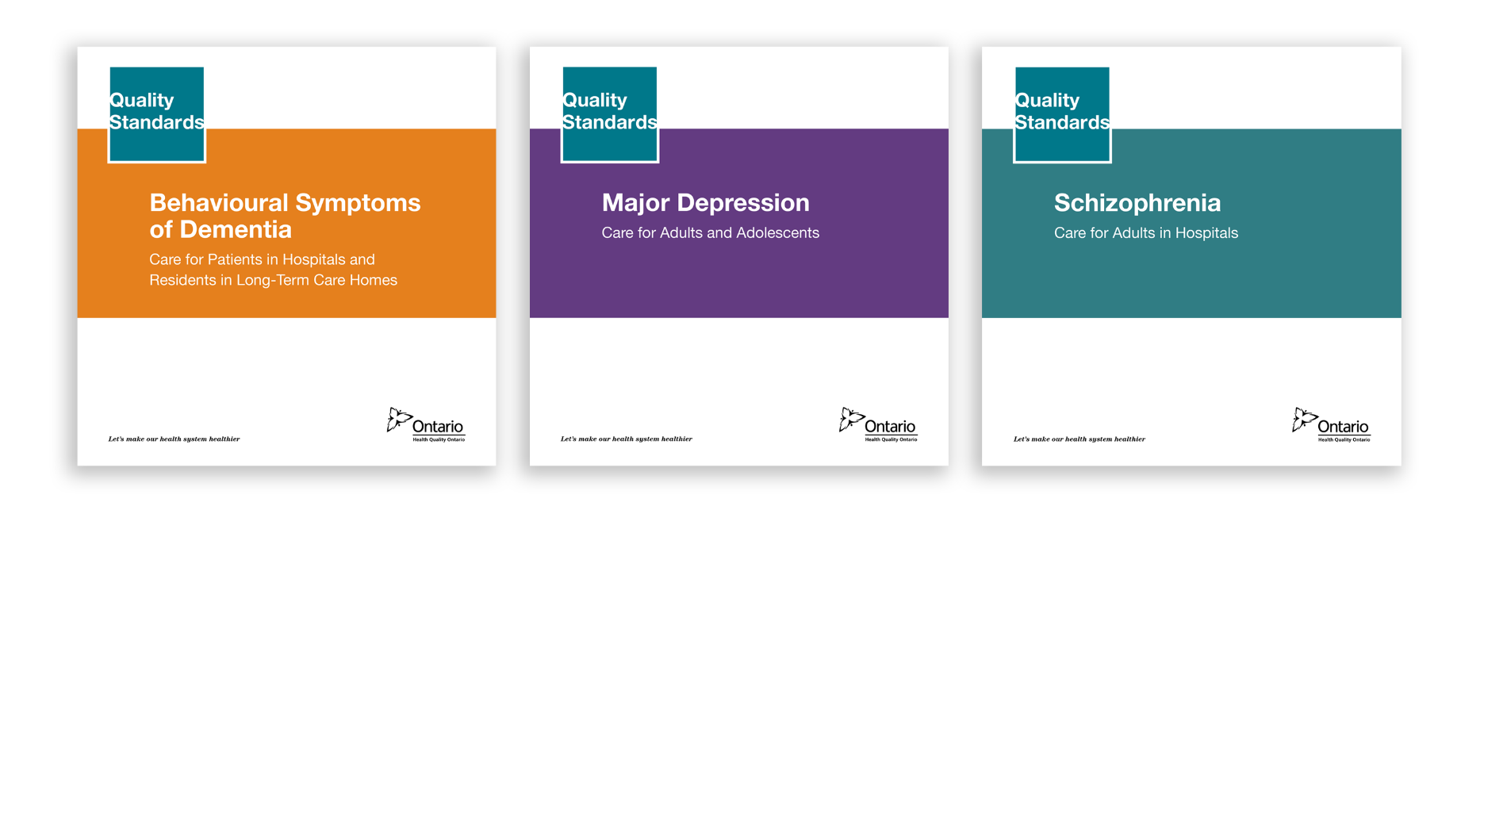


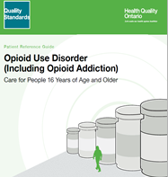
Quality Standards in Mental Health and Addictions
Behavioural Symptoms of Dementia
Dementia Care in the Community
Schizophrenia Care in the Hospital
Schizophrenia Care in the Community
Major Depression
Opioid Use Disorder
Anxiety Disorders (in development)
Obsessive Compulsive Disorders (in development)
Alcohol Use Disorder (in development)

Slide 6

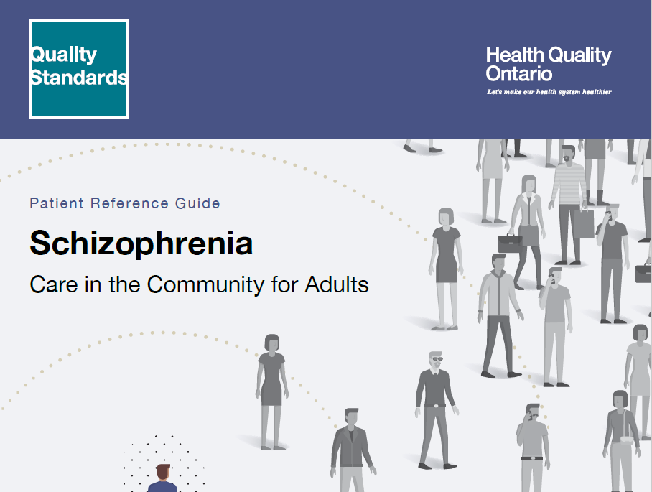



The Schizophrenia Care in the Community for Adults Quality Standard
Quality Standard
Patient Reference Guide
Data and Measurement Slides
Recommendations for Adoption
Measurement Guide
Find these resources here:
https://hqontario.ca/Evidence-to-Improve-Care/Quality-Standards/View-all-Quality-Standards/Schizophrenia-Care-in-the-Community
Notes:
Each quality standard focuses on a specific health care issue. The development of each quality standard is accompanied by an assortment of resources.
Through concise, easy-to-understand statements, quality standards outline what quality care looks like for a condition or topic based on the evidence.
Each quality standard is accompanied by:
A patient reference guide
Recommendations for adoption
A getting started guide
An infographic
A measurement guide
Quality standards provide the blueprint to enable the health care system in Ontario to work better, facilitate smooth transitions, and ensure patients receive the same high-quality care, regardless of where they reside.

Slide 7

Quality Standards:
Implementation Tools
The Getting Started Guide:
Outlines the process for using the quality standard as a resource to deliver high-quality care
Contains evidence-based approaches, as well as useful tools and templates for implementing changes ideas at the practice level
Notes:
The getting started guide is a document that outlines a process for using the quality standards as a resource to deliver high-quality care. It compiles a number of resources to support adoption such as links to implementation and quality improvement resources, examples and activities for reflection as well as templates and documents to support the implementation planning activities. The getting started guide also includes an Action Plan Template and examples on how Quality Improvement Plans can help to advance quality standards.

Slide 8
Inside the Schizophrenia Care in the Community for Adults Quality Standard

Slide 9
Scope
Addresses care for adults aged 18 years and older with a diagnosis of schizophrenia, including related disorders such as schizoaffective disorder
Focuses on care provided in the community, including primary care, hospital outpatient care, rehabilitation, care in correctional facilities, and community supports and services
Provides guidance on early psychosis intervention for people experiencing a first episode of schizophrenia.
Notes:
Terminology used within the standard:
In this quality standard, the term “health care professional” is used to acknowledge the wide variety of providers who may be involved in the care of people with chronic pain. The term refers to physicians, nurse practitioners, nurses, dentists, pharmacists, and other allied health professionals involved in the assessment, monitoring, and treatment of chronic pain. The term “prescriber” refers to physicians, nurse practitioners, and dentists who are authorized to prescribe opioids.

Slide 10
Quality Statement Topic Areas
Care Plan and Comprehensive Assessment
Physical Health Assessment
Self-Management
Family Education, Support and Intervention
Access to Community-Based Intensive Treatment Services
Housing
Antipsychotic Monotherapy
Treatment with Long-Acting Injectable Antipsychotic Medication
Treatment with Clozapine
Continuation of Antipsychotic Medication
Cognitive Behavioural Therapy for Psychosis and Other Psychosocial Interventions
Promoting Physical Activity and Healthy Eating
Promoting Smoking Cessation
Assessing and Treating Substance Use Disorder
Employment and Occupational Support
Notes:
Each topic area was turned into a quality statement. The remaining slides will go over each of these 10 quality statements.

Slide 11
Michael Dunn
Director, Quality Improvement, CMHA ON

Slide 12
Appendix A: Why Do We Need A Quality Standard for Schizophrenia Care in the Community for Adults in Ontario?

Slide 13
Why a community schizophrenia quality standard is needed in Ontario
Schizophrenia is a severe, chronic mental health condition that usually begins in late adolescence or early adulthood.
In Canada, about 1 in 100 people have schizophrenia
A 2012 report identified schizophrenia as one of the five mental health and addictions–related conditions with the greatest impact on the life and health of people in Ontario
People with schizophrenia face a number of physical health risks related to their condition and die about 15 to 20 years earlier than the general population, often from chronic respiratory or cardiovascular disease
Sources: American Psychiatric Association. Diagnostic and statistical manual of mental disorders. 5th ed. Arlington (VA): The Association; 2013. Health Canada. A report on mental illnesses in Canada: chapter 3, schizophrenia [Internet]. Ottawa (ON): Health Canada; 2002 [modified 2012 Mar 26; cited 2017 Dec]. Ratnasingham S, Cairney J, Rehm J, Manson H, Kurdyak PA. Opening eyes, opening minds: the Ontario burden of mental illness and addictions report. An ICES/PHO report. Toronto (ON): Institute for Clinical Evaluative Sciences and Public Health Ontario; 2012. Wahlbeck K, Westman J, Nordentoft M, Gissler M, Laursen TM. Outcomes of Nordic mental health systems: life expectancy of patients with mental disorders. Br J Psychiatry. 2011;199(6):453-8.

Slide 14
Fewer than 3 out of 10 people hospitalised for schizophrenia in Ontario have a follow-up with a family doctor or psychiatrist within 7 days of discharge

Slide 15
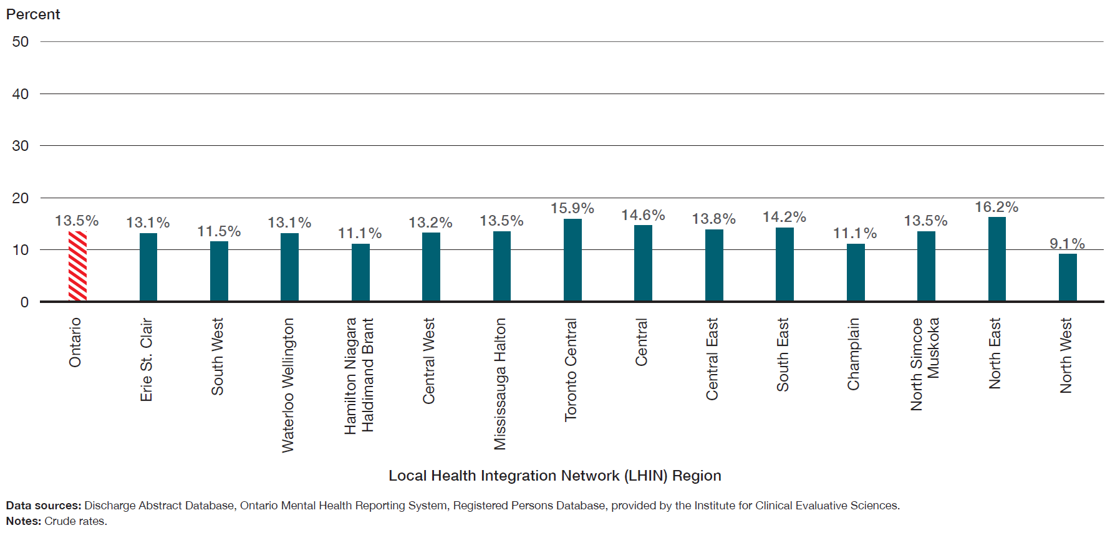
The percentage of patients who were readmitted to hospital for a mental health or addictions condition within 30 days of a previous hospital discharge for schizophrenia ranged from 9.1% to 16.2% across LHIN regions.
Percentage of patients who were readmitted to hospital for a mental health or addictions condition within 30 days of a previous hospital discharge for schizophrenia, in Ontario, by LHIN region, three-year average for 2012 to 2014

Slide 16
Appendix B: Quality Statements and Outcome Measures

Slide 17
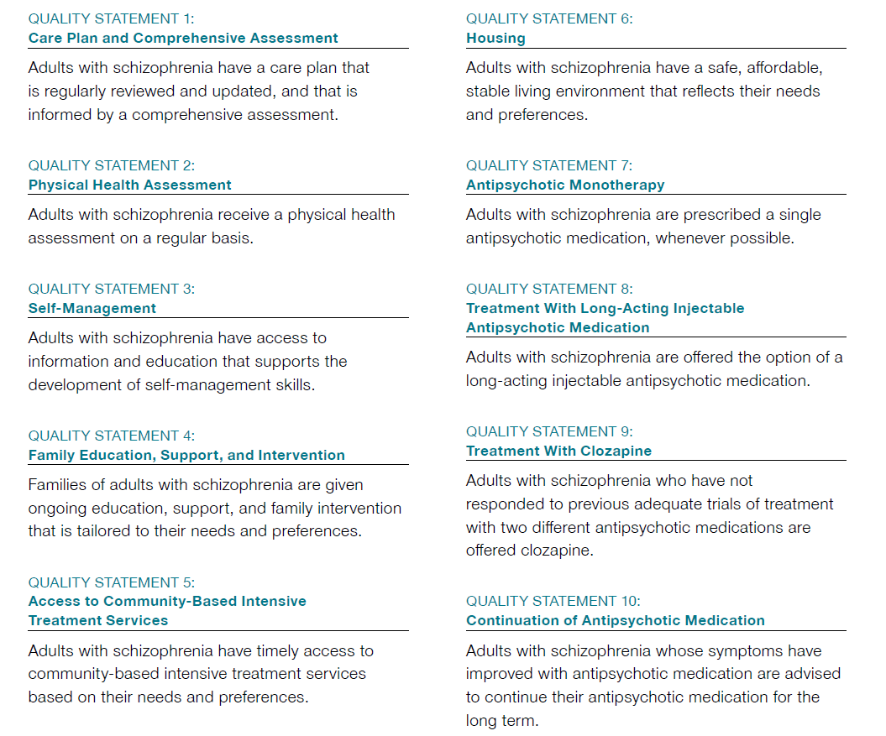
Quality Statements in brief

Slide 18
Quality Statements in brief

Slide 19
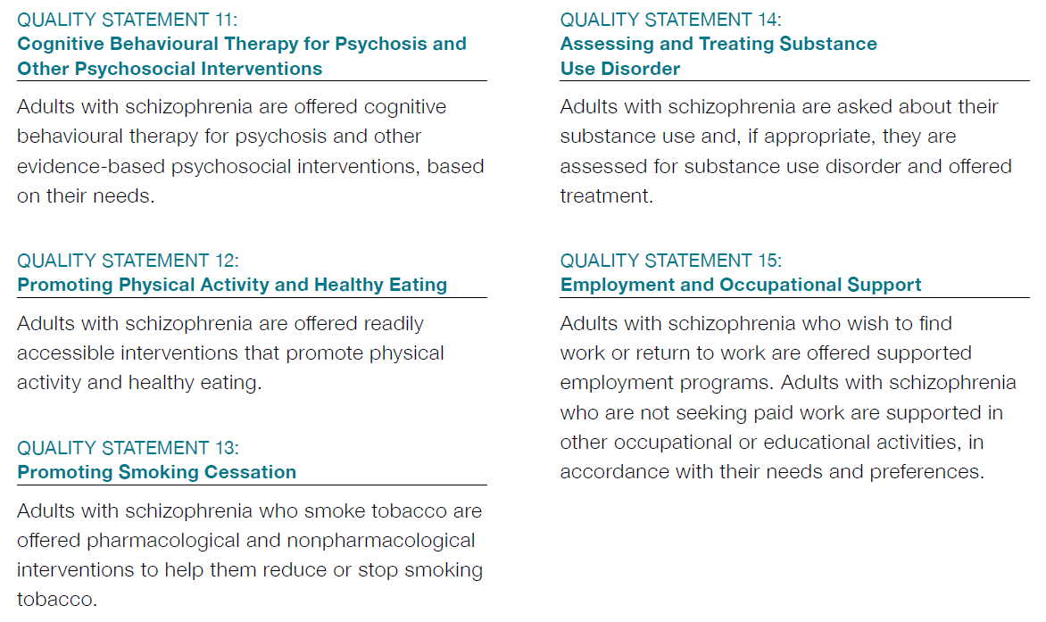
Quality Statements in brief

Slide 20
How can the success of this standard be measured?
How can success be measured provincially
Percentage of adults hospitalized for schizophrenia who have had an unplanned hospital readmission for a mental health or addictions condition within 30 days of discharge
Percentage of adults hospitalized for schizophrenia who had contact with a trained mental health physician:
  Within 7 days of hospital discharge
  Within 28 days of hospital discharge
How can success be measured locally
Percentage of adults with schizophrenia who report unmet care needs (suggested stratification: type of need)
Percentage of adults with schizophrenia who report living in stable housing for the past year
Percentage of adults hospitalized for schizophrenia who had contact with a trained mental health professional:
  Within 7 days of hospital discharge
  Within 28 days of hospital discharge
See the Schizophrenia: Care in the Community for Adults Measurement Guide for more information on how to calculate these indicators
Notes:
Locally:
In addition, each quality statement within this quality standard is accompanied by one or more indicators.
These indicators are intended to guide measurement of quality improvement efforts related to implementation of the statement.

Slide 21
Connect with us:
https://quorum.hqontario.ca/

Slide 22
The Excellence through Quality Improvement Project (E-QIP):
Supporting the Adoption of Quality Standards in the Community
Michael Dunn
Director, Quality Improvement
Canadian Mental Health Association, Ontario Division

Slide 23
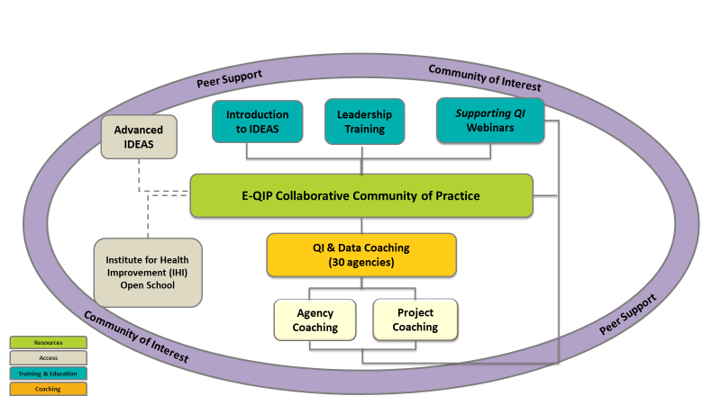
Excellence through Quality Improvement Project
E-QIP is a partnership project between Addictions & Mental Health Ontario, Canadian Mental Health Association, Ontario & Health Quality Ontario to promote and support quality improvement (QI) in the community mental health and addictions sector.
E-QIP is based on the sectors existing commitment to providing high quality, person-centered care to individuals and families.
Notes:
In response to the sector’s needs, E-QIP was launched in March 2016 for an 18-month pilot aimed at building capacity and capability to use data effectively fo rthe purposes of QI
A number of offerings were provided o the sector. All centered around creating a collaborative community of QI and data practice, supported by coaching, capacity building and access to information and resources
E-QIP is a collaboration between CMHA Ontario, Addictions and Mental Health Ontario and HQO. We are able to leverage the resources of each partner to offer a comprehensive menu of offerings to the sector .

Slide 24
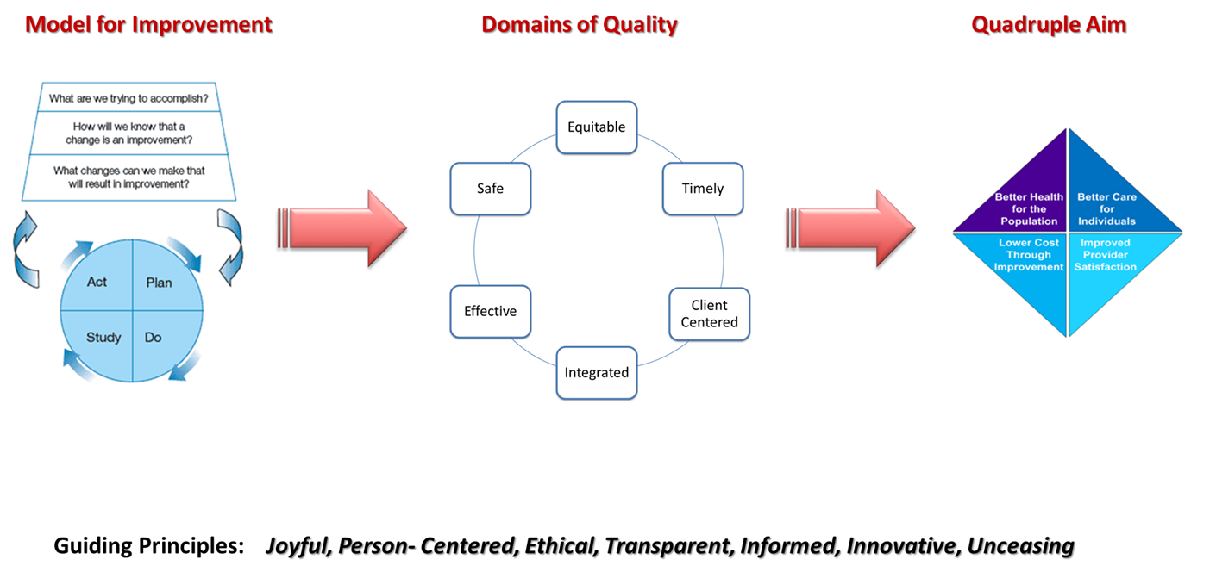
Working together to achieve a quality culture

Slide 25
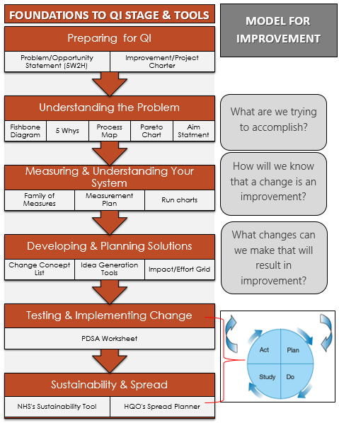
The Model for Improvement
Notes:
So here we are with the whole picture but remember these arrows and lines would go every which way as you work through a project. QI is a journey and it takes the scenic route

Slide 26
CMHA Toronto
Problem Statement #1:
Since 2015 CMHA Toronto clients with a diagnosis of a psychotic disorder receiving ICM services have not experienced a significant reduction in unmet needs related to physical health (range: -5% reduction to 4% increase in unmet need).
This impacts current clients as clients with unmet physical health needs are more likely to have chronic medical conditions which impact their quality of life and increases risk of death and/or physical disability. They are also more likely to remain in service for longer thereby increasing wait time for service for ICM services. This also impacts staff who may feel ineffective in addressing the needs of clients. This also increases the amount of time staff spend with clients with unmet physical health needs which decreases their availability for other clients.
Problem Statement #2
Since 2015 CMHA clients with a diagnosis of a psychotic disorder receiving ICM services have not experienced a significant reduction in unmet needs related to alcohol use (range: -13% reduction to 5% increase in unmet needs).
This impacts current clients because problematic alcohol use is associated with repeat ED visits, criminal justice involvement, homeliness, risk of eviction, violence, and loss of family support. This also impacts staff who may feel ineffective in addressing the needs of clients.

Slide 27
The Model for Improvement
Notes:
So here we are with the whole picture but remember these arrows and lines would go every which way as you work through a project. QI is a journey and it takes the scenic route

Slide 28
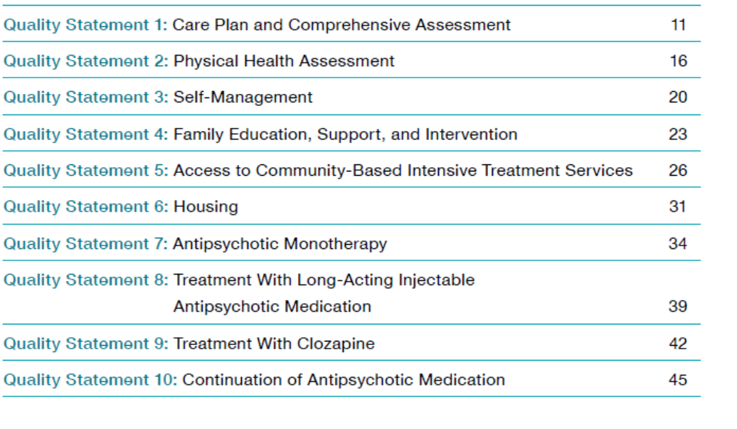
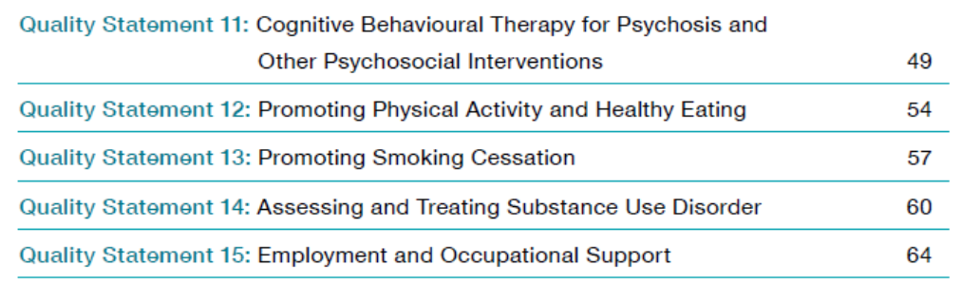

Slide 29
The Model for Improvement
Notes:
So here we are with the whole picture but remember these arrows and lines would go every which way as you work through a project. QI is a journey and it takes the scenic route

Slide 30
Measures
Process Measures | Outcome Measures | Additional/ Balancing Measures
% of clients who have a comprehensive physical health assessment within 12 weeks % of clients who have had a comprehensive physical health assessment within last 12 months | Reduction in unmet needs for physical health (OCAN) | Service duration ?
% of clients who have been assessed for substance within last 12 months % of clients who receive treatment for substance use | Reduction in unmet needs for alcohol/ substance use (OCAN) | Criminal justice involvement? Homelessness?

Slide 31
The Model for Improvement
Notes:
So here we are with the whole picture but remember these arrows and lines would go every which way as you work through a project. QI is a journey and it takes the scenic route

Slide 32
Considerations
Determine what matters for YOUR clients and teams
Consider communication and buy-in
Thoughtfully determine measures (ie. Process AND outcome)
Identify where improvements may be possible
Use a structured QI method to improve
Think sustainability and spread

Slide 33
For more information about E-QIP
Michael Dunn
Director of Quality Improvement
CMHA Ontario
mdunn@ontario.cmha.ca
1.800.875.6213 (Toll-free in Ontario)
Debbie Bang
Director of Quality Improvement
Addictions and Mental Health Ontario
debbie.bang@addictionsandmentalhealthontario.ca
416.490.8900 ext. 236
Join our mailing list to stay informed of future webinars and training events:
http://eepurl.com/b1A5EX

